Slide 1
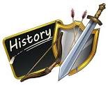
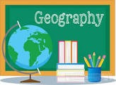
Senior Infants SESE remote learning
Assumption Junior School
June 1st – 12th

Slide 2
Our theme: Summer
Science: Week 1: Minibeasts and the bee
Week 2: Light and ice-cream
History: Week 1: Story “The Very Greedy Bee” by Steve Smallman
Week 2: Story “Gorilla loves vanilla” by Chae Strathie
Geography: Week 1: Helping at home
Week 2: The season of Summer and mapping a Summer garden

Slide 3
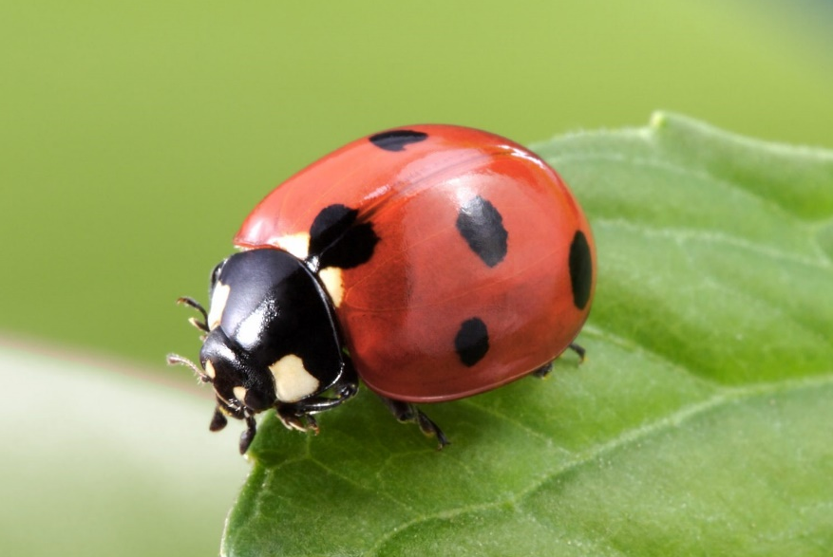
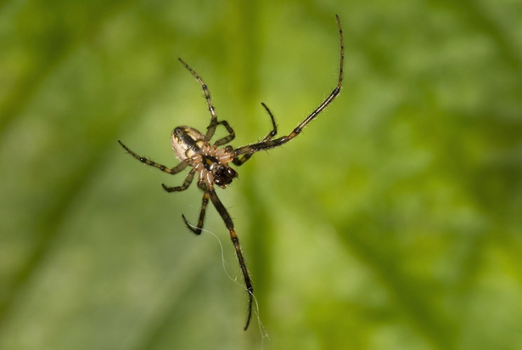
Week 1 Science
minibeasts and the bee
What minibeast am I?
I have 6 legs.
I can fly.
I have spots.
I spin webs.
I have 8 legs.
I eat other insects.
ladybird
spider

Slide 4
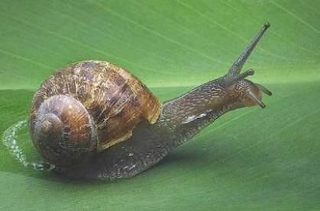
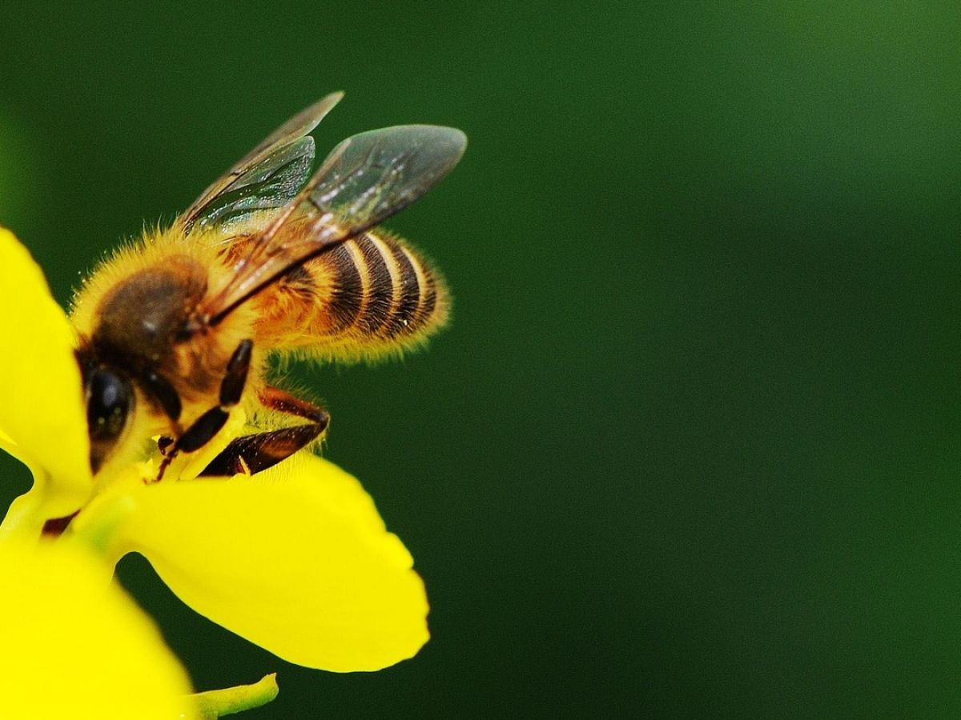
I carry my home with me.
I have no legs.
I leave a slimy trail.
I am very busy!
I am striped.
I make honey.
snail
bee

Slide 5
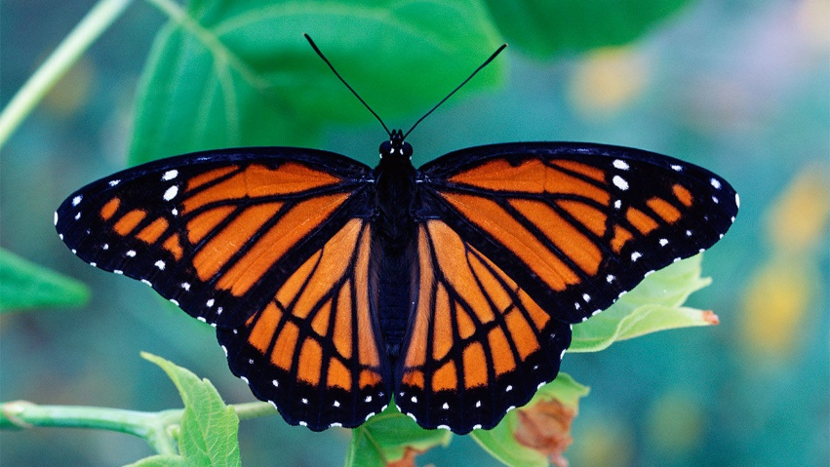
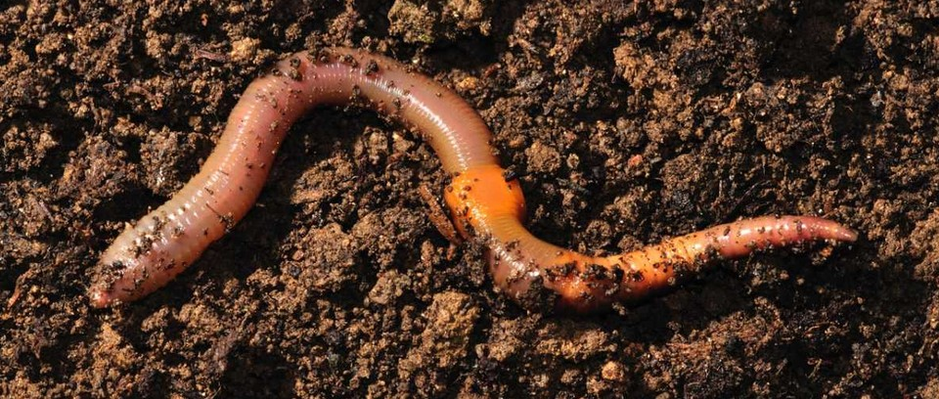
I have no legs.
I wriggle around.
I like to burrow.
I fly around.
I have 4 wings.
I was once a caterpillar.
worm
butterfly

Slide 6
`Minibeast Hunt
Look out for these
minibeasts in the garden
or when you are out
for a walk.

Slide 7
Come Outside Video - snails
https://www.youtube.com/watch?v=ki97nLa2rjk

Slide 8
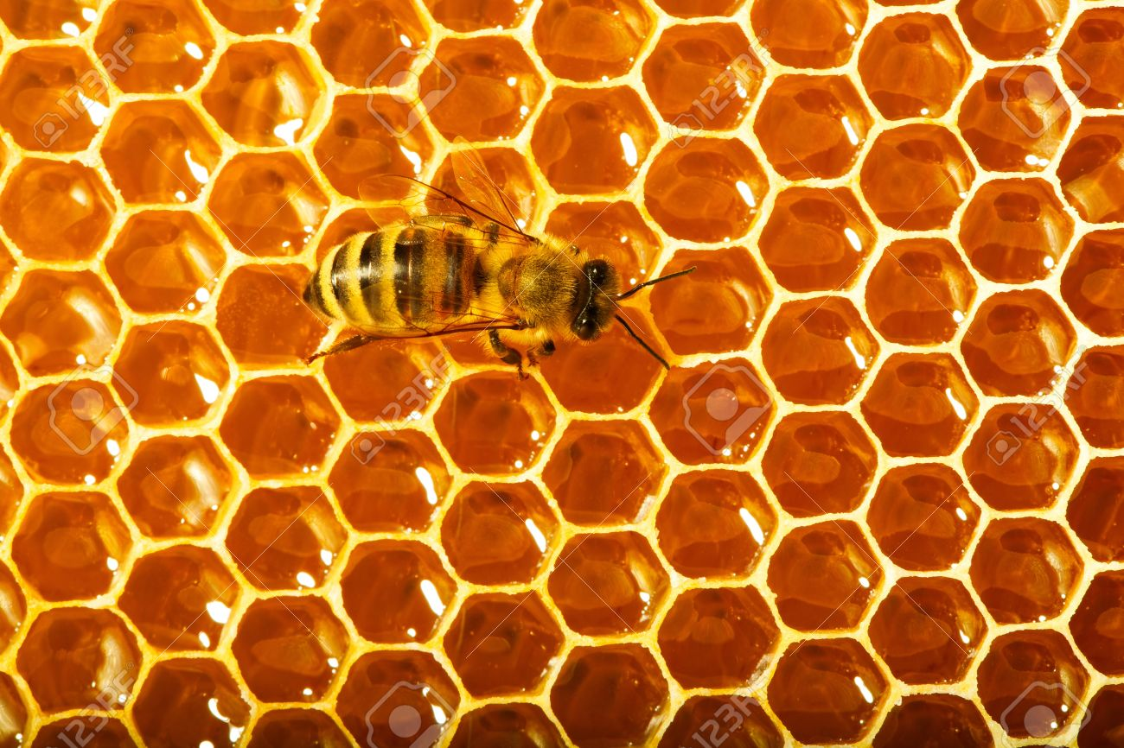
Bees
Bees are very important minibeasts.
Bees love flowers.
We see lots of bees flying around looking for flowers in Summer.
Bees collect nectar from the flowers and
make it into honey in the hive.
Bees store the honey in a honey comb.
Bees help pollinate flowers and vegetables
- they help flowers and vegetables grow.
honeycomb

Slide 9
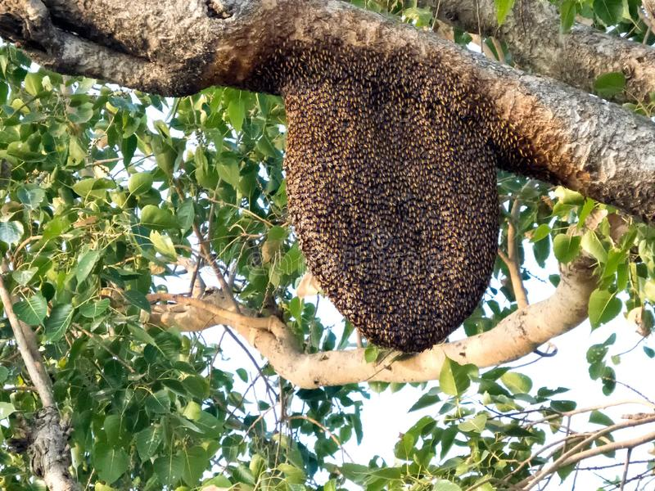
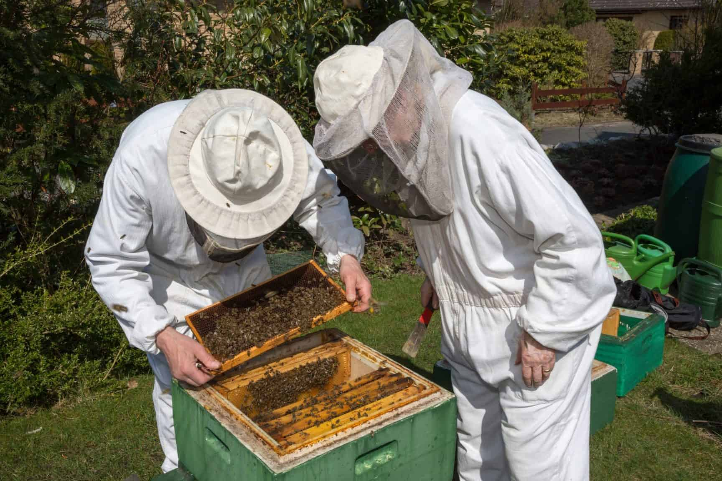
A bee hive in a tree.
Beekeepers collect honey from the hive.

Slide 10
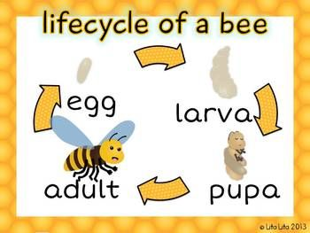

Slide 11
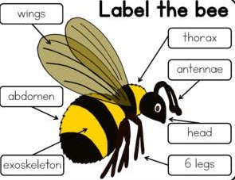

Slide 13
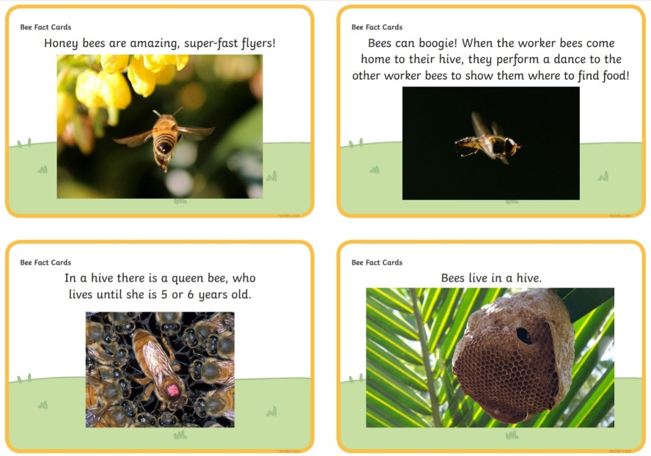

Slide 15
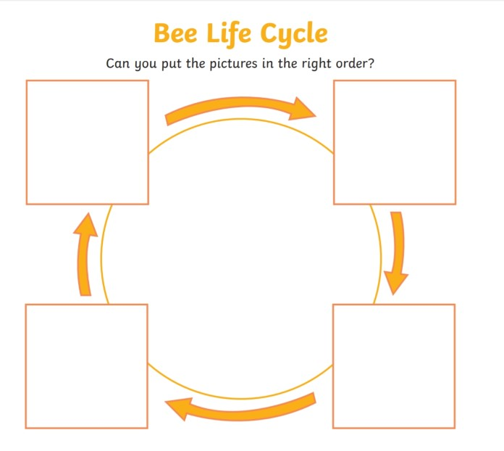

Slide 16
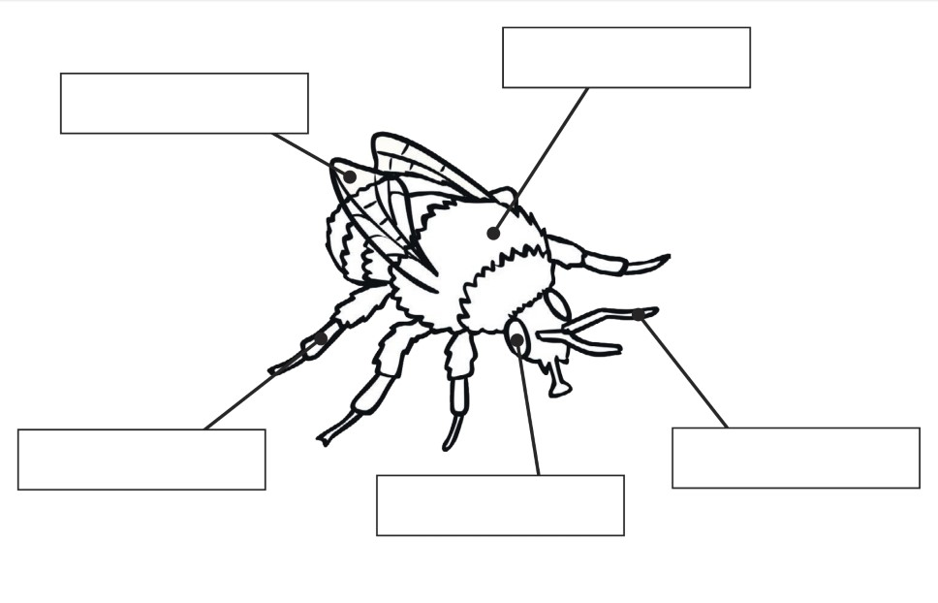
Can you label the bee’s body parts?
thorax
wings
antenna
legs
eyes

Slide 17
Can you make your own bee factfile?
bee drawing | interesting facts
lifecycle of a bee

Slide 18
How to draw a bee
https://www.dailymotion.com/video/x3obrsr
Bee song
https://www.youtube.com/watch?v=V5Bs9xydba0

Slide 19
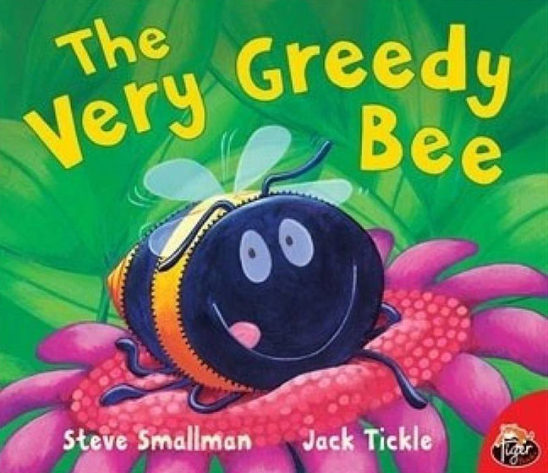
Week 1 History
“The Very Greedy Bee.” by Steve Smallman
History at this level concentrates on stories and story sequencing.
We want to you to follow the link below to read the given story. It
is important that your child can re-tell the story, and be able to sequence the events accurately. They could also draw pictures that reflect their understanding of the sequence of the story.
Other ideas: design the front cover, come up with a new name/different ending, ask the author a question, make a new character.
https://www.youtube.com/watch?v=q2N6wmqafu8

Slide 20
Sequence the story “The Very Greedy Bee”.
First
Next
Then
Last

Slide 21
Week 1 Geography
Helping at home
You are all very helpful children in school.
At home what can you do to help?
Talk about what is happening in these pictures.

Slide 24
Draw a picture and write about how you help at home.
I can help at home.

Slide 25
Can you help to write the shopping list?

Slide 27
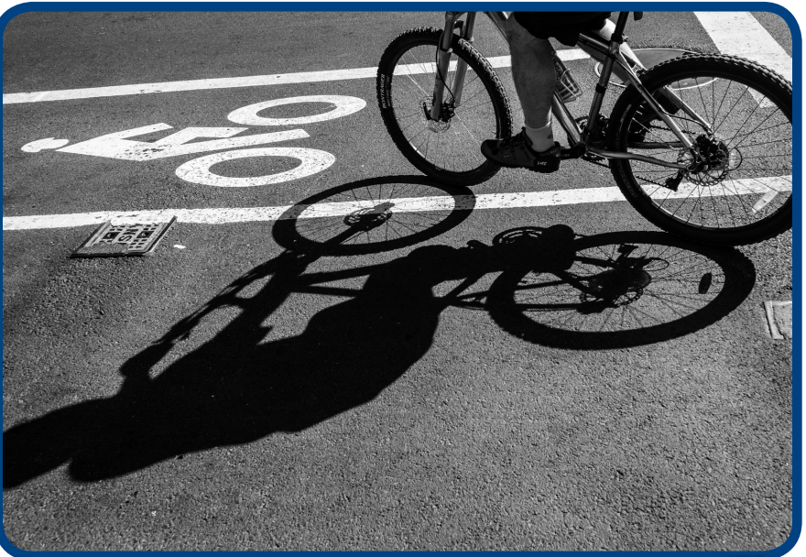
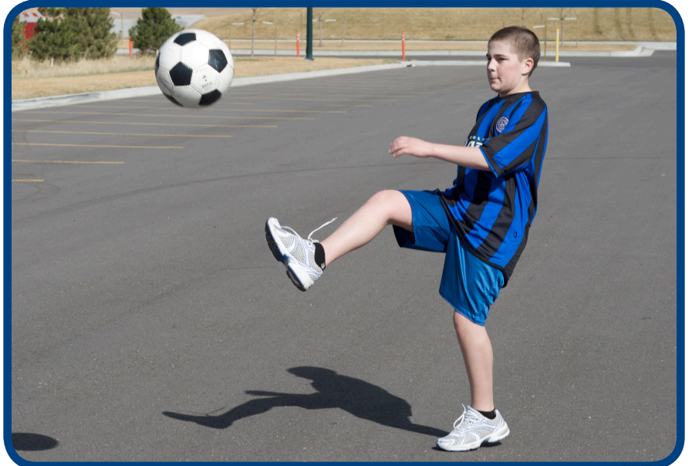
Week 2 Science
We are having lots of sunny days. It is nice to get outside!
What is a shadow?
A shadow is made when
an object blocks the light.
https://www.oxfordowl.co.uk/api/interactives/29309.html
Light and shadow video
https://www.youtube.com/watch?v=YuUJCNzfoBw

Slide 28
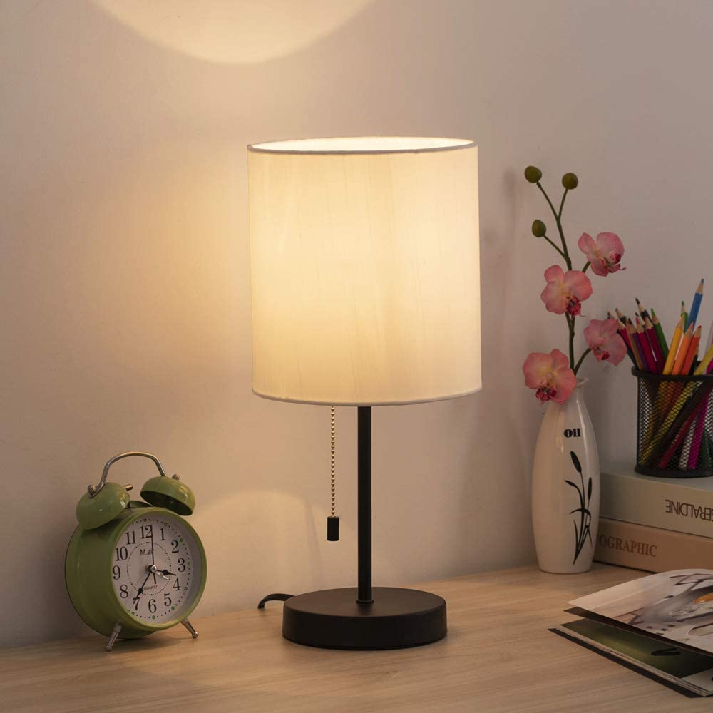
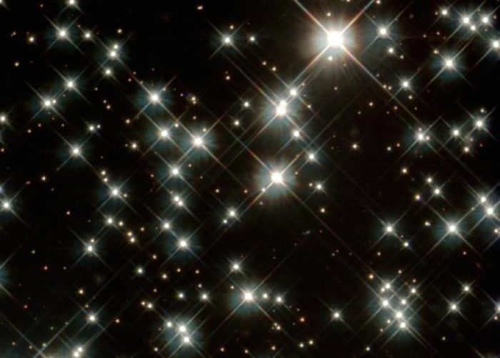
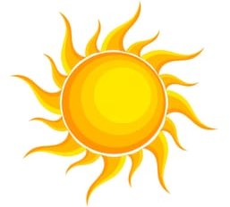
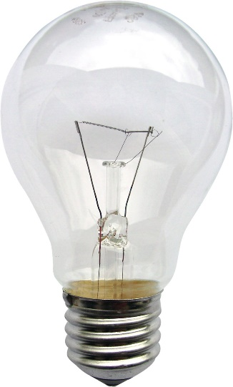
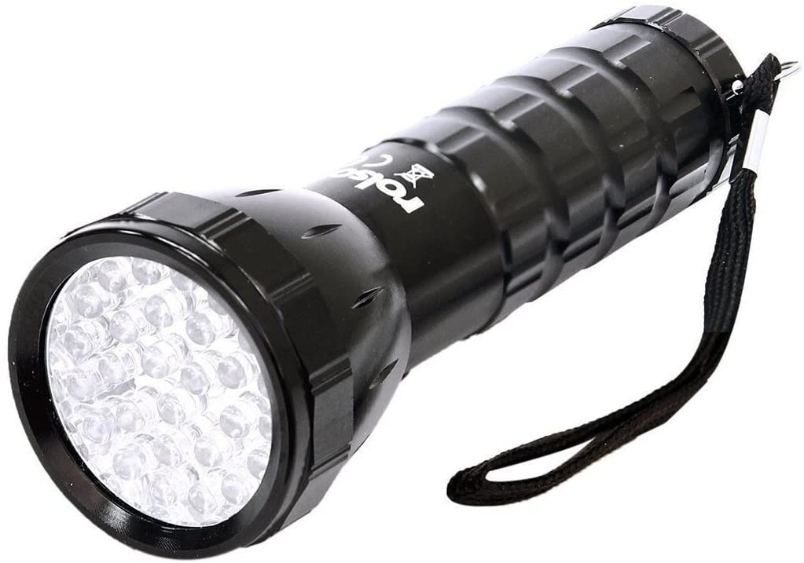
The sun is a source of light.
Can you name some other sources of light?
bulb
torch
candle
fire
screen

Slide 29
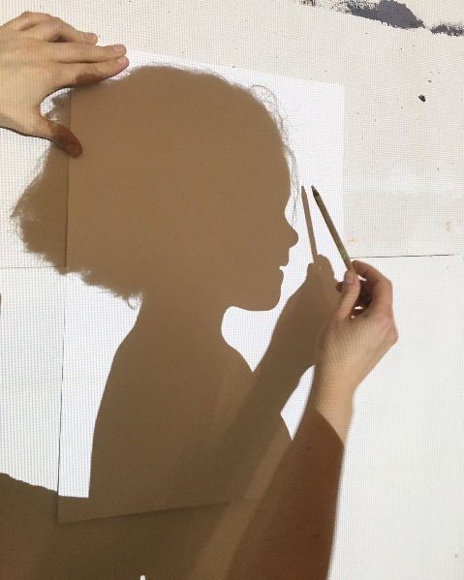
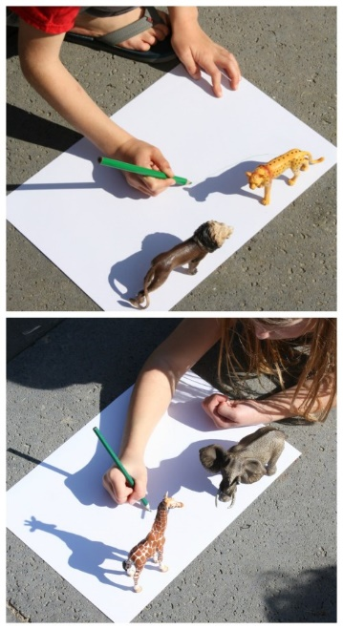
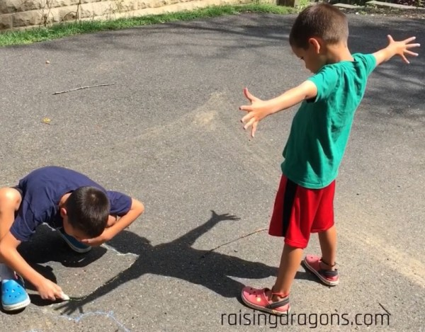
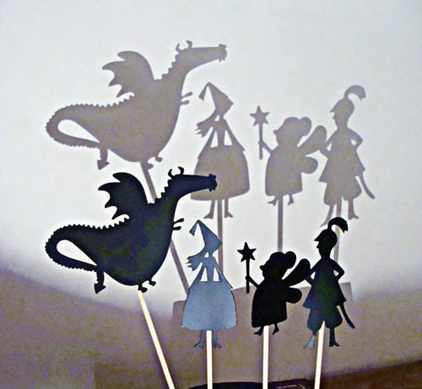
Here are some fun shadow activities for you to try.
shadow drawing
shadow portrait
shadow puppet
shadow hand puppet

Slide 30
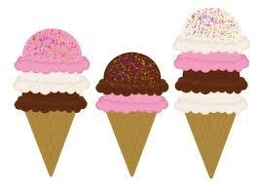
Ice-cream
In the lovely warm Summer weather,
it’s nice to cool down with ice-cream!
Ice-cream is made from milk.
What is your favourite ice-cream flavour?
On a hot day, what will happen to your ice-cream?

Slide 31
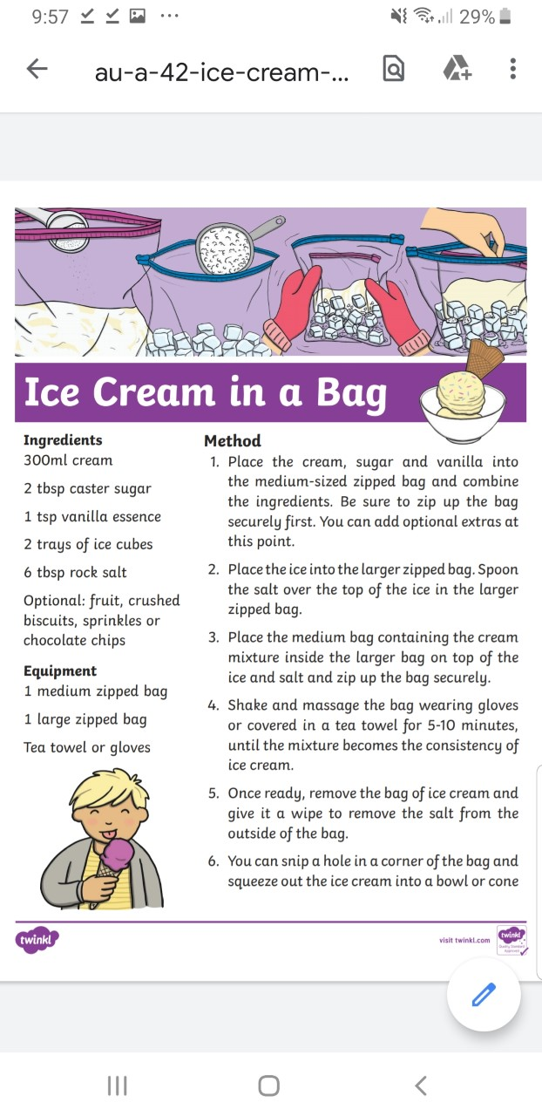
Can you make
your own
ice-cream?

Slide 32
Week 2 History
“Gorilla loves Vanilla”
By Chae Strathie
History at this level concentrates on stories and story sequencing.
We want to you to follow the link below to read the given story. It
is important that your child can re-tell the story, and be able to sequence the events accurately. They could also draw pictures that reflect their understanding of the sequence of the story.
Other ideas: design the front cover, come up with a new name/different ending, ask the author a question, make a new character.
https://www.youtube.com/watch?v=9pIGdkME89M

Slide 33
Sequence the story “Gorilla loves Vanilla”.
First
Next
Then
Last

Slide 34
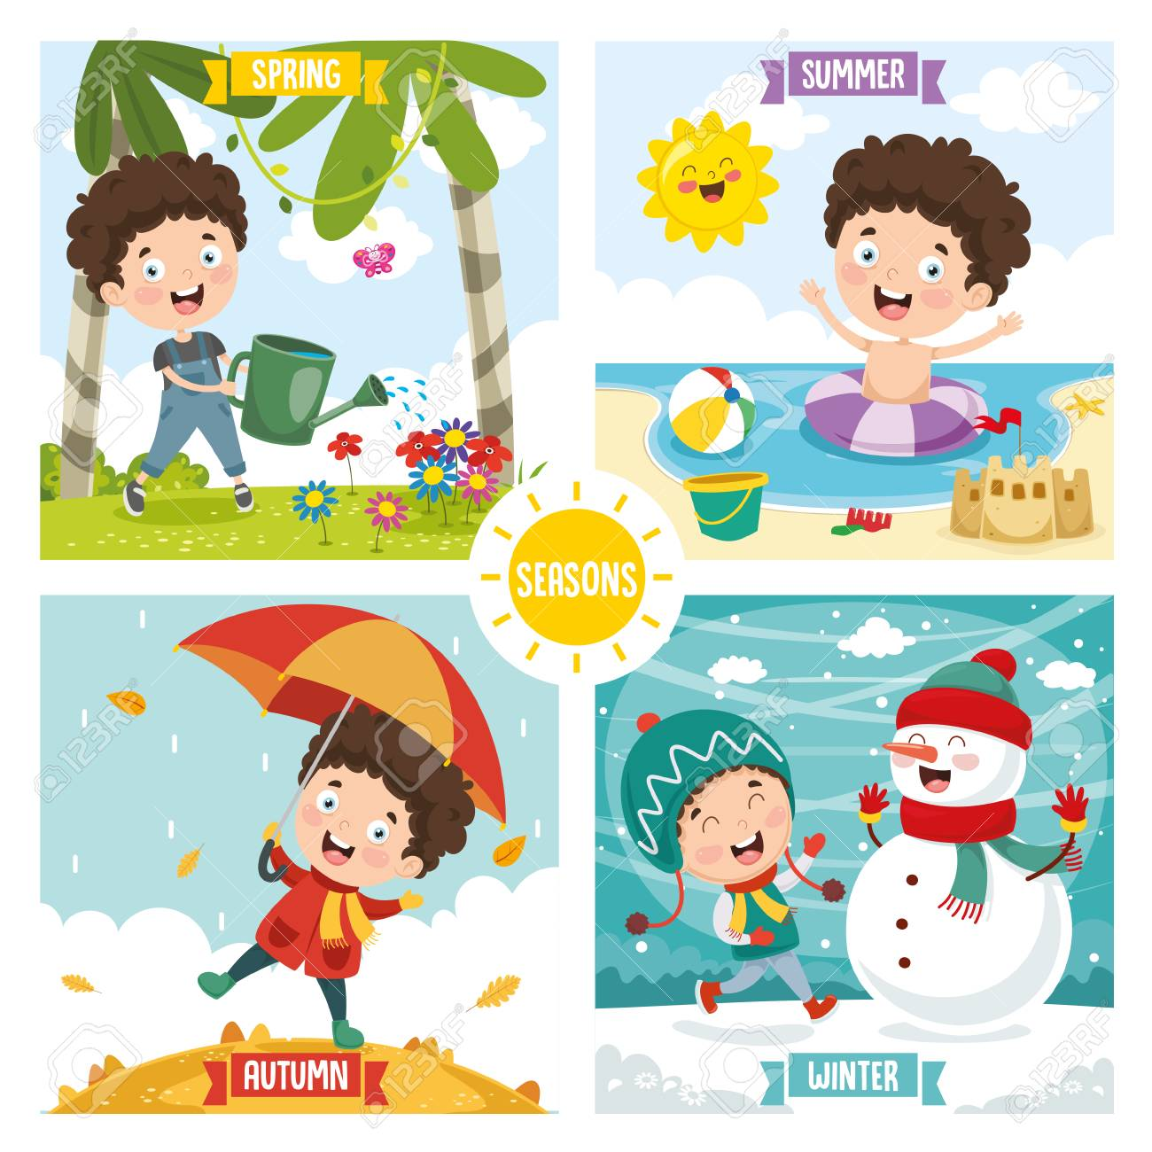
Week 2 Geography
The season of Summer.
Can you name the four seasons?

Slide 35
It is the season of Summer.

Slide 36
https://www.met.ie/cms/assets/uploads/2017/08/YP-Fun-Facts-Seasons.pdf
A tree in all 4 seasons
https://www.youtube.com/watch?v=ZdsJBAqHlzA

Slide 37
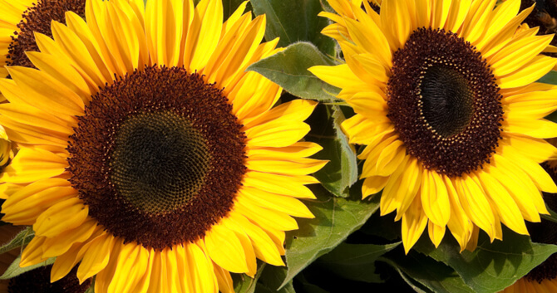
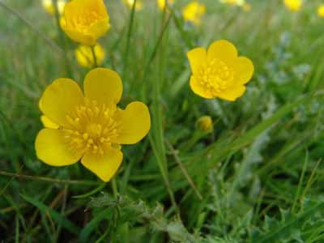
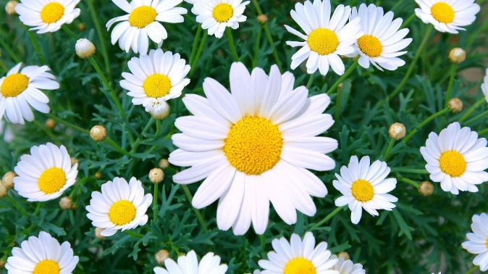
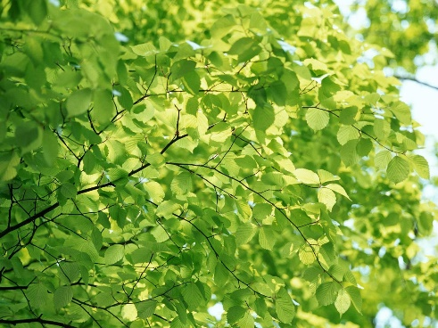
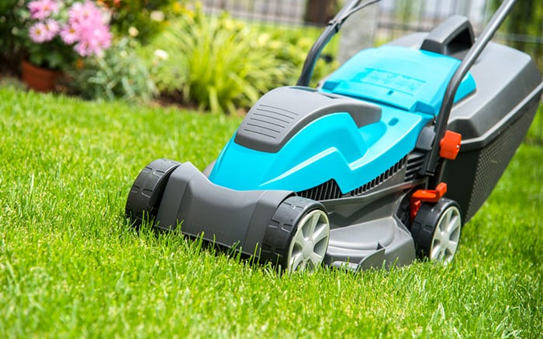
The months of Summer are May, June and July.
Have you seen any signs of Summer yet?
There are Summer flowers.
buttercups
sunflowers
daisies
The leaves on the
trees are green.
The grass is growing.

Slide 38
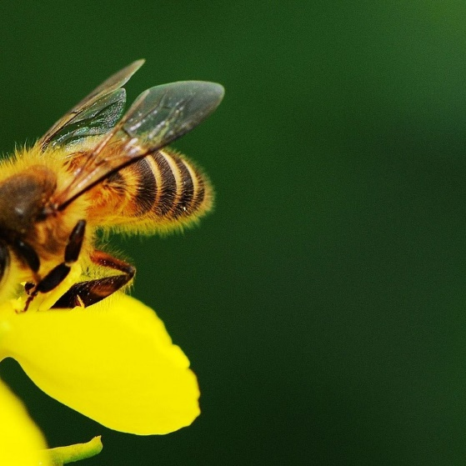
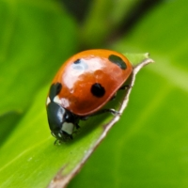
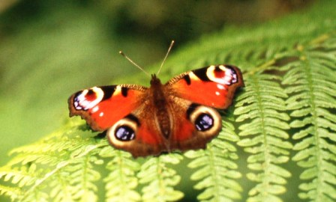
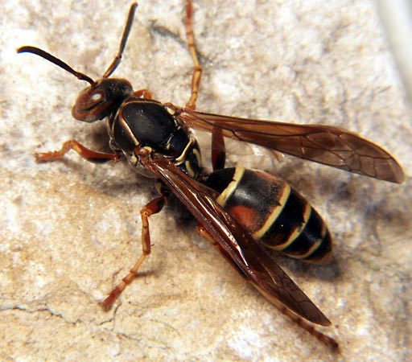
Minibeasts are busy in the garden!
butterfly
bee
ladybird
worm
wasp
ants

Slide 39
The weather is sunny and warm.
There can be rain showers.

Slide 41
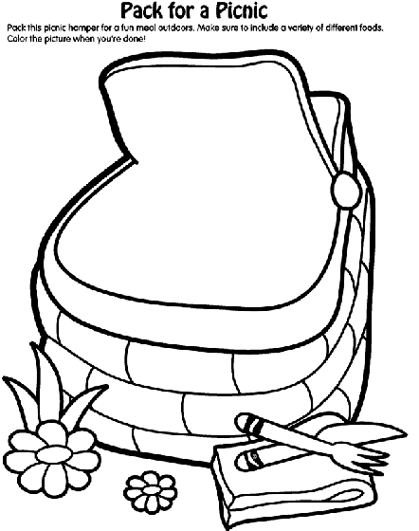
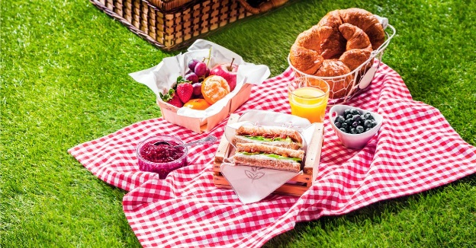
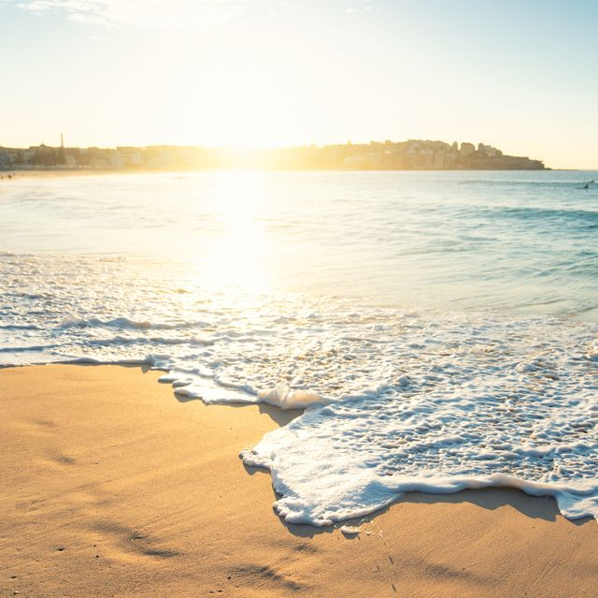
The days are brighter much later in the evening. It is nice to play outside!
We could have a picnic or go to the beach.
What food would you bring in your picnic basket?

Slide 42
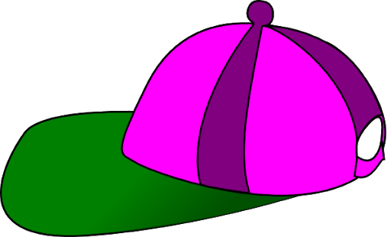
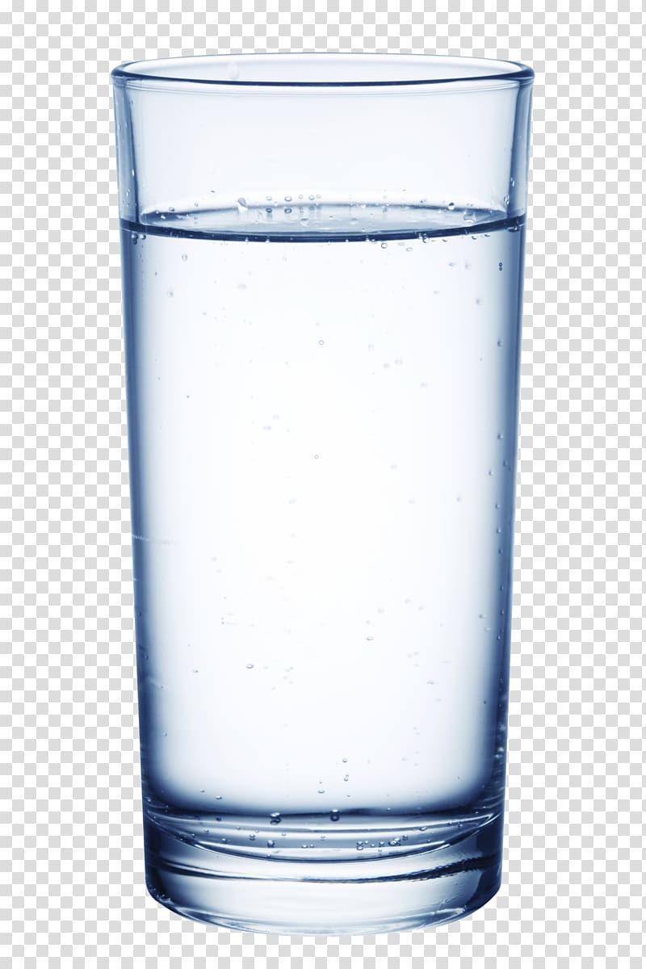
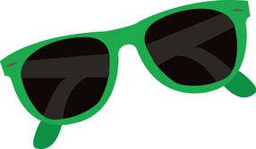
How can we stay safe in the sun?
Wear a sun hat, sun slasses and sun cream and drink water.

Slide 43
Pack for sun safety!
What will you pack for sun safety?
Draw a bag and some of these items in it.
Which items will you need?

Slide 45
In our last powerpoint, you learned about birds eye view of maps.
This week you can make your own map.
You have been learning about Summer.
You job is to make a map of a Summer garden.
It can be as creative as you like!
You can include Summer flowers and plants, outdoor toys,
characters and furniture.

Slide 46
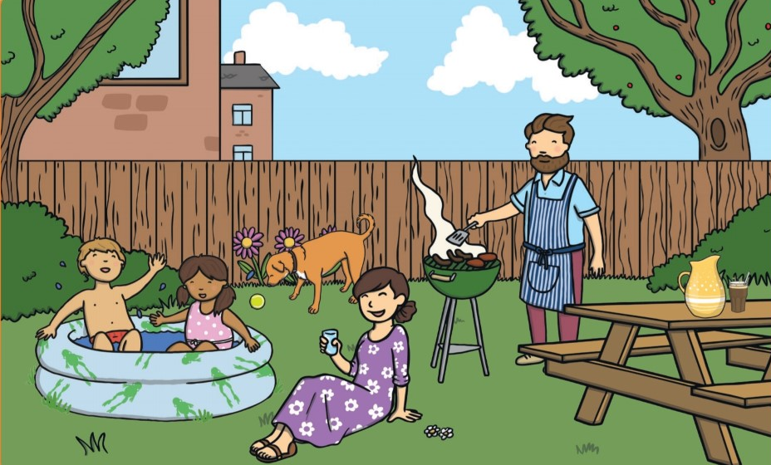

Slide 47
Aistear – Summer theme
Role play: set up a picnic or ice-cream parlour.
Playdough: make ice-pops and ice-creams Make Summer flowers and mini-beasts.
Small world: use your figures/lego characters/ dolls/ cut out characters. Scenes to play – the ice-cream parlour, a picnic, the beach
Construction: use you blocks/lego/cardboard boxes to build
a playground.
Junk art: use toilet rolls, egg cartons, bottle tops etc to make your own minibeast.
Drawing: draw a Summer picture.

Slide 48
Well done you have finished this fortnights task!

