Slide 1
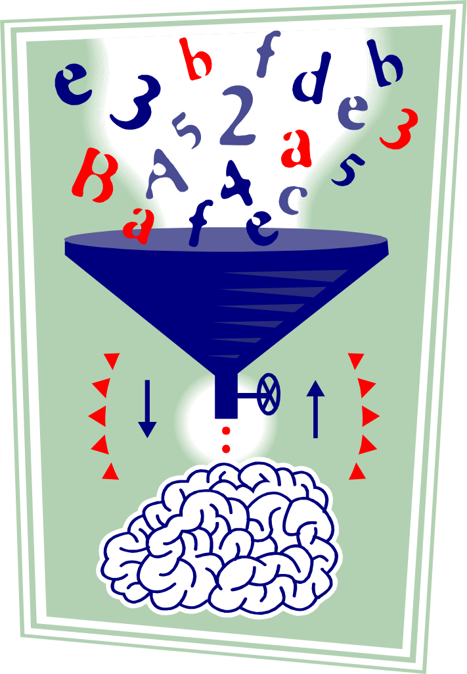
Senior Infants Mathematics Remote Learning
Assumption Junior School June 15th-30th

Slide 2
You will need:
A number line from 0-20
A copy book that you can keep all your answers, drawings and work that you do in.
Some coins (1c, 2c, 5c, 10c, 20c)
Colours, paper, any art supplies you have

Slide 3
Week 1

Slide 4
Week 1 Mental Maths

Slide 5
Which number comes between?
Can you fill in the
missing numbers?

Slide 6
Outdoor Counting

Slide 7
Ordinal Number
How many children are there in this queue?
Where do you think they are going?
Who is 1st in the queue?
Who is 3rd in the queue?

Slide 8
How many?
Write the answers into your copy
Now add on two more to each row. Write your new answers into your copy

Slide 9
Count and add. Write these sums in your copy.

Slide 10
Word Problems

Slide 11
There were 6 apples at home.
I brought 3 more apples home from the shop.
How many apples are there altogether now?
I ate 5 apples during the week.
How many apples were left?

Slide 12
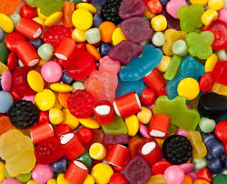
There are 4 sweets in a bag
How many sweets are there
in 2 bags?
3 sweets were eaten
How many are left?
Extra challenge!
Sam got 4 bags of sweets
How many sweets did he get?

Slide 13
Billy has 8 comics
Katie has 3 more comics than Billy
How many comics does Katie have?
How many comics do Billy and Katie have altogether?

Slide 15
5 + 2 = _
2 + 6 = _
6 + 3 = _
8 + 4 = _
7 + 0 = _
1 + 8 = _
4 + 6 = _
3 + _ = 8
1 + _ = 7
4 + _ = 9
10 + _ = 10
2 + _ = 9
3 + _ = 7
7 + _ = 8
3 + 3 + 0 = _
4 + 2 + 2 = _
1 + 4 + 2 = _
3 + 5 + 1 = _
0 + 7 + 2 = _
6 + 3 + 1 = _
3 + 1 + 3 = _

Slide 16
Week 1: Days of the Week Practice
Monday
Tuesday
Wednesday
Thursday
Friday
Saturday
Sunday

Slide 17
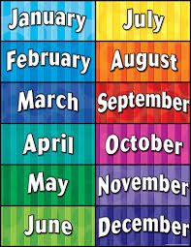
Months of the Year Practice
What month is it now?
What month comes next?
What month is your birthday in?
Christmas is in __________.
Which month comes next?
January, February, __________
June, July, _________
What month comes after October? __________

Slide 18
The Seasons
Can you name the 4 seasons?
Which picture do you think belongs to each season? Why?

Slide 19
Week 1: Weight

Slide 20
Which is heavier?

Slide 21
Which is heavier?

Slide 22
Which is lighter?

Slide 23
Which is lighter?

Slide 24
We put the two items we are measuring on the balance, one on each side.
The item that is heavier will be lower than the lighter one.
The item that is lighter will be higher than the heavier one.

Slide 25
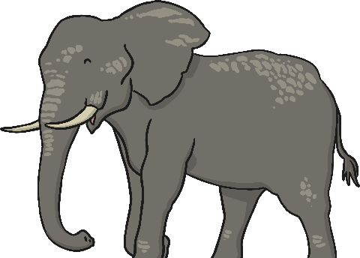
Look at this balance.
The elephant is heavier than the butterfly.
The butterfly is lighter than the elephant.

Slide 26
Which items are heavier?

Slide 27
Which items are lighter?

Slide 28
Look at this balance. It is balanced because the water and the cubes weigh the same.
The water is equal to the cubes.
The water weighs the same as 3 cubes.

Slide 29
Count the number of conkers on each balance. Write the answer

Slide 30
Count the number of cubes on each balance.
Then write which object is heavier and which object is lighter.

Slide 31
Look at these balances and finish the sentences with heavier, lighter or equal.

Slide 32
Look at these balances and finish the sentences with heavier, lighter or equal.

Slide 33
Make your own balance at home!
You will need:
A children’s clothes hanger with notches
Two paper cups
Some twine or string
A hole punch (or something sharp will be fine)-An adult must help you with this!
Scissors
1. Hang your clothes hanger somewhere where it can swing easily and it easy to reach.
2. Use the hole punch to create holes on either side of the paper cups. Cut two equal lengths of twine, and tie onto the paper cup to turn them into two buckets.
3. Find different things to fill each bucket.
4. Add your buckets to the hanger and see which one is heaviest (which one hangs the lowest)

Slide 34
Make your own balance at home!
You will need:
A children’s clothes hanger with notches
Two paper cups
Some twine or string
A hole punch (or something sharp will be fine)-An adult must help you with this!
Scissors
1. Hang your clothes hanger somewhere where it can swing easily and it easy to reach.
2. Use the hole punch to create holes on either side of the paper cups. Cut two equal lengths of twine, and tie onto the paper cup to turn them into two buckets.
3. Find different things to fill each bucket.
4. Add your buckets to the hanger and see which one is heaviest (which one hangs the lowest)

Slide 35
Week 2

Slide 36
Week 2 Mental Maths

Slide 38
Ordinal Number

Slide 40
2-D Shape

Slide 41
Sports Day Maths Challenges

Slide 43
Above, below, left, right
What picture is left of the chick?
What picture is below the sock?
What picture is above the parrot?
What picture is right of the orange?

Slide 44
Week 2: Data Revision
Count the pictures
Copy this graph into your copy and fill it in. The first one is done for you: There are 4 bikes in the picture so we colour in 4 blocks

Slide 45
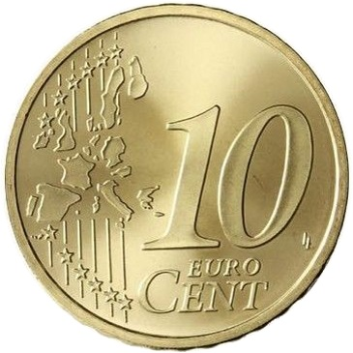
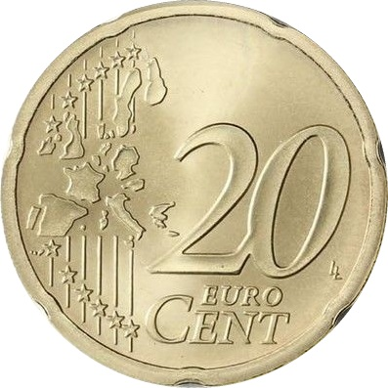
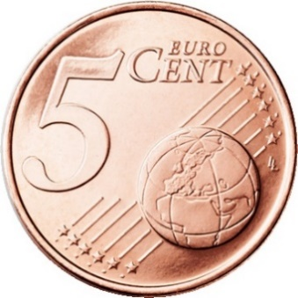
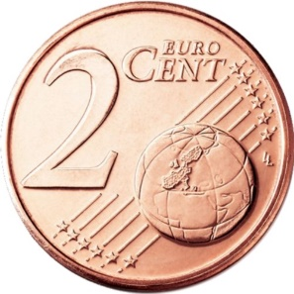
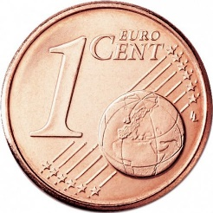
Week 2: Money Revision
1 cent 1c | 2 cent 2c | 5 cent 5c | 10 cent 10c | 20 cent 20c
If you have some coins at home,
use them to help you with the work on the next few slides

Slide 46
Week 2: Money Revision

Slide 47
Week 2: Money Revision

Slide 48
Week 2: Money Revision
Write these money sums into you copy and fill in the answers

Slide 49
Week 2: Money Revision

Slide 50
Summer Revision: Check what you have learned!
The following slides are a revision of all the work that you have learned in the last few months.
See how much you know

Slide 52
*Point the coins out to an adult instead

Slide 53
*Show an adult which one

Slide 55
Boys and girls-Well done!! You have finished the Maths work for Senior Infants! We are so proud of you for all the work you have been doing at home. Hopefully things will be back to normal soon and we will see you all in September. We wish you all the best in First Class! Have an amazing summer!! From all the Senior Infant teachers | Dear Parents, Thank you so much for your support and cooperation over the last year, particularly in recent months. We hope that things will be back to normal soon and we wish you and your families all the best over the summer. The Senior Infant teachers

