Slide 1


Senior Infants Literacy remote learning
Assumption Junior School
Week 1 May 18th –May 22nd
Week 2 May 25th – May 29th

Slide 2
Students you will need:
- A copy book to record all your work.
- Pens, pencils, colours, rubber.
An adult to help sometimes!
A computer / tablet / phone for some activities.

Slide 3
Oral Language:
1. Don’t Mention it
One person looks at the screen at the image and keeps it in their mind. They give clues to the others, however, they cannot mention the key words to give away the ‘secret word’.
Don’t Mention:
Chalk
School
Teacher
Chalk

Slide 4

Don’t Mention It!
Don’t Mention:
Bricks
Builder
Wall
Bricks
© Seomra Ranga 2014 www.seomraranga.com

Slide 5

Don’t Mention It!
Don’t Mention:
Hanger
Trousers
Wardrobe
Hanger
© Seomra Ranga 2014 www.seomraranga.com

Slide 6
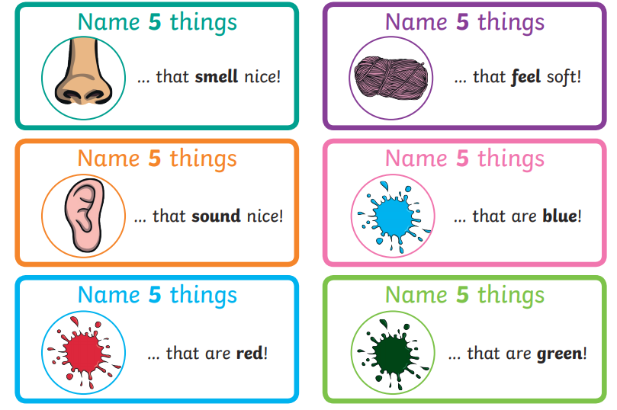
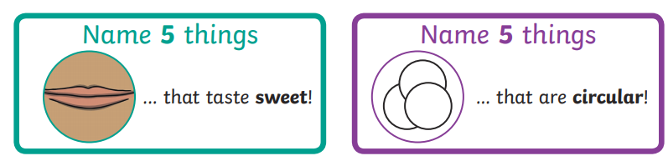
2. Name 5 Things:

Slide 7
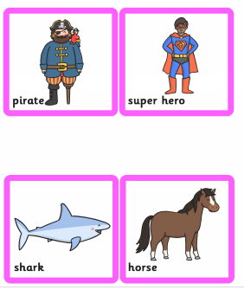
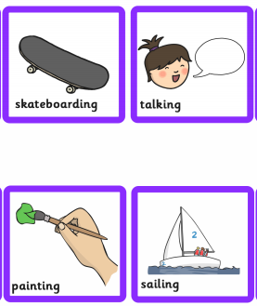
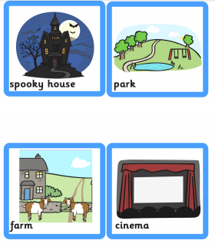
3. Silly Sentences
Can you make your own silly animal sentences?
Pick one option from the Who, What and Where columns
Who? What? Where

Slide 8
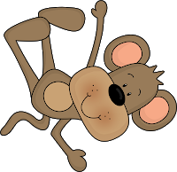
4.What Am I?
Revise some of your sounds from the last few weeks with this game.
Choose a sound
Think of a word beginning with that sound
Give three clues to your partner
Get your partner to ask you questions to try and guess the word – you can only answer yes or no
e.g. For the sound ‘ch’ you could pick ‘chimp’
Questions: Are you human?
Are you real or imaginary?
Do you live in Ireland?

Slide 9
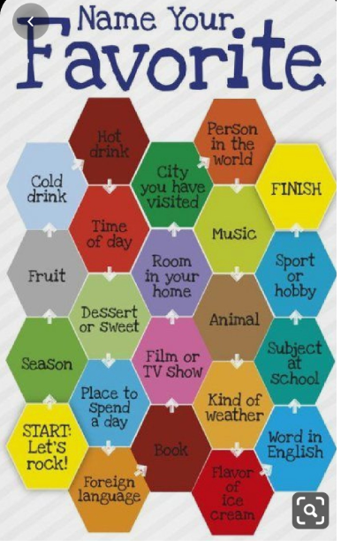



Start
Here

Slide 10
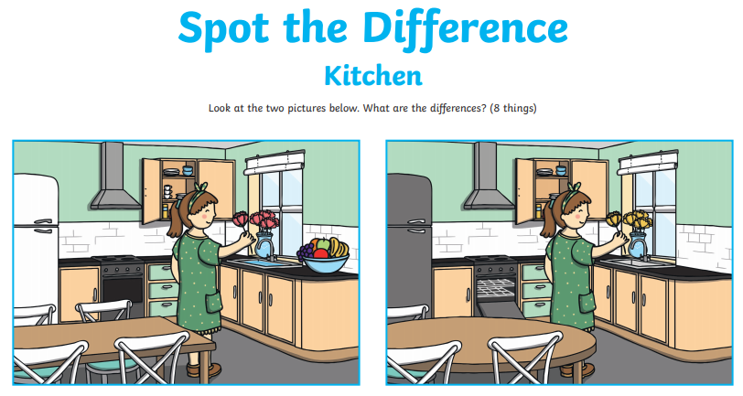
6. Spot the Difference

Slide 11
Phonics
Phonic sound for week 1 (May 18th – May 22nd) ^{sh} Task 1 Write a list of 6 or more ‘sh’ words. Task 2 Put 4 of these words into sentences Task 3: ‘sh’ story spotter Task 4: ‘Forest Phonics’ game http://www.ictgames.com/mobilePage/forestPhonics/index.html | Phonic sound for week 2 (May 25th - May 29th) ^{ir} Task 1 Write a list of 6 or more ‘ir’ words. Task 2 Put 4 of these words into sentences Task 3: ‘ir’ Hangman Task 4: ‘Tell a T-Rex’ game https://www.ictgames.com/mobilePage/tellATRex/index.html

Slide 12
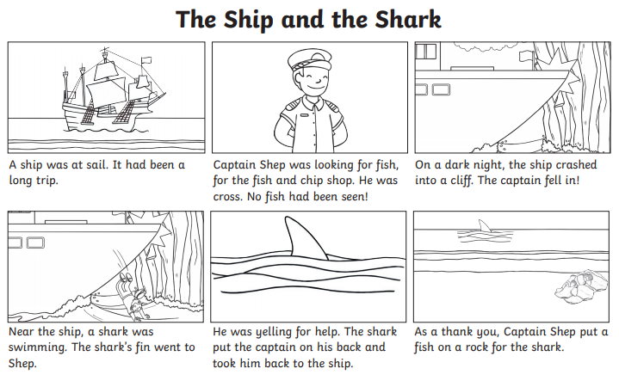
Week 1: ‘’sh” Story Spotter
Read the story and write down all the ‘sh’ words you find in your copy.

Slide 13
Tricky Words
On the next slide please find a list of the tricky words covered in class.
Here are some suggested activities to play to revise them with your child:
Hot/Cold- Write a word on a piece of paper and hide it on your child. Say the word loudly if they are close ‘hot’ to finding the word, and softly if they are ‘cold’ walking away from where the word is hidden.
Make a list of all the tricky words you find in the book you’re reading.
Write silly sentences using your tricky words in your copy. Underline the the word.
Play bingo
Play ‘guess the word’. Write out blank lines for the number of letters in the word, child calls out letters to guess the tricky word. They have only 4 chances to guess the correct word/letter. e.g _ _ _ _ _ = other
Write out each tricky word twice on a piece of paper and play a memory game
Write them out with chalk/paint/markers, etc.
Use a marker and an old newspaper/magazine and allow your child to ‘highlight’
tricky words.
Play hangman

Slide 14
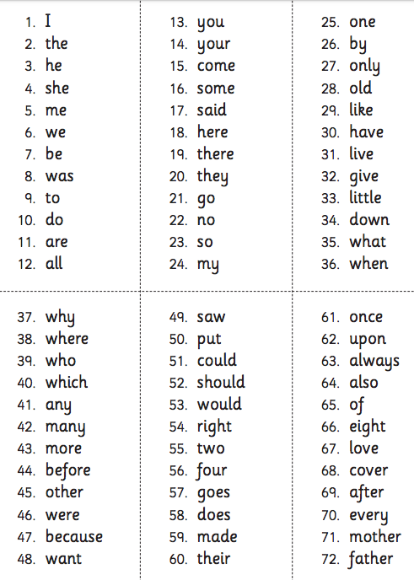

Slide 15
Writing
Handwriting- Some writing reminders…..
The following slides have a selection of writing tasks.
***Please only do what you child is able for and only what you can manage.
When you are writing please remember all the handwriting rules. Tall letters tall, hanging down letters. Use capital letters correctly. Do not forget full stops. Spaces in between your words.
If you see your child forming a letter incorrectly please show them how to write it correctly. Example of a common mistake: Forming b like a 6. The letter ‘d’ does not start at the top but with a ‘c’.
Try to encourage you child to sound out words before looking for help.

Slide 16
Walkinstown
See how many words you can write using the word ‘Walkinstown’ e.g. ‘in’
Hippopotamus
See how many words you can write using the word ‘Hippopotamus’ e.g. ‘pot’

Slide 17
Punctuation: Capital letters and fullstops:
Teacher forgot to use capital letters and fullstops!
Rewrite these sentences in your copy using a capital letter at the beginning
of the sentence and fullstops at the send of a sentence.
the pen is on the table
it is very hot out today
the dog is barking
i like to play football
you can have a turn

Slide 18
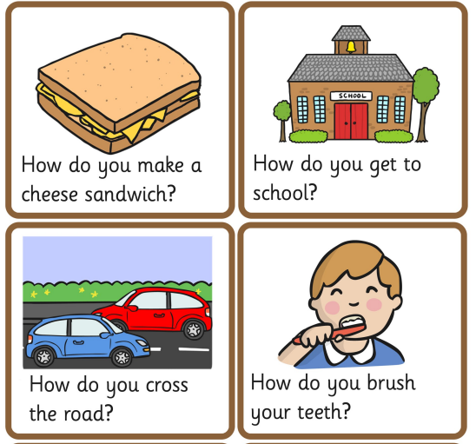
Procedural writing
Procedural writing: writing instructions to tell someone how to make or how to do something. Give it a try in your copy with some of these: (Remember to use first, next, then, last)

Slide 19

ADJECTIVES
An adjective is a describing word.
Here is a picture of a house.
Write a list of adjectives to describe it.
Example: spooky, dark, big
How many can you think of?

Slide 20

triangle poems
Read the triangle poem about a house.
Can you see how the poem is shaped like a triangle?
What do you notice when reading the poem?
Can you count how many adjectives are in the poem?
The house
The house is big.
The house is big and spooky.
The house is big, spooky and dark.
The house is big, spooky, dark and haunted.

Slide 21
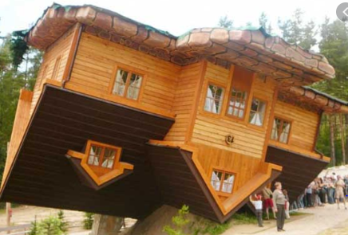
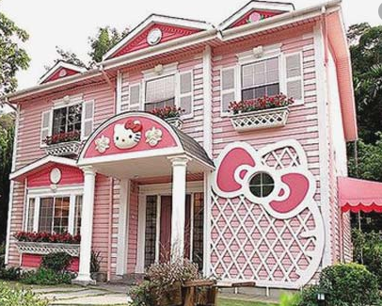
Can you write your own triangle poem?
Choose a house from below. Write a sentence to describe a house (example: The …. is ….).
On each line of your poem, add one new adjective.
On the last line you should have 4 adjectives.
Adjective ideas:
strange
beautiful heavy
huge
funny
pink
crazy

Slide 22
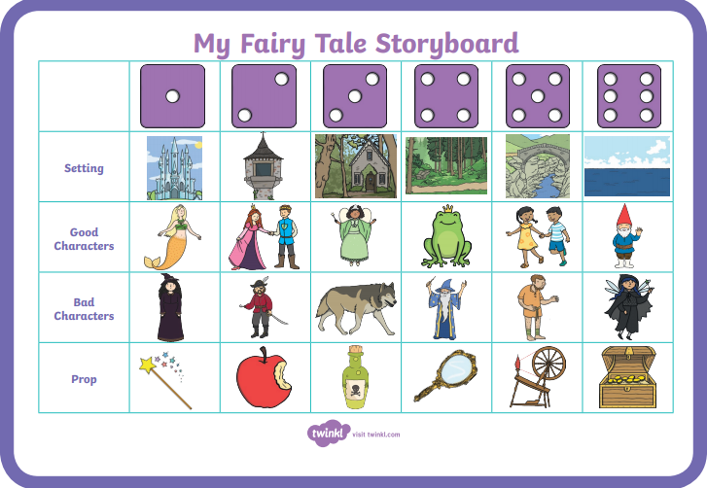
Story Writing:
Roll a dice to choose one option from setting, good character, bad character and prop in order to help you to write a fairy tale story

Slide 23
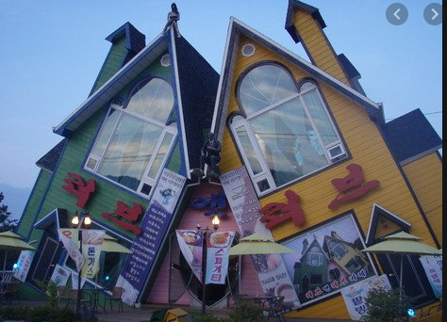
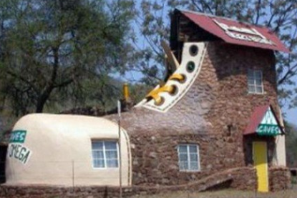
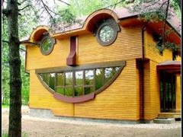
Write about the picture:
Have a look at these pictures. Write sentences or a story about the pictures. You could use sentence starters such as
“There are…” or “I can see…”
**Don’t forget to use your capital letters, fullstops, finger spaces.
Try use some adjectives if you can.

Slide 24
Read every day. Try to have 10 to 40 mins reading time set aside everyday. It really is so important. The length of time depends on your child’s level of interest. If your child is not that interested, start with a small amount of time and try to build it up. Just read every day it really is so important no matter the length of time.
Reading
Reading with your child apart from improving their general reading skills will also help them develop their oral language skills and ability to express what is happening.
Things parents can do.
Ask questions,
Encourage them to use expression.
Make sure your child heeds punctuation marks, such as commas, full stops etc.. This will help to improve fluency.
Talk about the setting, the characters, the problem, the solution present in all stories.
Look up the author online and find out information about who wrote the book.
Record information about stories read in their copies by writing simple sentences, or drawing pictures to re-tell the story.

Slide 25
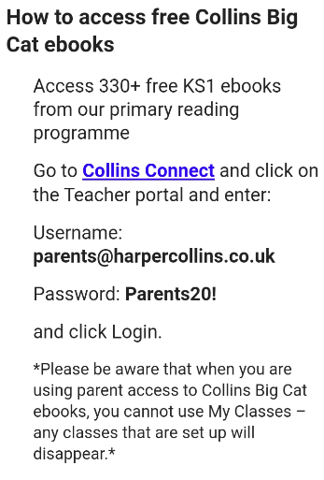

Collins connect!
Follow the directions below to sign up to Collins connect. There is a wide range of books that will be available for your child and plenty to choose from at the right level for your child.
Click on the link:
https://connect.collins.co.uk/school/portal.aspx
When you have chosen a book suitable for your child you could ask him/her to write a book review on it

Slide 26
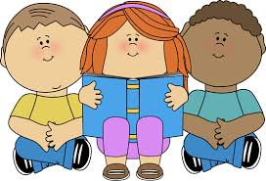
Week 1: Pick up a book at home that you can read.
Week 2: Pick up a book at home that you have never read before.
Discuss: predictions, author, illustrations, front cover, etc. Then answer these questions after you read it.
What is your favourite part of the story? Why?
Who is your favourite character in the story? Why do you like them?
Can you think of 3 adjectives to describe the main character in the story?
Where is the story set? Can you think of 5 adjectives to describe the setting?
Can you think of a different ending for the story?

Slide 27
Extra
Good reading websites include:
https://home.oxfordowl.co.uk/
https://www.storylineonline.net/

Slide 28

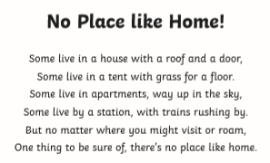

Poetry-Week 1
Learn this poem and record it on your tablet / your parents phone.
Use plenty of expression. Watch it back. Could you do it better? How?
If you are friends online with anyone in the class send it to them and
ask them to send you their recording.
Can you make a list of the rhyming words from this poem?

Slide 29
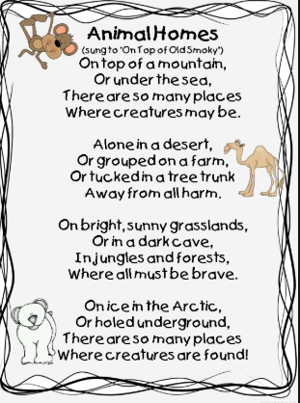
Poetry-Week 2
Learn this poem and record it on your tablet / your parents phone. Use
plenty of expression. Watch it back. Could you do it better? How?
If you are friends online with anyone in the class send it to them and ask them
to send you their recording.

Slide 30
Well done you have finished this fortnights task!

