Slide 1
Senior Infants Literacy remote learning
Assumption Junior School
June 15th-30th

Slide 2
Students you will need:
- A copy book to record all your work.
- Pens, pencils, colours, rubber.
An adult to help sometimes!
A computer / tablet / phone for some activities.

Slide 3
Week 1
Use a dice to play this game if you have one! Each player takes turns to roll the dice and move along the words. Each time you land on a word, you must give the opposite for that word.
E.g. if you land on ‘big’, then the opposite could be ‘small’.
Good luck!

Slide 4
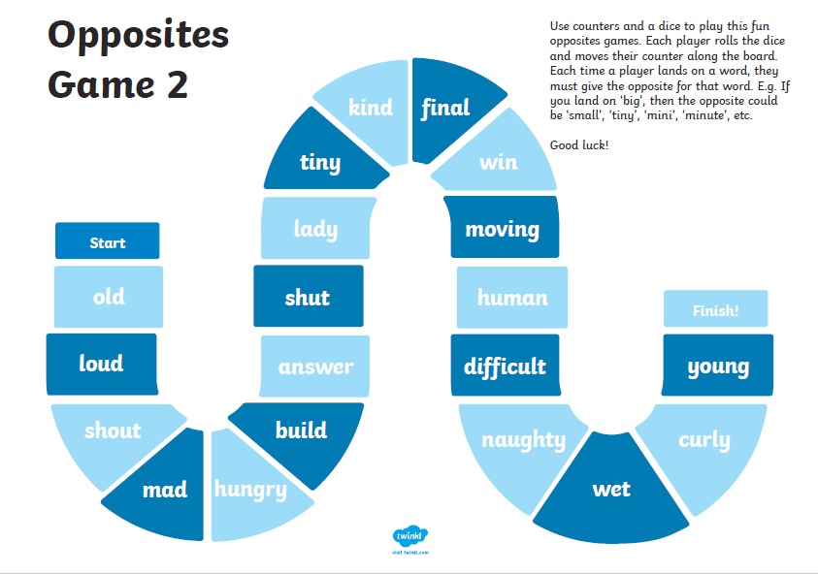
Week 2
Use a dice to play this second game of opposites.
Each player takes turns to roll the dice and move along the words. Each time you land on a word, you must give the opposite for that word.
E.g. if you land on ‘hot’, then the opposite could be ‘cold’.
Good luck!

Slide 5
How many can you name?
This activity can be played with two or more people.
The first player picks a topic and names an item relating to it eg if the topic is
clothes, they could say shorts. Play then passes to the next player and they say
An item relating to the topic eg dress. Play continues until a player cannot answer.
Then start again with a new topic.
Here are some topics…
Week 1:
Shops
TV programmes
Zoo animals
Sports
Things that are hot
Cartoon characters
Things in a playground
Week 2:
Musical instruments
Ice cream flavours
Fruits
People who wear uniforms
School subjects
Drinks
Things you eat for dinner

Slide 6
Week 1: Look and talk
What place do you see in the picture?
Is there a place like this near where you live?
What do people do here?
What do builders and gardeners put in parks to make people enjoy spending time here?
Why might people prefer to walk their dogs in the park rather than along the street?
What animals might you find in the park? What habitats or homes do they live in?
What might you smell when you visit the park?

Slide 7
Week 2: Look and talk
Who is in the picture and what type of food are they making?
What cooking utensils have they used to make the cookies?
Where will they put the cookies to make them cook? What important things will they have to remember when they put them there?
Have you ever baked anything at home or in school? Describe it
Can you list all the things you would find in a kitchen?

Slide 8
Week 1: Rhyming Words
Can you pick the odd one out in each line?
Which word does not rhyme with the rest?

Slide 9
Week 2: Rhyming Words
Can you pick the odd one out in each line?
Which word does not rhyme with the rest?

Slide 10
Is it a question? Week 1
Write these sentences into your copy.
If it is a question, write a question mark at the end(?)
If it is not a question, write a full stop(.)
Hint:
Look for question words!

Slide 11
Is it a question? Week 2
Write these sentences into your copy.
If it is a question, write a question mark at the end(?)
If it is not a question, write a full stop(.)
Hint:
Look for question words!

Slide 12
Real or nonsense words
Week 1

Slide 13
Real or nonsense words
Week 2

Slide 14
Phonics
Phonic sound for week 1 (June 15th 19th) ^{aw} Task 1 Write a list of 6 or more ‘aw’ words. Task 2 Put 4 of these words into sentences Task 3: ‘aw’ Snakes & Ladders Task 4: https://new.phonicsplay.co.uk/ ^{Username: march20} ^{Password: home} ^{Try some of the games here} | Phonic sound for week 2 (June 22nd-26th) ^{er} Task 1 Write a list of 6 or more ‘er’ words. Task 2 Put 4 of these words into sentences Task 3: ^{‘er’ Story Spotter} Task 4: https://www.phonicsbloom.com/ Phase 3 games Alien Escape Tricky Trucks

Slide 15
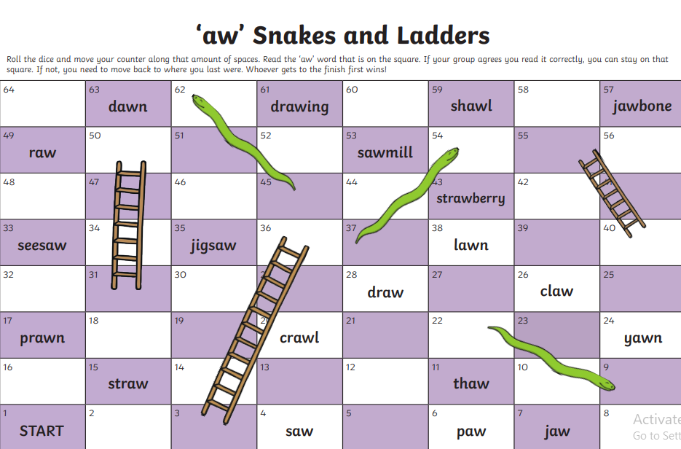
Week 1

Slide 16
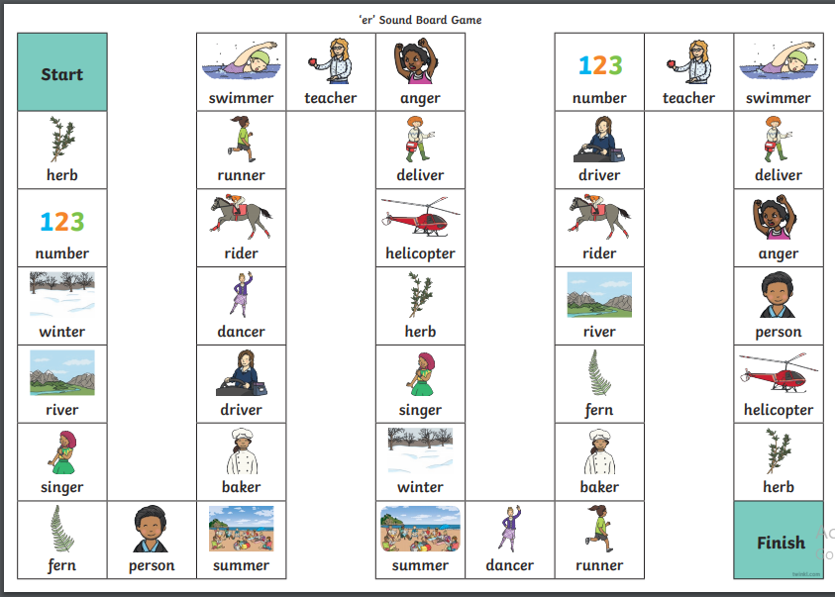
Week 2: Use a dice and take turns with someone at home

Slide 17
Test yourself!
Over the next few slides, you can check to see how many sounds and tricky words you have learned in Senior Infants.

Slide 18
Senior Infants: End of Year Phonics Check
ai |  | sh |  | oo
oa |  | th |  | OO
ie |  | qu |  | ue
ee |  | ou |  | er
or |  | oi |  | ng
ng |  | ar |  | er
ch |  | My score:

Slide 19
Senior Infants: End of Year Tricky Words Check
I |  | to |  | said
the |  | do |  | here
he |  | are |  | there
she |  | all |  | they
me |  | you |  | go
we |  | your |  | no
be |  | come |  | so
was |  | some |  | my

Slide 20
Senior Infants: End of Year Tricky Words Check
one |  | little |  | any
by |  | down |  | many
only |  | what |  | more
old |  | when |  | before
like |  | why |  | other
have |  | where |  | were
live |  | who |  | because
give |  | which |  | want

Slide 21
Senior Infants: End of Year Tricky Words Check
saw |  | goes |  | of
put |  | does |  | eight
could |  | made |  | love
should |  | their |  | cover
would |  | once |  | after
right |  | upon |  | every
two |  | always |  | mother
four |  | also |  | father

Slide 23
Writing
Handwriting- Some writing reminders…..
The following slides have a selection of writing tasks.
***Please only do what you child is able for and only what you can manage.
When you are writing please remember all the handwriting rules. Tall letters tall, hanging down letters. Use capital letters correctly. Do not forget full stops. Spaces in between your words.
If you see your child forming a letter incorrectly please show them how to write it correctly. Example of a common mistake: Forming b like a 6. The letter ‘d’ does not start at the top but with a ‘c’.
Try to encourage you child to sound out words before looking for help.

Slide 24
Week 1:
Summer Sensory Writing Activity
Use your senses to write about summer. Finish these sentences:
Summer looks like _____________
Summer sounds like ____________
Summer smells like ____________
Summer tastes like ____________
Summer feels like _____________

Slide 25
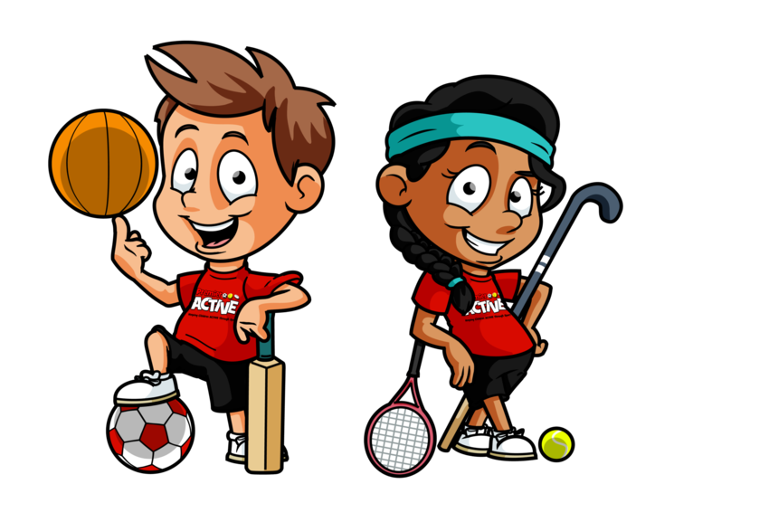
Week 2:
Design your own Sports Day event at home and write about it.
Where will your event take place?
What equipment do you need?
What are the rules?

Slide 26
Week 1-Finding Adjectives
Put a circle around the adjective (describing word) in these sentences.
Hint: There is one adjective in each sentence.
The cat is pretty.
I have long legs.
She found a shiny shell.
The happy penguin looked up.
The big elephant drank water.
The dog had fluffy hair.

Slide 27
Week 2-Finding Adjectives
Put a circle around the adjectives (describing word) in these sentences.
Hint: There is more than one adjective in each sentence!!!
There was a big, hairy spider in the bath.
A wet, sticky slug was in my sink.
I saw a tiny ladybird on the big leaf.
A blue and white butterfly flew into my house.
There is a wiggly, pink worm in my garden.

Slide 28
Capital Letters Revision:
Write the capital letter for each of these lower case letters in your copy
Week 1:
a b
c d
e f
g h
i j
k l

Slide 29
Capital Letters Revision:
Write the capital letter for each of these lower case letters in your copy
Week 2:
m n
o p
q r
s t
u v
w x
y z

Slide 30
Punctuation: capital letters and full stops
Teacher forgot to use capital letters and full stops!
Rewrite these sentences in your copy.
Remember, the beginnings of sentences, names and ‘I’ need capital letters!
the sun is shining
ben wants to go to the park
he got a postcard from spain
they saw a cat in jack’s garden
my brother and i like to read books

Slide 31
Write sentences in your copy.
Look at this picture. What is happening?
He is... She is… They are…The animals are…etc

Slide 32
Vowels Revision
Can you remember? There are 5 vowels in the alphabet:
a e i o and u
On the 2 next slides, fill in the missing vowel in the words

Slide 33
Week 1:
Write these words into your copy and don’t forget to fill in the missing vowel

Slide 34
Week 2:
Write these words into your copy and don’t forget to fill in the missing vowel

Slide 35
Narrative Writing: Week 1
Use this picture to help you to write a story.
Who will be in the story?
Where does the story take place?
What happens in the story?
How does it end?

Slide 36
Narrative Writing: Week 2
Use this picture to help you to write a story.
Who will be in the story?
Where does the story take place?
What happens in the story?
How does it end?

Slide 37
Read every day! Try to have 10 to 40 mins reading time set aside everyday. It really is so important. The length of time depends on your child’s level of interest. If your child is not that interested, start with a small amount of time and try to build it up. Just read every day it really is so important no matter the length of time.
Reading
Reading with your child apart from improving their general reading skills will also help them develop their oral language skills and ability to express what is happening.
Things parents can do:
Ask questions,
Encourage them to use expression.
Make sure your child heeds punctuation marks, such as commas, full stops etc.. This will help to improve fluency.
Talk about the setting, the characters, the problem, the solution present in all stories.
Look up the author online and find out information about who wrote the book.
Record information about stories read in their copies by writing simple sentences, or drawing pictures to re-tell the story.

Slide 38
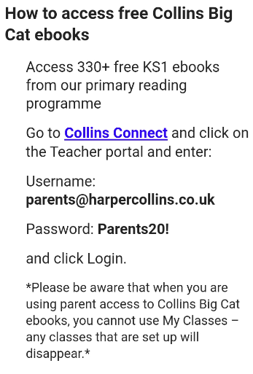
Collins Connect
Follow the directions below to sign up to Collins connect. There is a wide range of books that will be available for your child and plenty to choose from at the right level for your child.
Click on the link:
https://connect.collins.co.uk/school/portal.aspx

Slide 39
Extra
********Walkinstown Library is offering a Call and Collect service for borrowing books
Check out www.dublincity.ie/story/call-and-collect for more details
Good reading websites include:
https://home.oxfordowl.co.uk/
https://www.storylineonline.net/

Slide 40
Write about a character from one of the stories you read.

Slide 41
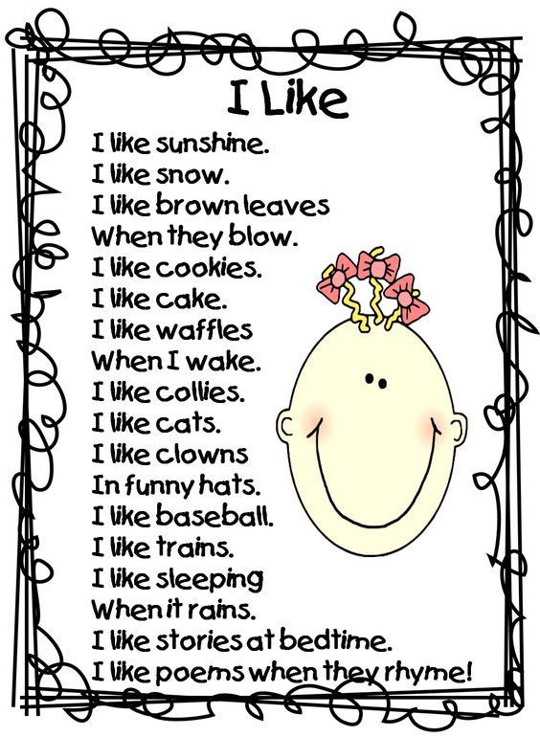
Poetry week 1

Slide 42
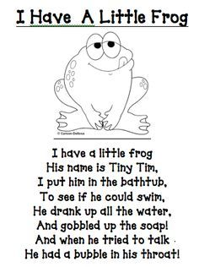
Poetry week 2

Slide 43
Boys and girls-Well done!! You have finished the Literacy work for Senior Infants! We are so proud of you for all the work you have been doing at home. Hopefully things will be back to normal soon and we will see you all in September. We wish you all the best in First Class! Have an amazing summer!! From all the Senior Infant teachers | Dear Parents, Thank you so much for your support and cooperation over the last year, particularly in recent months. We hope that things will be back to normal soon and we wish you and your families all the best over the summer. The Senior Infant teachers

