Slide 1
Junior Infants NUMERACY
Assumption Junior School May 18th-May 29th 2020

Slide 2
Dear Parents/ Guardians,
We hope the home schooling is going well and that the work we are sending is helpful. We will cover many of the same strands each fortnight as repetition is an important part of the learning process.
We would suggest that 3 slides is enough to complete in a day as we are conscious that you have a lot of demands on your time at the moment.
Setting the table, tidying toys, cooking, sorting laundry, gardening.. can all be turned into numeracy lessons so don’t stress if you can’t get through everything.
Best of luck !

Slide 3
You will need:
Counters (pasta, coins, stones, lego figures or anything else that can be used to touch count).
A copy book that you can keep all your work in.
Paper, pencil, colours.
Listening ears.
Have fun.

Slide 4
Are there more red circles or blue circles?
More or Less
Are there more pink triangles or green triangles?
Are there less yellow squares or purple squares?

Slide 5
Let’s sing the Days of the Week song! https://www.youtube.com/watch?v=mXMofxtDPUQ
Write the names of the days of the week on pieces of paper/post-it stickers. Place the names randomly on the table and ask your child to place them in order starting with Monday.
Ask them questions, such as:
Which day comes after Wednesday?
Pass me the day that comes after Sunday.
Show me the day that comes between Thursday and Saturday.
See if your child can find the day of his/her birthday on a calendar.

Slide 6
Find the Missing Numbers
0
1
?
3
4
5
?
1
2
3
4
?
0
?
2
3
?
5

Slide 7
Number Line Game
Write numbers 1 to 10 on pieces of card/paper and ask your child to place them in the correct order.
Get them to turn away while you remove one number and see if they can identify the missing number.
Let them remove the next number for you to identify.
If they find it difficult, start with numbers 1 to 5.
1
2
3
4
6
7
8
9
10
?

Slide 8
Time: Before/After/Between
Talk to your child about things s/he does before/after/between significant events in his/her day by asking questions such as the following:
What do you do before you get dressed in the morning?
What do you do after you eat your lunch?
What do you do between dinnertime and bedtime?
Encourage them to give as many answers as possible and to answer with complete sentences.

Slide 9
After
Write/ name the numeral that comes after
1
2
?
3
4
?
?
2
3

Slide 10
Before
Write/name the numeral that comes before.
2
3
4
5
3
4

Slide 11
Between
Write/ name the numeral that comes between
1
3
3
5
2
4

Slide 12
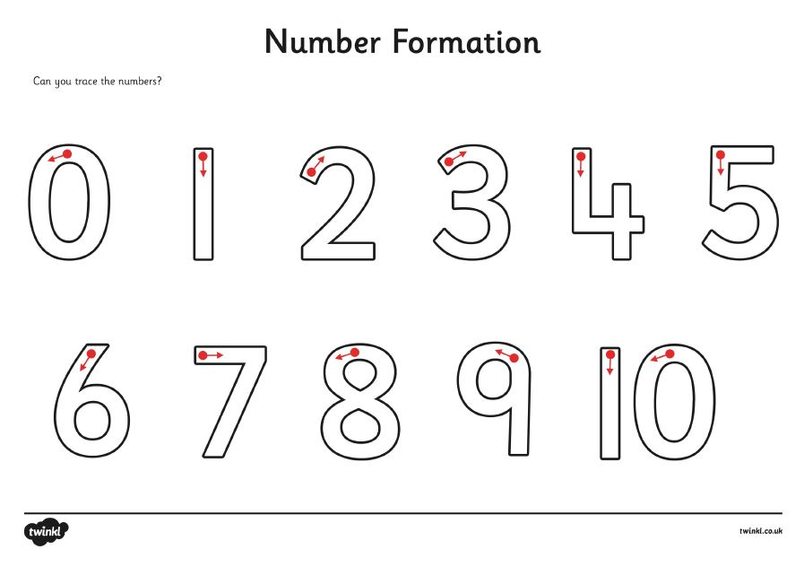
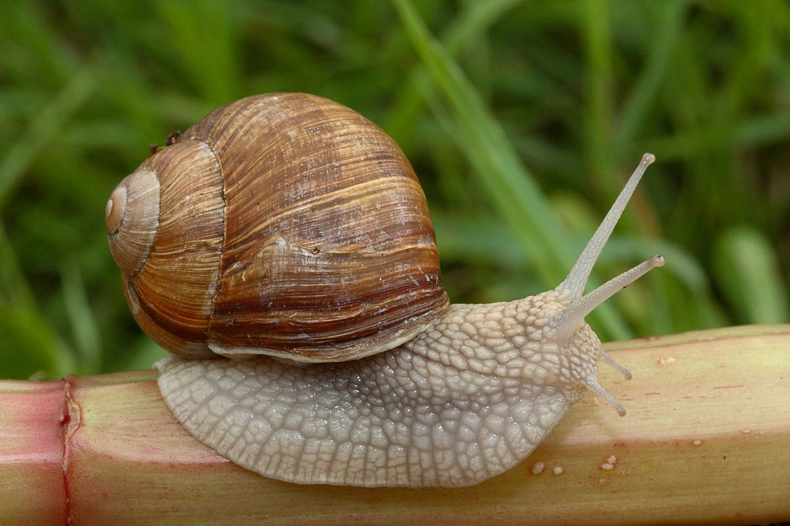
Practise writing the numbers 0-5
Draw/make a set of objects to match each numeral..
2

Slide 13
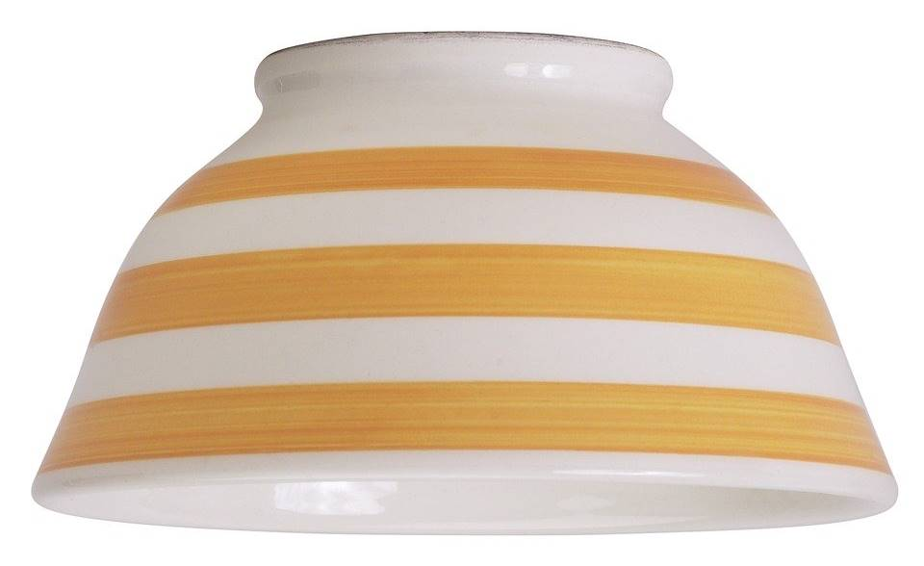
How Many Are Under The Bowl ?
Get 5 counters. Hide some of them under a bowl/ cup and leave the rest visible. Ask your child to identify how many are under the bowl. Take turns hiding and guessing
?
If struggling start with fewer counters and if finding it easy try 6/7 counters.

Slide 14
Try the following sums
2+ is the same as 3
3+ is the same as 4
4 + is the same as 5
?
?
?

Slide 15
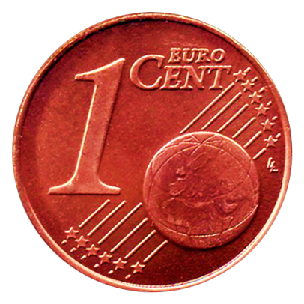
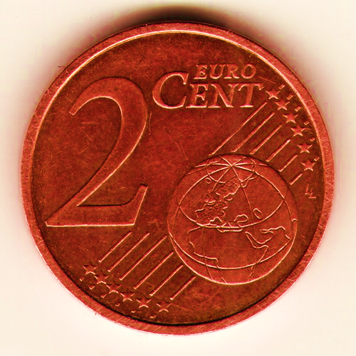
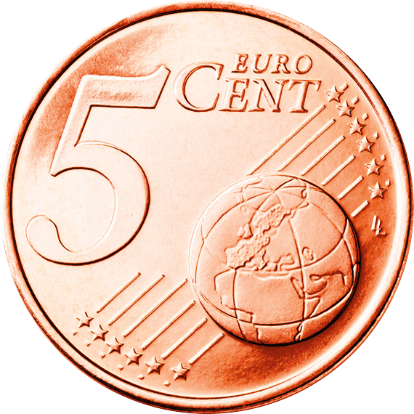
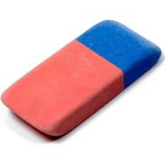
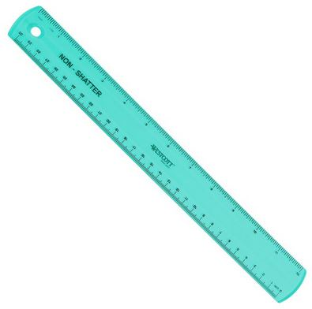
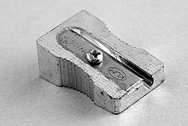
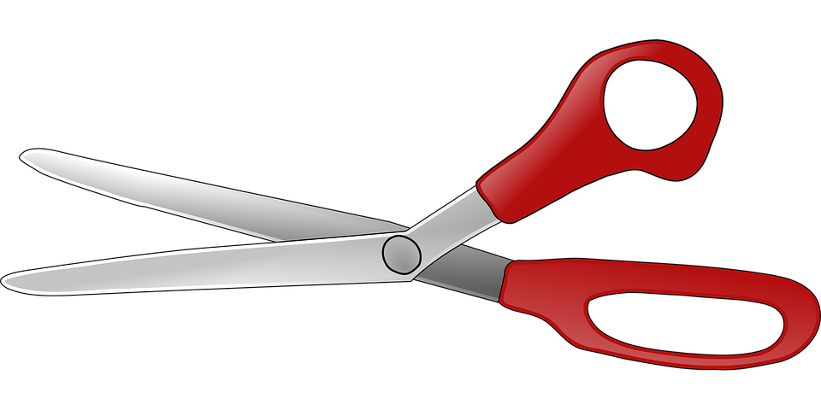

Money
Count out/draw the correct amount of coins for each object
1c 5c 2c
4c 3c

Slide 16
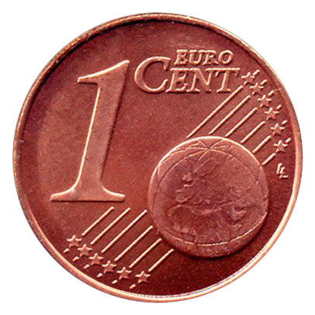
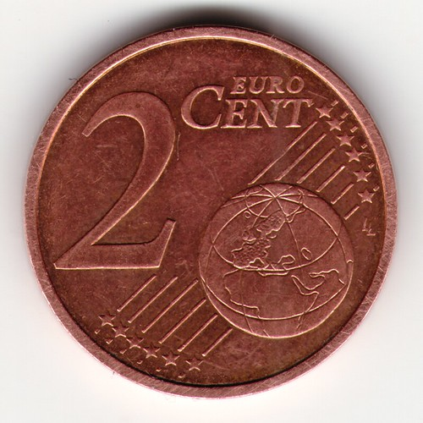
How much money is there in each box?

Slide 17
Number Pairs to 5
Join the pairs of numbers that add up to 5.
3
0
1
2
5
1
2
4
4
3

Slide 18
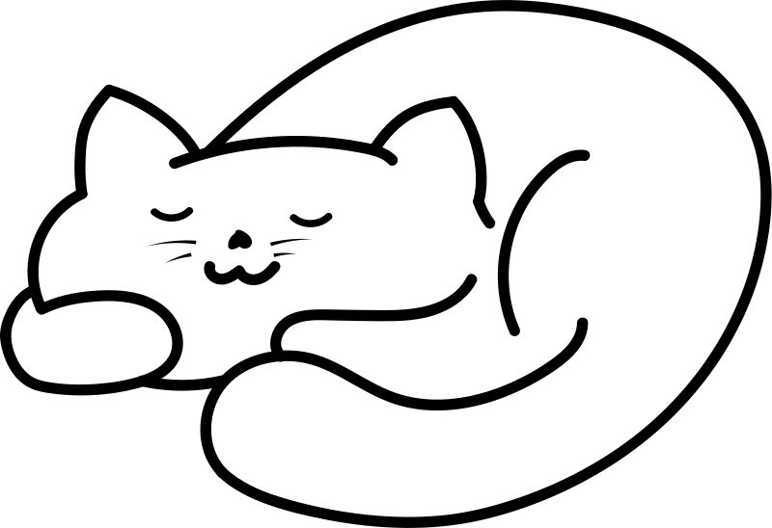
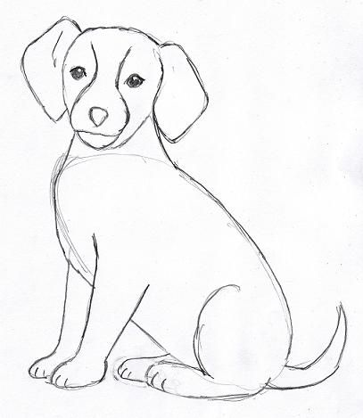


Colour the correct number
3 cats
2 dogs
4 rabbits
5 fish

Slide 19


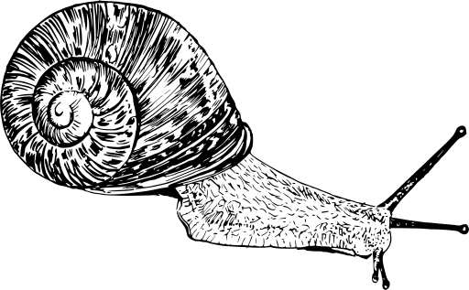
Add 1
Draw one more. How many are there now?
worms
ladybirds
snails

Slide 20
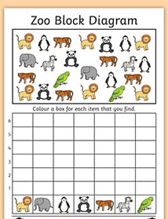

Slide 21
Which animal is there most of?
How many tigers are there?
Are there more pandas or birds ?
How many elephants and zebras are there altogether?
How many two legged animals can you find?

Slide 22
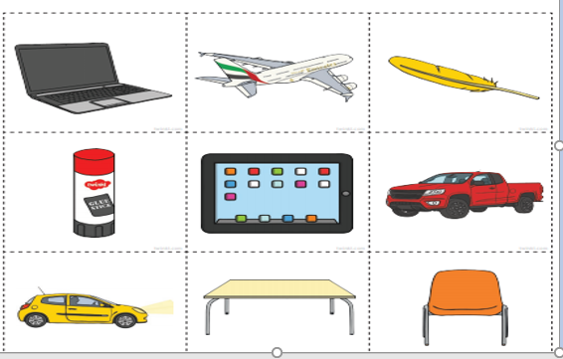
Weight
Order the items below from the lightest to the heaviest.

Slide 23
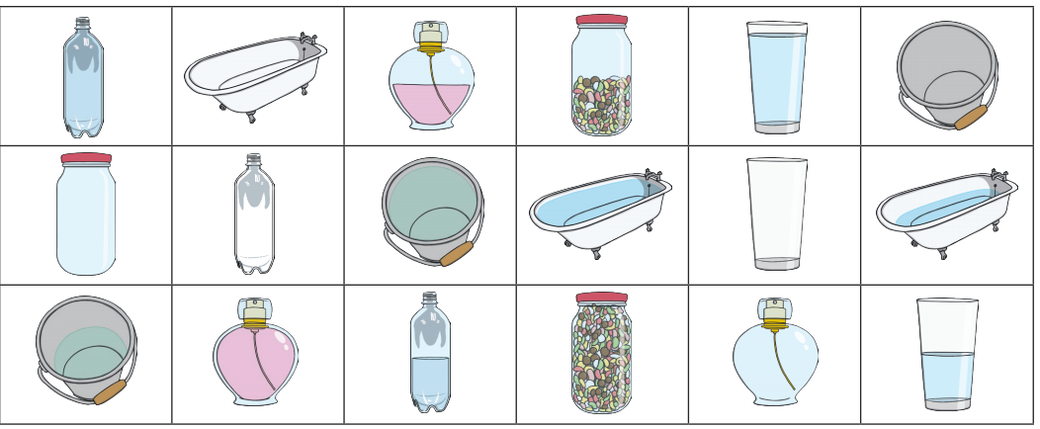
Capacity
Sort the pictures into full, half full and empty

Slide 24
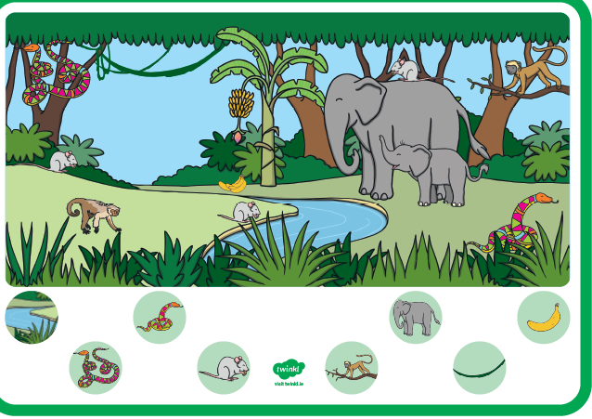
Length

Slide 25
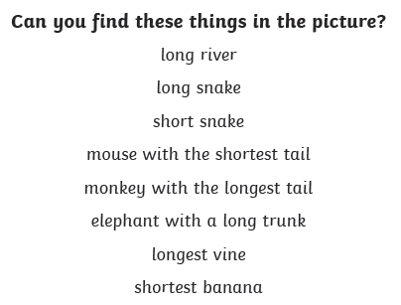

Slide 26
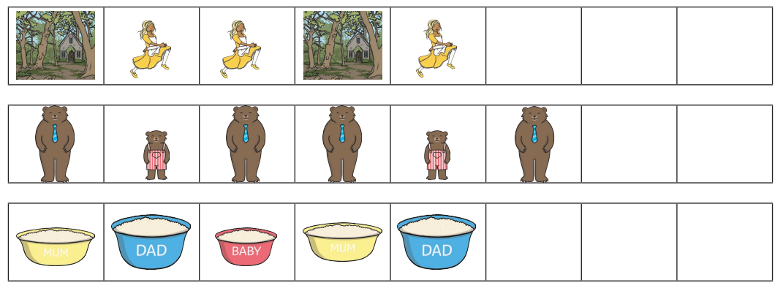
Algebra
Can you complete the pattern?

Slide 27
Number Stories
Draw pictures to help solve the following.
1.There were 3 monkeys in a tree. 2 more came along. How many monkeys are there now?
2. Ann has 4 sweets and Bob has 1. How many sweets do they have altogether?
3. There are 2 frogs in the pond and 2 on a log. How many frogs are there in total?
4. A bird has 2 wings. How many wings do two birds have?

Slide 28
More Number Stories.
Tom’s mum gave him 1 Euro and his dad gave him 3 Euro. How much money has he now
Mum baked 5 buns. She put 1 sweet on each bun. How many sweets did she need?
Jill scored 2 goals in the first half of the football match and 3 in the second half. How many goals did she score?

Slide 29
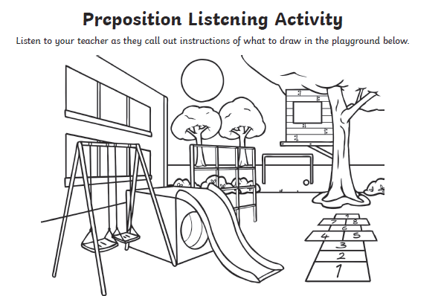

Slide 30
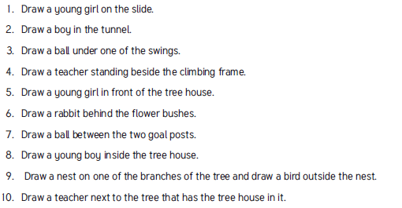

Slide 31
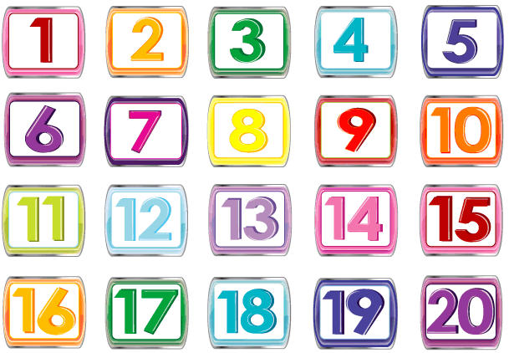
Let’s sing some rhymes counting to 5 and 10!
One, two buckle my shoe
https://www.youtube.com/watch?v=INyHLYfasTU
5 little peas
https://www.youtube.com/watch?v=2b_XLKHMcPM
Counting to 10 and 20
https://www.youtube.com/watch?v=DR-cfDsHCGA
https://www.youtube.com/watch?v=Aq4UAss33qA
Practise counting to 10.
Now count backwards from 10!
Can you count to 20?
Backwards from 20?

Slide 32


Well done you have finished this fortnights task!

