Slide 1
Junior Infants
Gaeilge Remote Learning
May 4th to May 15th

Slide 2
In school we use the Abair Liom programme to teach Irish. Follow the instructions below to sign up and access the programme.
Go to FolensOnline.ie and click register
Select Teacher
Fill in a username, email and password
For Roll Number use the code: Prim20
Go to Junior Infants
Click on resources

Slide 3
Week One Abair Liom: An Bosca Lóin
https://content.folensonline.ie/programmes/AbairLiom/JI/resources/Poster/AL_JI_ACT_Postaer_L03_001/index.html
Suggested Activities
Learn the song ‘Cad atá i do Bhosca Lóin’
Learn the poem ‘Buail Bos’
Éist leis an scéal (Listen to the story)
Cuardach 1 agus 2 (Click on the pictures to hear the words)
Foclóir 1 agus 2 (Listen to words and click on the right picture)

Slide 4
Week Two Abair Liom: Ag Súgradh
https://content.folensonline.ie/programmes/AbairLiom/JI/resources/Poster/AL_JI_ACT_Postaer_L04_001/index.html
Suggested Activities
Learn the song ‘Hé Hó Mo Dhaideo’
Learn the poem ‘Sín do Lámha Thuas Thar Do Cheann’
Éist leis an scéal (Listen to the story)
Cuardach 1 agus 2 (Click on the pictures to hear the words)
Foclóir 1 agus 2 (Listen to words and click on the right picture)

Slide 5
Extra Activities….

Slide 6
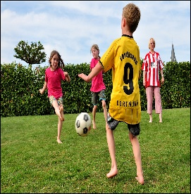
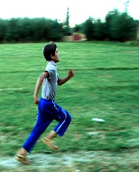
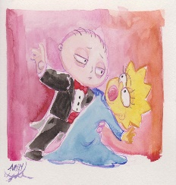
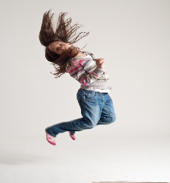
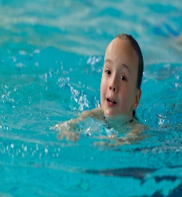
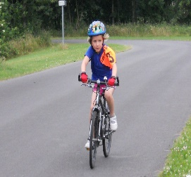
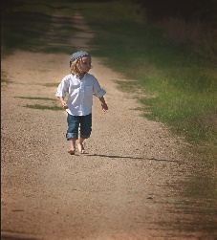
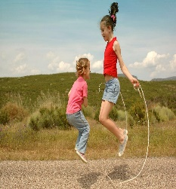
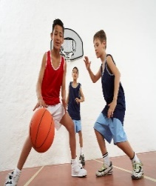
Be Active At Home ‘As Gaeilge’
Bí ag rith Bí ag dámhsa Bí ag imirt peile
Bí ag léim Bí ag snámh Bí ag rothaíocht
Bí ag siúl Bí ag scipeál Bí ag imirt cispheile

Slide 7
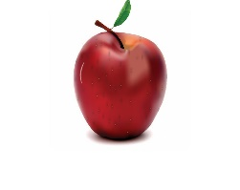
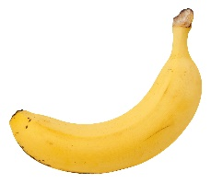
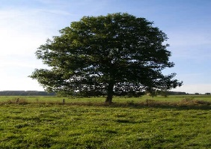
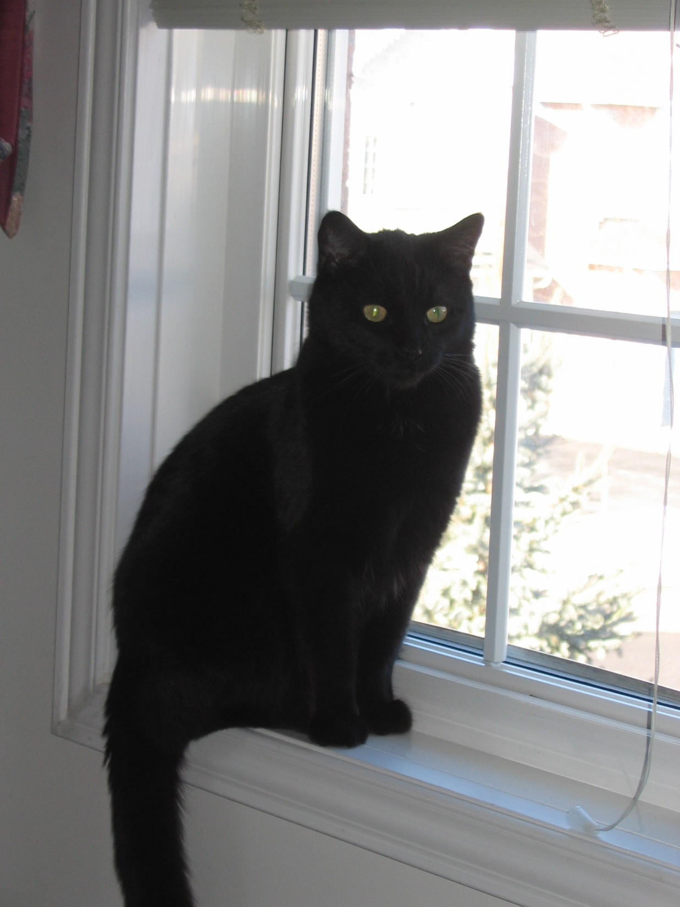
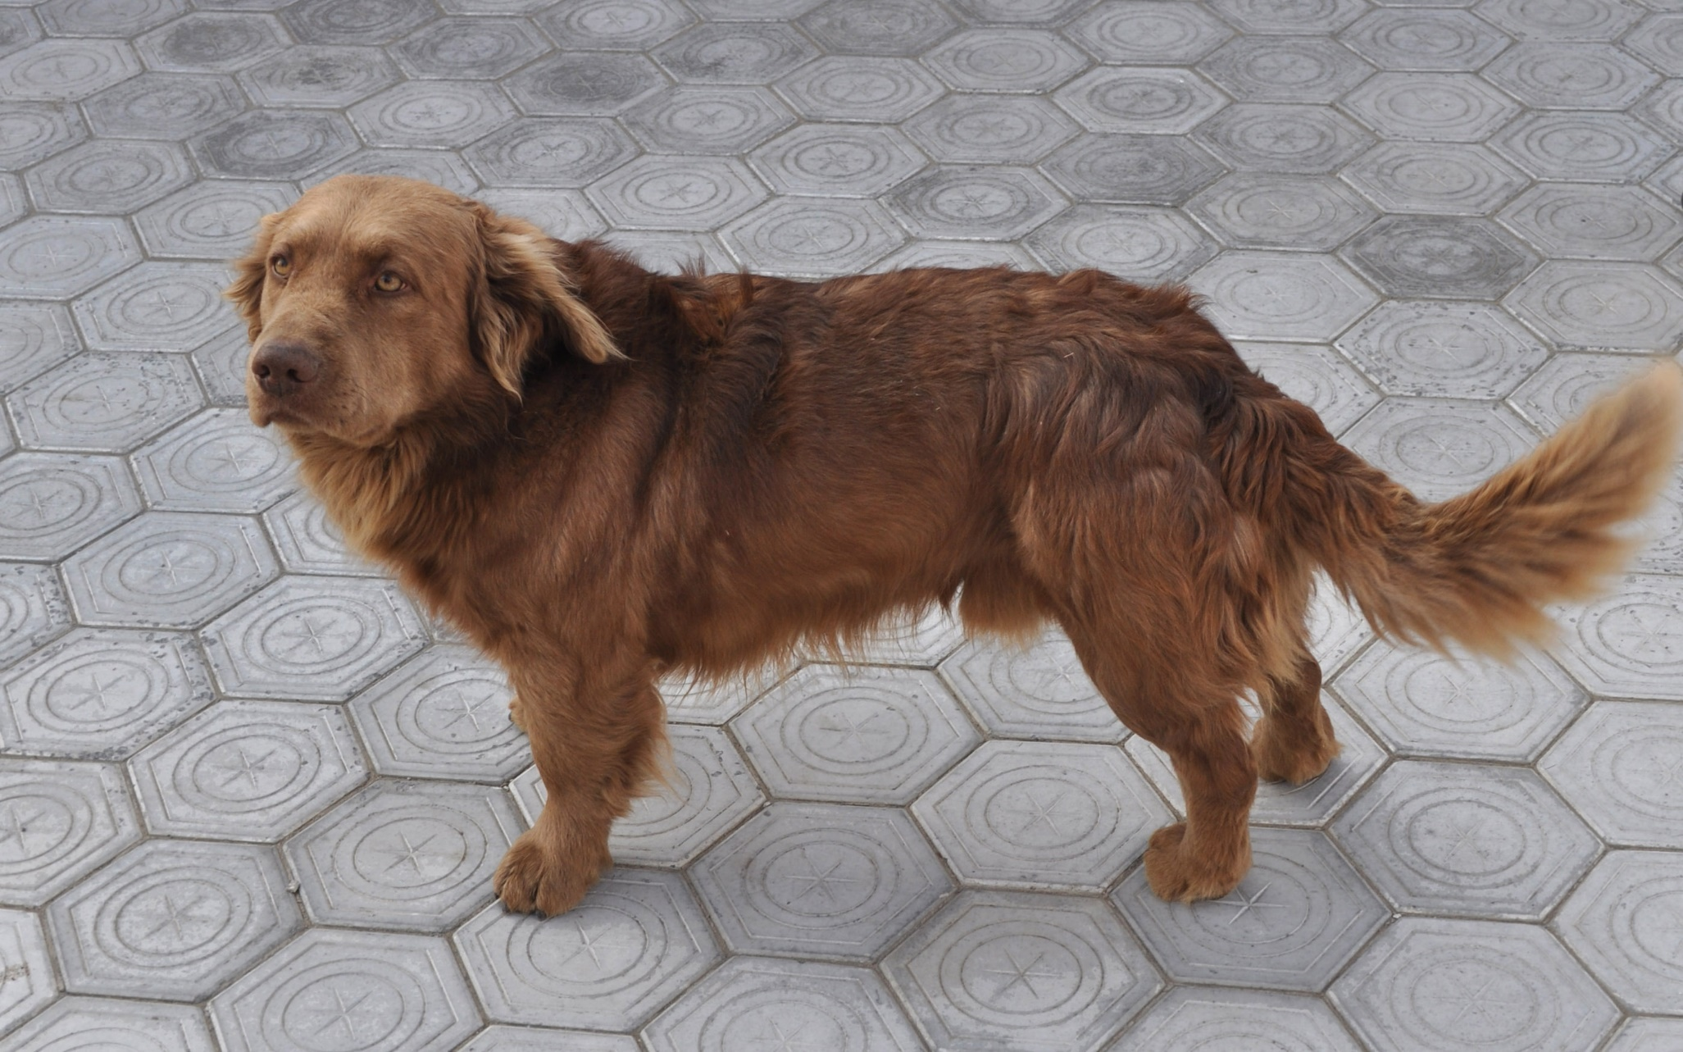
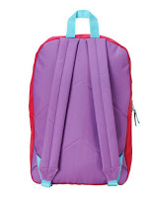
Tarraing agus Dathaigh : Draw and Colour
úll dearg banana buí crann glas
liathróid gorm téidí oráiste
cat dubh madra donn mála scoile corcra

Slide 8
Check out YouTube and the TnaG player for the Irish programmes listed below.
Is Eolaí Mé
Ár Scéal
An Siopa Ealaíne
Scéal na Lae
Corpoidechas Le Ciarán ( PE )
Dino Lingo
Cúla4 ar Scoil 10.00 a.m Monday to Friday on TnaG

Slide 9
Maith thú!

