Slide 1
Home Sensory Circuits

Slide 2
Sensory Circuits can help to keep your child calm and regulated at home.
The circuits consists of simple exercises which are completed in a specific order. You can pick and choose from each section to create a different circuit each day!
The order of the circuits are as follows:
Alerting Organising Calming
Here is a clip of what they might look like at home
https://www.virginmediatelevision.ie/player/show/809/170606/0/Ireland-AM
Have fun!

Slide 3
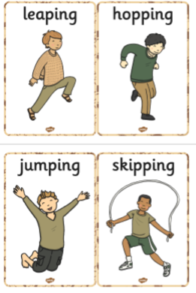
Alerting (2 mins)
Running
Jumping Jacks
Crash Landing
Skipping
Trampoline
Bounce on an exercise ball.
Hopscotch
Giant Steps

Slide 4
Organising (10 mins)
Balance Obstacle Course (Use chalk lines outside or masking tape)
Roll on exercise ball
Simon Says
Jump to a height (touch wall)
Wheelbarrow races
Animal Walks
Balloon Volleyball
Commando Crawl (Use chairs as the obstacles)

Slide 5
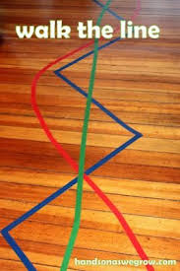
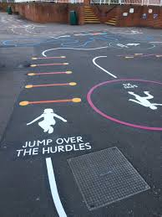
Balance

Slide 6
Calming ( 3 mins)
Press ups
Wheelbarrow walk
Wall Pushes
Plank
Tunnel Crawl
Yoga pose

Slide 7
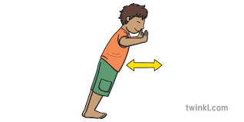
Ideas for Calming
Yoga Poses
Wall Pushes

Slide 8
Breathe
Smell the flowers
Blow out the candles

