Slide 1
Second Class SESE
(History, Geography & Science)
March 30th – 3rd
April 6th – 10th Fortnightly Theme: Houses and Homes
You will need: A copybook/paper, pencil, colours, ruler

Slide 2
History
The Celts came to Ireland around 500BC, 2,500 years ago! They lived in houses known as Celtic Roundhouses.
Read the following description of a Celtic Roundhouse.
In your copybook, make a list of all the similarities and differences between your home and the Roundhouse home.

Slide 3
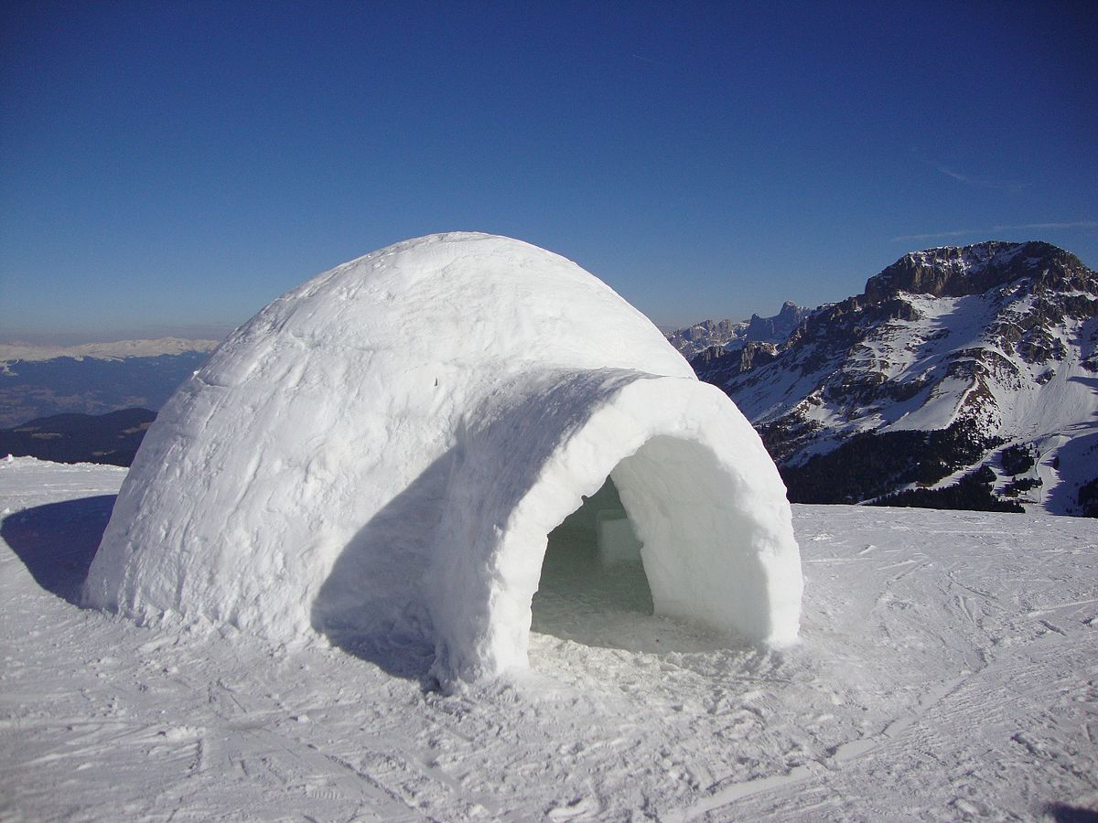
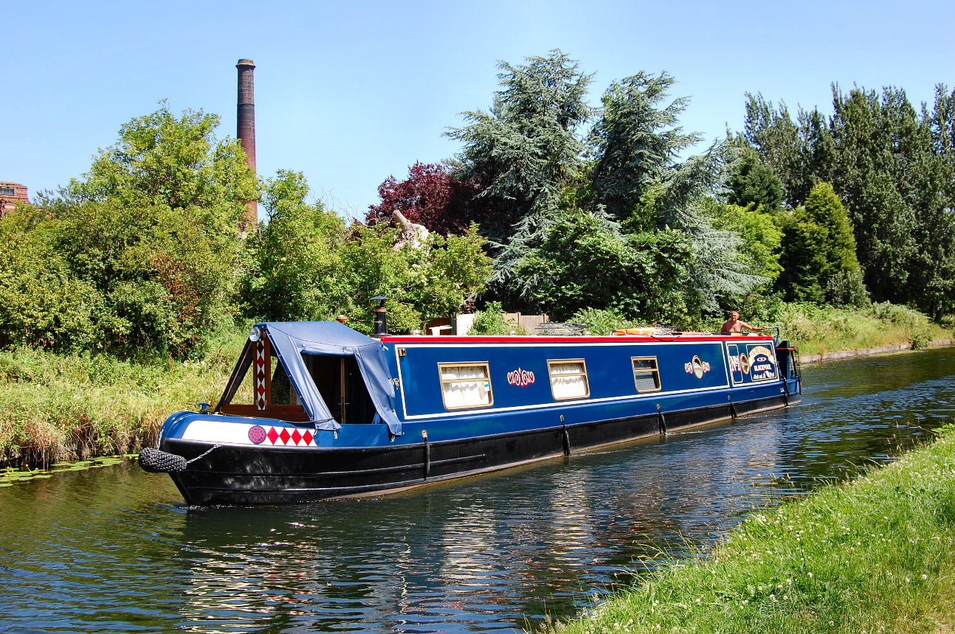
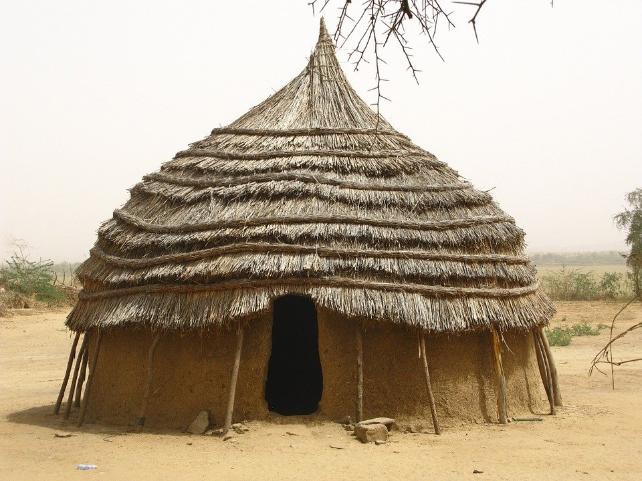
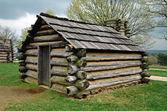
Geography
Look at these pictures of different types of homes from around the world.
Where in the world might you find these homes?
What kind of materials are they made from?
What kind of climate would you find these homes in?
In your copybook answer these questions and write about which of these homes you would most like to live in and why.

Slide 4
Science
Write about your home. . .
What type of home do you live in?
How many rooms are in your home?
What is your favourite place in your home and why?
Look at this plan of a home.
Can you identify the windows and the doors?
Now, draw a plan of your own home and remember to label the rooms.

