Slide 1
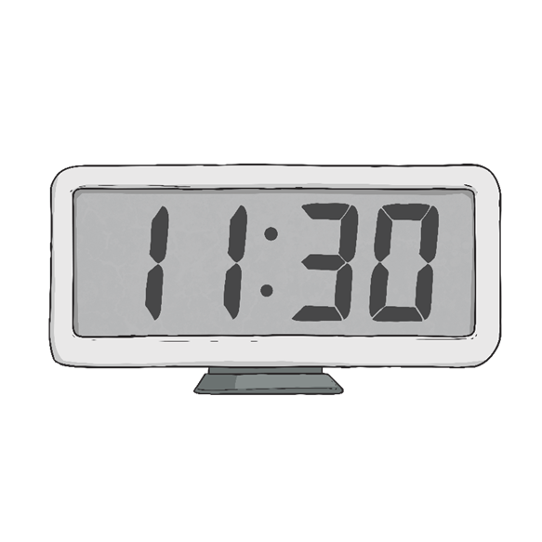
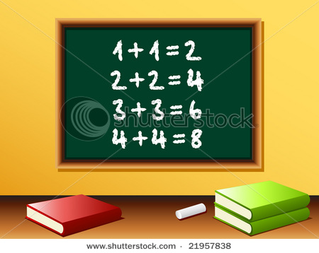
Second class maths

Slide 2
Module 3 work at a glance
Your child will need a copy , pencil, colours and a ruler
Each day there will be a different topic – following the same pattern each week.
Mondays – Length
Tuesdays- Numbers to 200
Wednesdays – Mental Maths
Thursdays- Money
Fridays are fun with teacher-selected games on Matific.

Slide 3
Monday

Slide 4
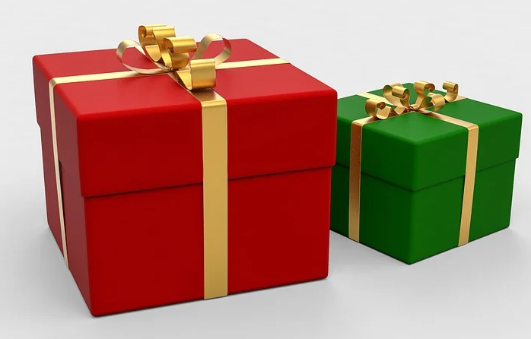
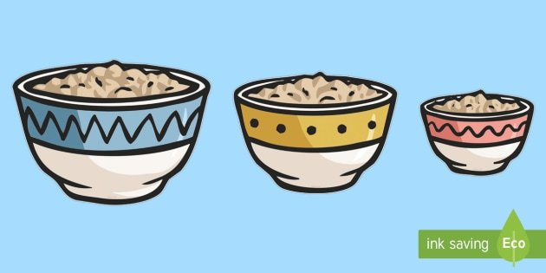
A piece of ribbon was 94cm long. Sheila cut 63cm off it.
How long is it now?
The red present is 47 cm in height, the green one is 29cm. What is the total height of the two presents?
Daddy Mammy Baby
What is the total width of
the three bowls?
½ m
¼ m
10 cm

Slide 5
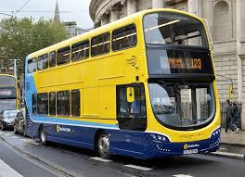
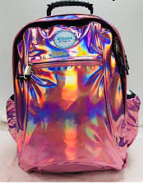
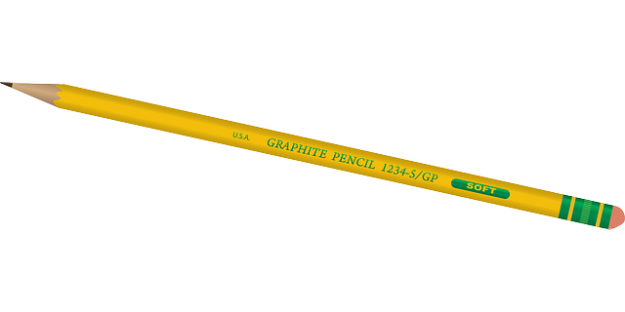
Task : Match the object to its most likely measure, then talk about objects that you think would be longer/shorter/taller than these measurements.
9m
30cm
11cm
2m
50cm
length
height
height
height
length

Slide 6
Tuesday

Slide 7
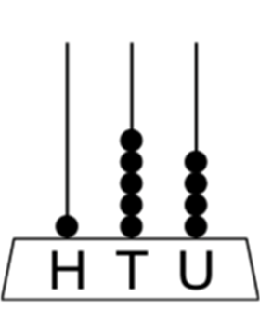
Counting to 200
Can you count from 100 to 200?
Use the number square in the next slide to help you – can you tell which numbers are hidden by smiley faces?
Draw these numbers in your copy on an abacus
Example : 154

Slide 9
Wednesday

Slide 10
6
1. Sarah had €125. She spent €21, how much does she have left?
2. What month of the year is half way through?
3. Write the odd numbers between 170 and 180.
4. Jane rode her bike for an hour and travelled 14km. (Before the 2km restriction) How far did she travel in half an hour?
5. Write the number of hundreds, tens and units in; 152, 63, 144, 100, 173, 89.
6
6

Slide 11
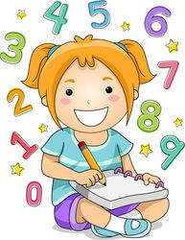
6. There are 5 marbles in every bag, how many are in 7 bags?
7. The time is 10:30. What time was it an hour and a half ago?
8. 50 cm + 60 cm = ___m ___cm
9. Jacqui does 20 Jumping Jacks every day at home. How many has she done between Monday and Friday?
10. How many days are in 4 weeks?
11. Count back 17 from 55.

Slide 12
Thursday

Slide 13
Use three different coins each time. How many different amounts can you make?

Slide 14
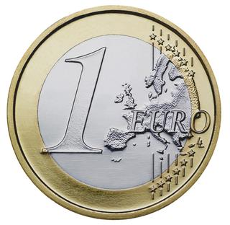
How much more would you need with each amount to make €1 ?
27c
52c
10c
74c
39c
46c
82c
63c

Slide 15
Friday
(1) Follow the link below or type the address in your browser:
www.matific.com/class
(2) Enter the Class Code: 912IJX
(3) Enter your username and password that you have from last week
(4) Select ‘schoolwork’ on the left hand side
(5) Have fun

Slide 16
Monday

Slide 17
Challenge - using a ruler and a pencil, draw lines the lengths stated below.
2cm
5cm
4cm
10cm
15cm
11cm
17cm
8cm
How do I use a ruler to measure a length?
What mistakes could I make?
Remember to start your line at 0 cm .

Slide 18
Extra Challenge
If you found it really easy to draw those lines, try drawing a line 20cm longer than each of those lengths.
Tip : You might need to use your ruler twice for some lines.
How long is your ruler? If its 30cm long, and I want to draw a line of 35cm, I will first draw a 30cm line, then move my ruler and then draw a 5cm line.
Don’t forget! Label your lines and check them at the end by measuring them with your ruler.
2cm + 20 cm =
5cm + 20 cm =
4cm + 20 cm =
10cm + 20 cm =
15cm + 20 cm =
11cm + 20 cm =
17cm + 20 cm =
8cm + 20 cm =

Slide 20
Write the following numbers in your copy;
One hundred and forty nine
One hundred and fifty six
One hundred and seventy seven
One hundred and nineteen
One hundred and thirty eight
One hundred and sixty four
One hundred and twenty nine

Slide 21
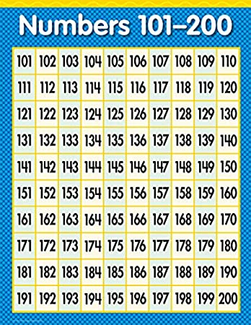
Find the number that is ….
5 more than 165
40 less than 189
20 more than 114
18 less than 199
30 more than 138
14 less than 178
22 more than 144
Remember to jump in tens when you need to!

Slide 23
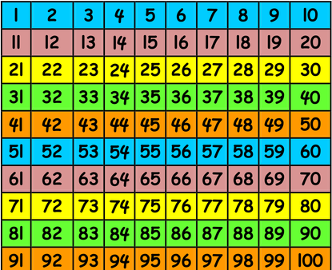
Remember – sometimes you may need to draw a picture in your rough work to help work it out. You can also use your 100 square.

Slide 24
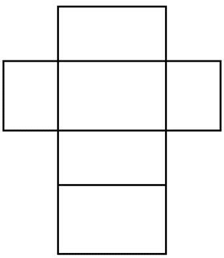
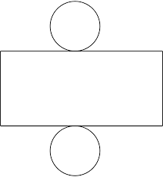
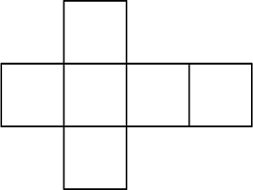
Can you recognise the net of these 3D shapes?
If that’s really easy, try making them yourself .
Draw (use a ruler for straight lines, and trace around something for circles)
Colour if you like
Cut
Stick using glue or sellotape
Ask an adult to send your teacher a picture on Aladdin Connect

Slide 26
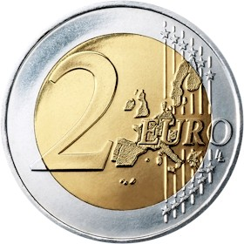
How much more would you need with each amount to make €2 ?
€1.70 €1.00
50 c €1.10
€1.20 €1.99
€1.40 80 c

Slide 27
What is the value of each group of coins?
a) g)
b) d) h)
c) (e) i)
f) j)
a)

Slide 28
Friday
(1) Follow the link below or type the address in your browser:
www.matific.com/class
(2) Enter the Class Code: 912IJX
(3) Enter your username and password that you have from last week
(4) Select ‘schoolwork’ on the left hand side
(5) Have fun!

Slide 29
Well done!
You have worked hard at your Maths for 2 more weeks.
We would love to see some of your work on Aladdin Connect.
We may even have some dojo points to give out as a reward!

