Slide 1
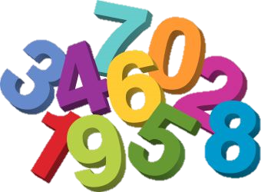
Numeracy – Second Class Module 4: Week 7 – 18th_22nd May Week 8 – 25th May_29th May

Slide 2
Module 4 work at a glance
Your child will need a copy and a pencil each day
Week 7’s topic = Measure – capacity (litres)
Your child will need a measuring beaker, an empty yogurt carton and various kitchen utensils.
Week 8’s topic = Measure – weight (kgs)
Your child will need a kitchen scales.
Friday is Fun in the Kitchen!

Slide 3
Week 7 – 18th May_22nd May Capacity

Slide 4
Monday Let’s have fun this week!
Capacity is the maximum amount of liquid that a container can hold
Watch the video below:
https://www.youtube.com/watch?v=TPFQd7ZjErU

Slide 5
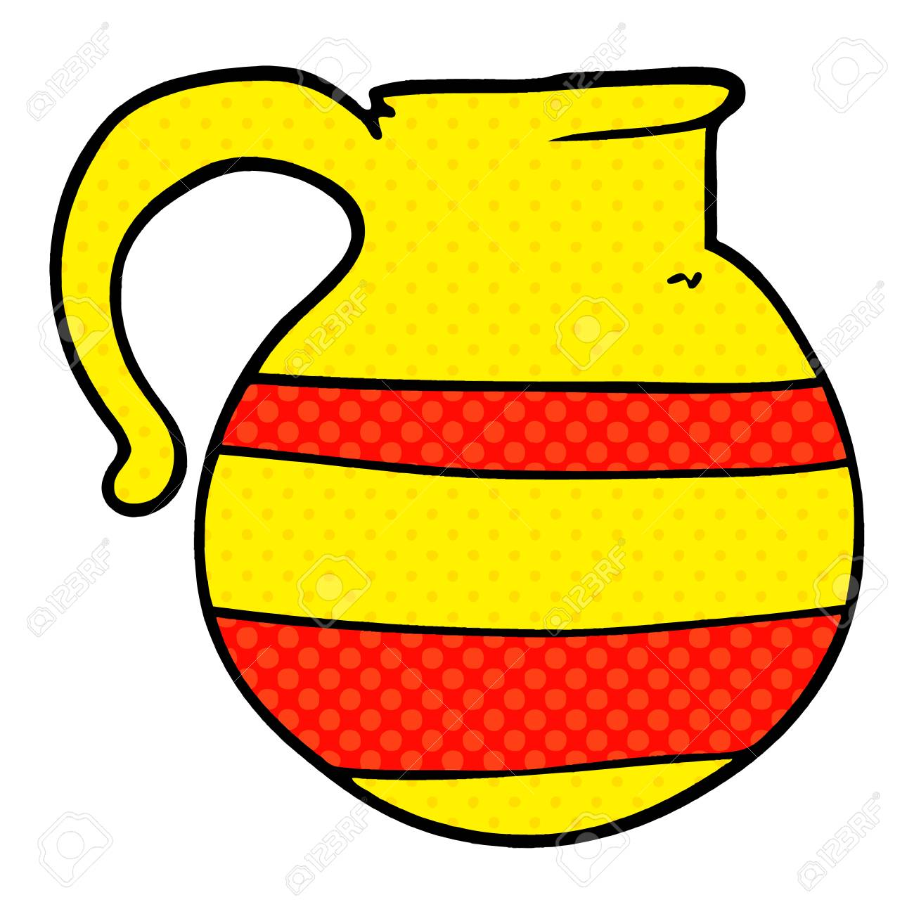
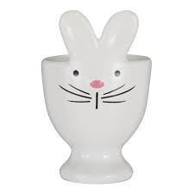
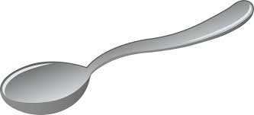
egg cup
spoon
cup
jug
bucket
Complete these sentences in your copy:
The_____________ holds more than the cup.
The jug holds more than the_____________.
The egg cup holds more than the ________________.
The spoon holds less than the_________________________.
The jug holds less than the __________________________.
The ______________ has the most capacity.

Slide 6
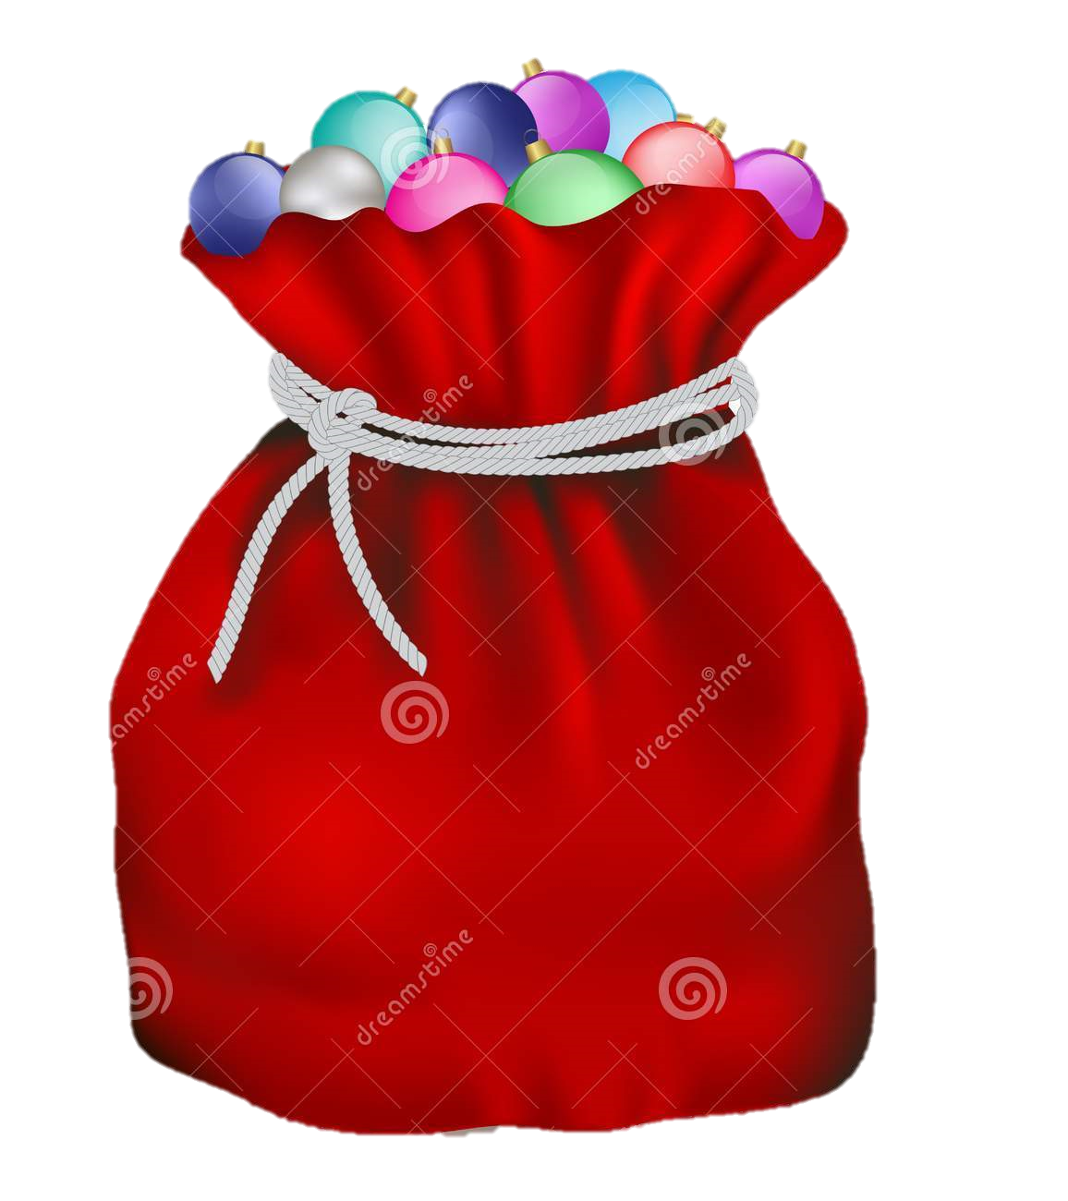
…….Monday
I am between May and September and I have 30 days, what month am I ?
Amy scores 62 points on her computer game and then 19 more points, how
much has she scored altogether?
3. Amelia is 8, Ava is 2 years older than Amelia and Caoimhe is 5 years older
than Ava, how old is Caoimhe?
4. There are 2 children in Second Class. Each child has 2 balls. They put all the
balls equally into 2 bags.
How many balls are in each bag?

Slide 7
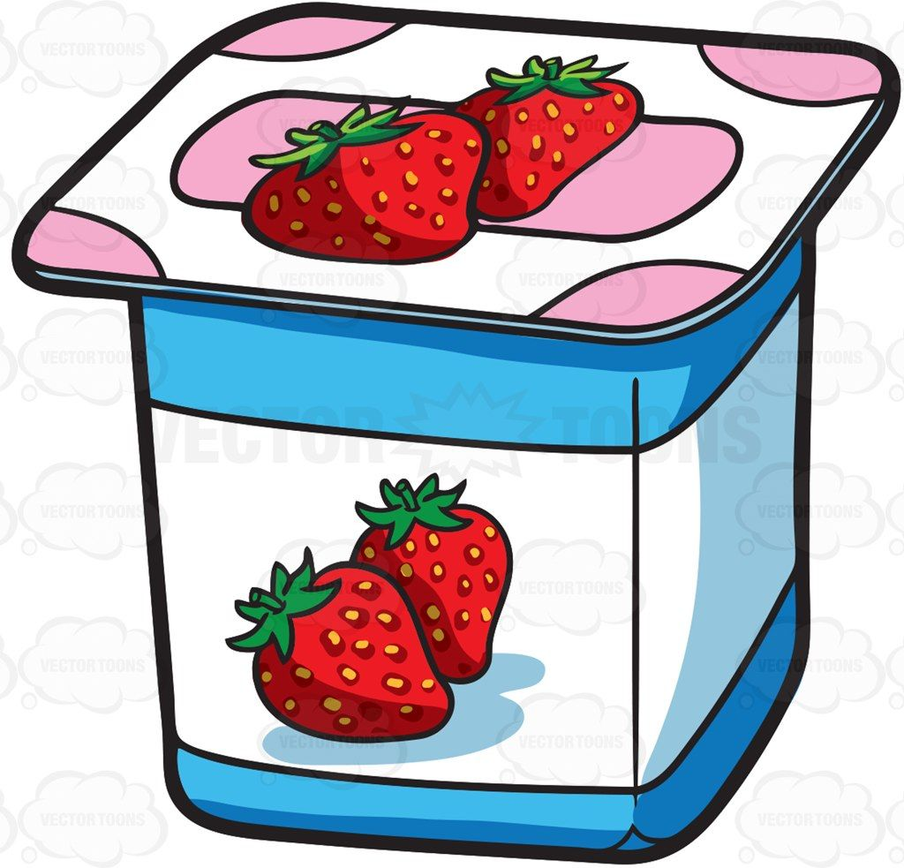
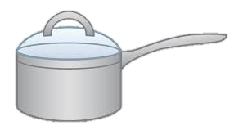
Tuesday
How many cartonfuls of water will it take to fill each container below. Draw this table in your copy and fill it out:
 | Estimate (Don’t cheat!) | Measure | What is the difference between your estimate and your measure?

Slide 8
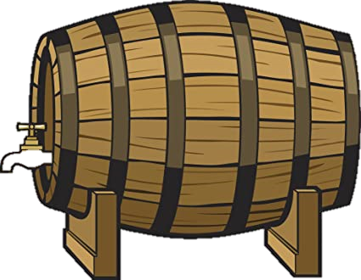
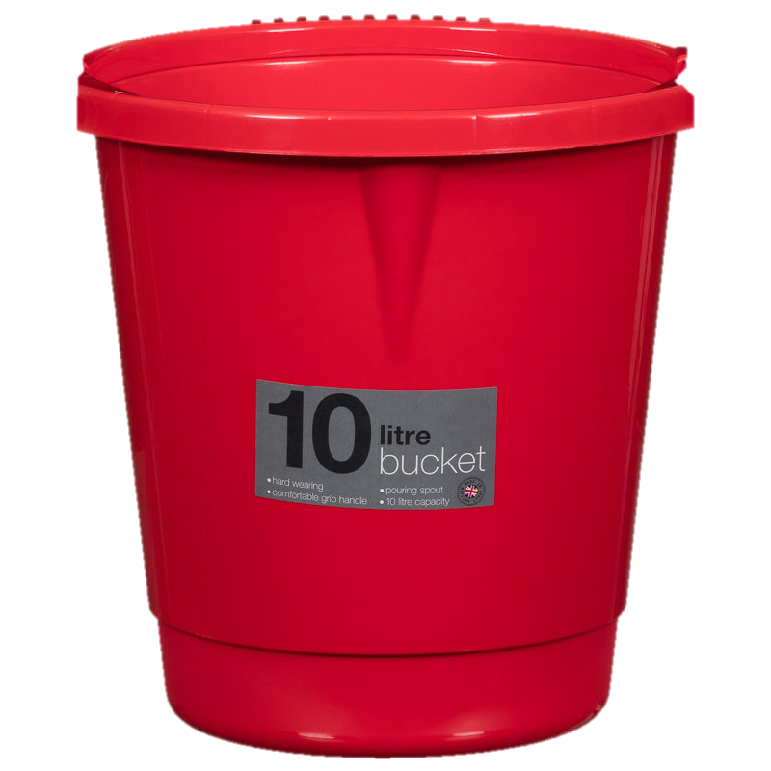
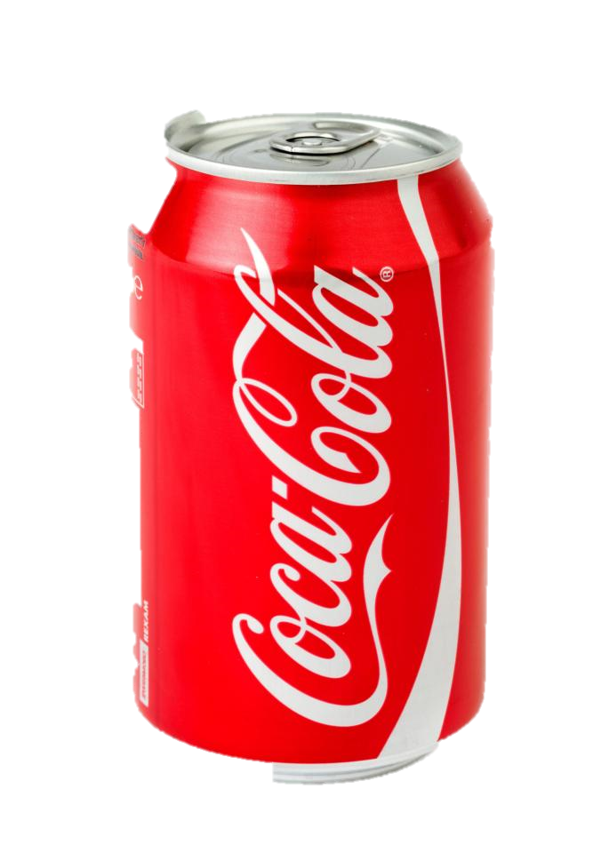
…….Tuesday
1.) A barrel of beer holds 16 litres. It is divided equally between 2 smaller
barrels. How many litres are in each barrel ?
2.) Each pack of coke has 10 one-litre cans. How many litres are in 9 packs?
Challenge question……
Ms. Leonard uses a 10 litre bucket to fill the paddling pool. She pours 6 full
buckets into the pool but it is only ½ full, what is the capacity of the pool?

Slide 9
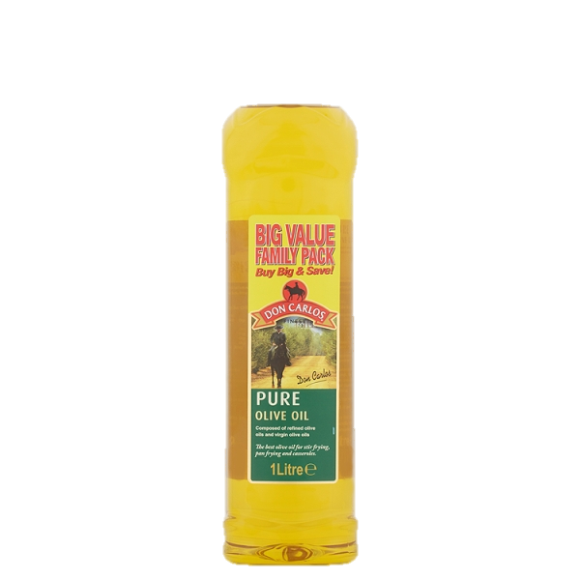
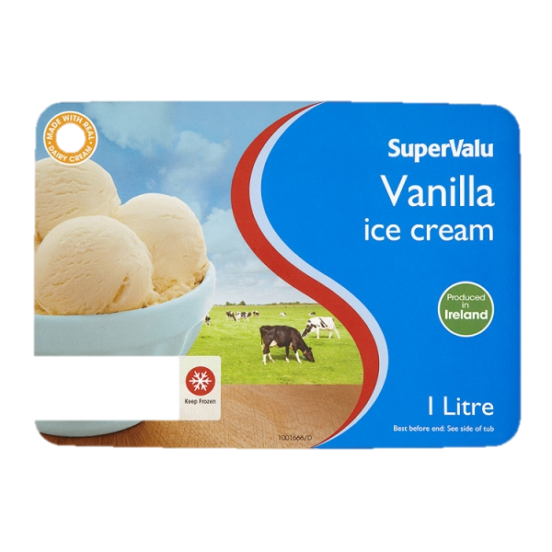
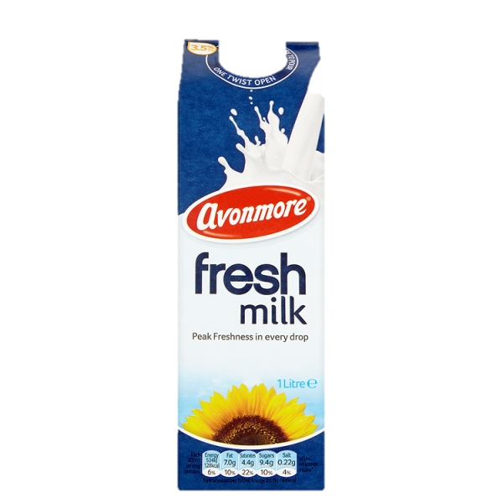
Wednesday
Capacity is measured in litres. Today, find containers that are
in litres and draw them in your copy, you can also upload photos to
Aladdin Connect with the help of a grown-up.
Examples:

Slide 10
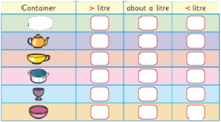
Estimate and Measure in Litres….
You can use a 1 litre beaker or any litre container for this task…..
Use a litre measure to find out whether these containers hold more than a litre, less than a
litre or about a litre.

Slide 11
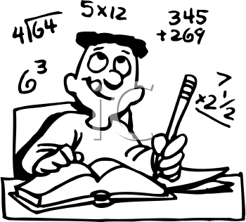
http://data.cjfallon.ie/resources/19626/activity-145/index.html
How good are you at estimating? Test yourself,
copy and paste the link below into your browser and have fun!

Slide 12
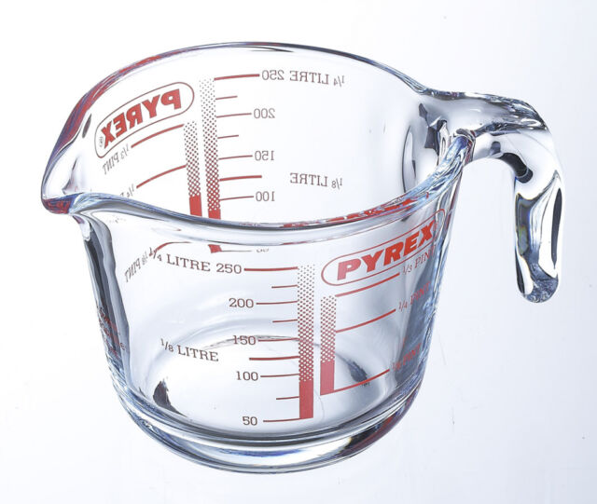
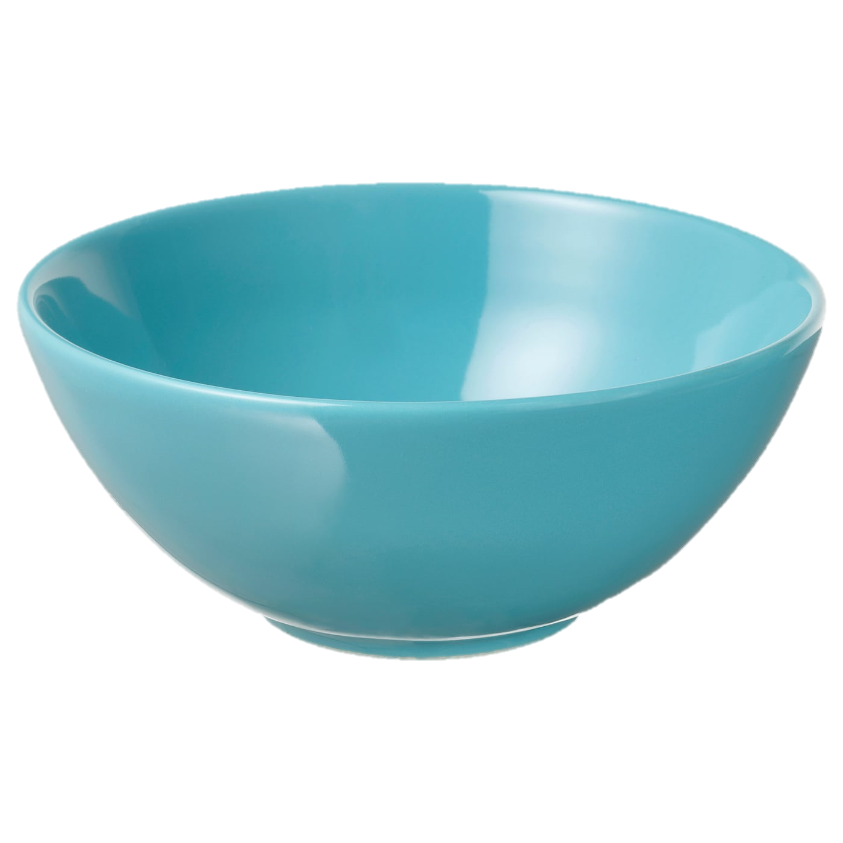
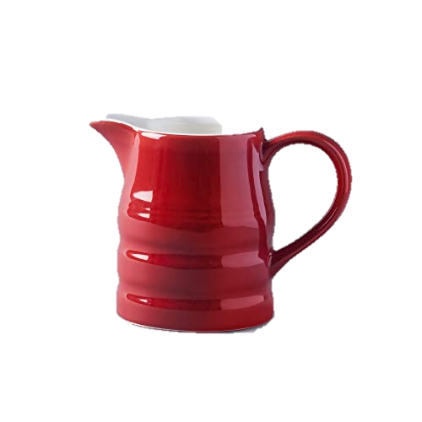
Thursday – ¼ Litre (250ml)
1 litres = ¼ litre + ¼ litre + ¼ litre + ¼ litre
You will need a measuring jug with ¼ litre measure, to
find how much these containers will hold…..
¼ litre is the same as 250ml
Container | > ¼ litre | about a ¼ litre | < ¼ litre

Slide 13
http://data.cjfallon.ie/resources/19626/activity-146/index.html
How good are you at sharing litres..test yourself,
copy and paste the link below into your browser!

Slide 14
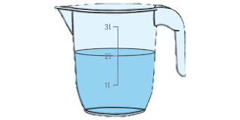
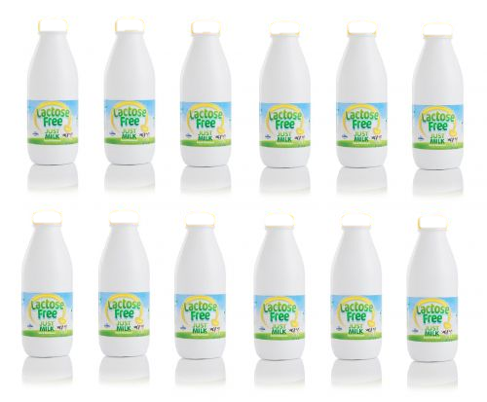
…….Thursday
1.) How much more liquid is needed to fill this jug.
2.) Ms. Nestor buys twelve 1 litre bottles of milk. She divides the 12 bottles
equally into 2 shelves. How many litres of milk is on each shelf ?
Challenge question……
I am less than 60 litres and more than 50 litres. The sum of
my two digits is 9… what am I?

Slide 15
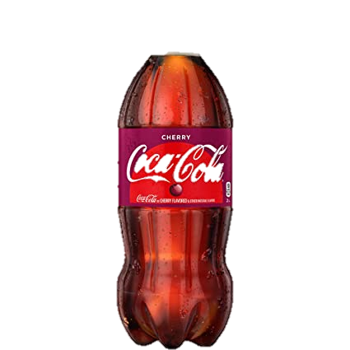
Friday
1 litre = ½ litre + ½ Litre
1 litre = ¼ litre + ¼ litre + ¼ litre + ¼ litre
) A litre of cherry cola costs 80c, how much does ½ litre cost?
2.) Ms. Lawless drank ¼ litre of milk at 8am and ¼ litre at 11 am,
how much milk did Ms. Lawless drink altogether?
Challenge question……
I had 40 litres of coke for my party, my brother drank 12 litres,
I spilled 5 and a half litres, how many litres did I have left?

Slide 16
http://data.cjfallon.ie/resources/19626/activity-147/index.html
Can you tell how much liquid is in a jug…..test yourself,
copy and paste the link below into your browser!

Slide 17
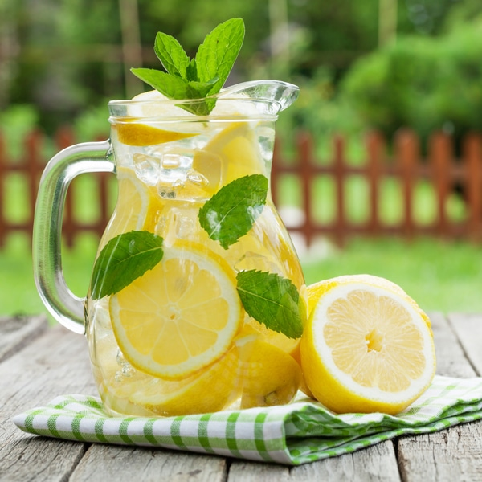
Homemade Lemonade Try this recipe or one of your own, make sure an adult supervises your work. Post a photo on Aladdin Connect and we can share it on the school website.
You will need:
500ml (1/2 litre) of water.
Juice of 4 lemons
1 cup of sugar
Method:
Measure out the water using a jug.
Combine the water and sugar in a saucepan.
With a grown-up, bring to the boil over high heat, stirring to dissolve the sugar.
Halve and juice the lemons.
Remove the sugar syrup from the heat and stir in the lemon juice and let cool.
Fill ¼ glass with the syrup and add water and ice cubes, enjoy!

Slide 18
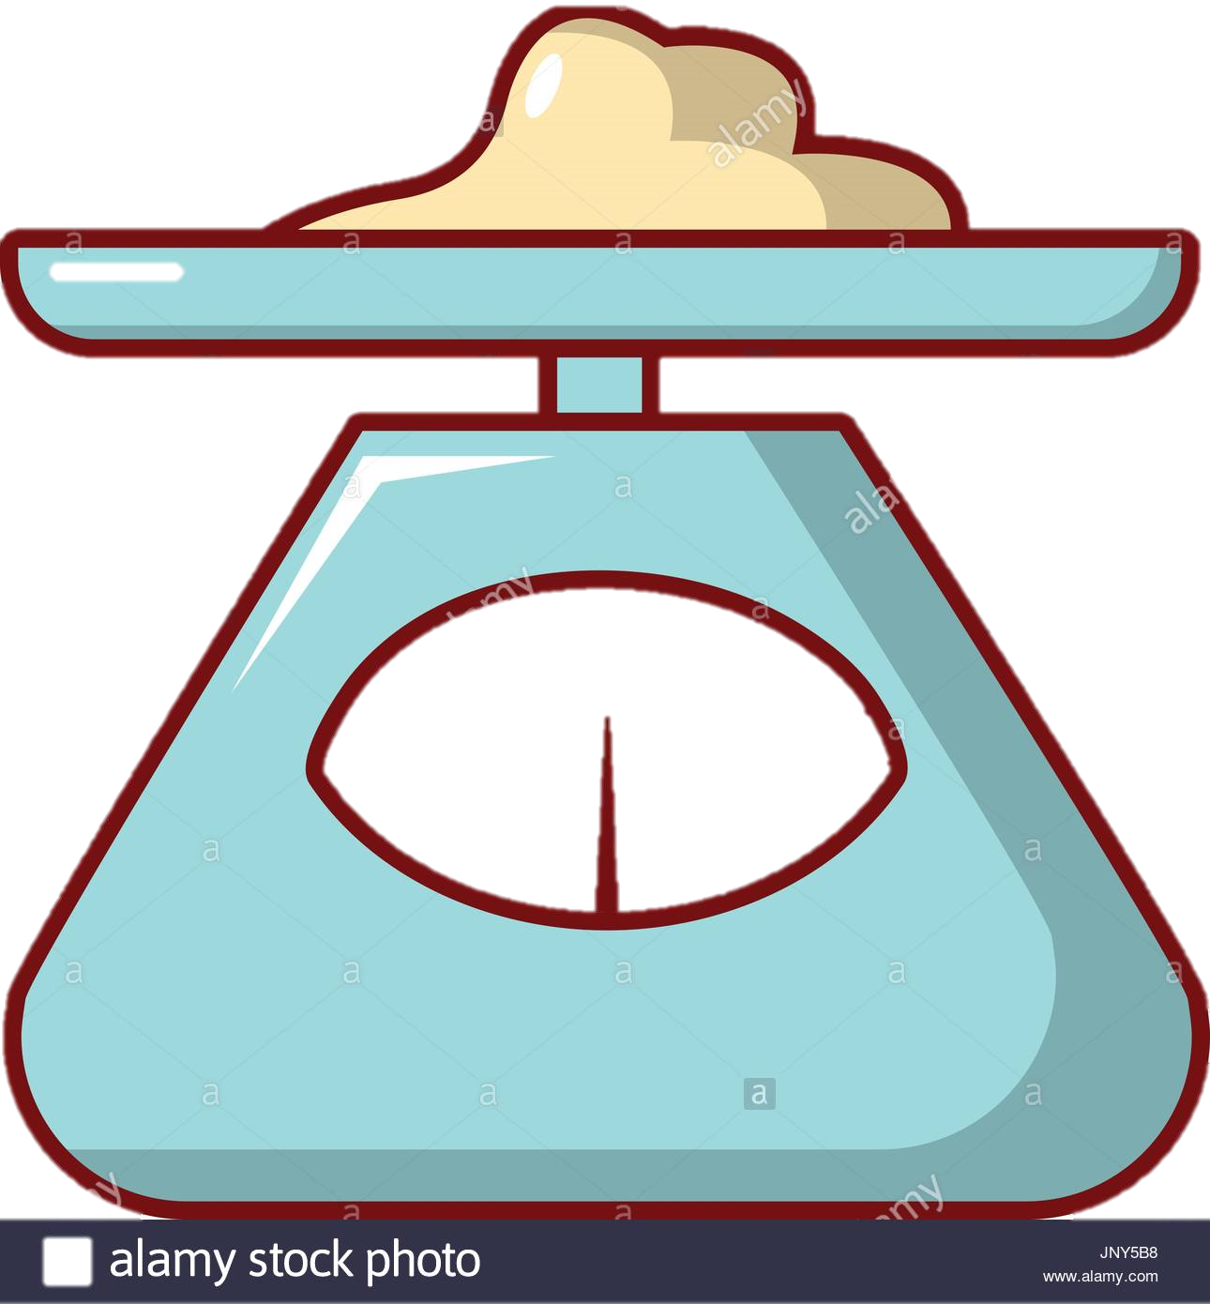
Week 8 – 25th May_29th May Weight

Slide 19
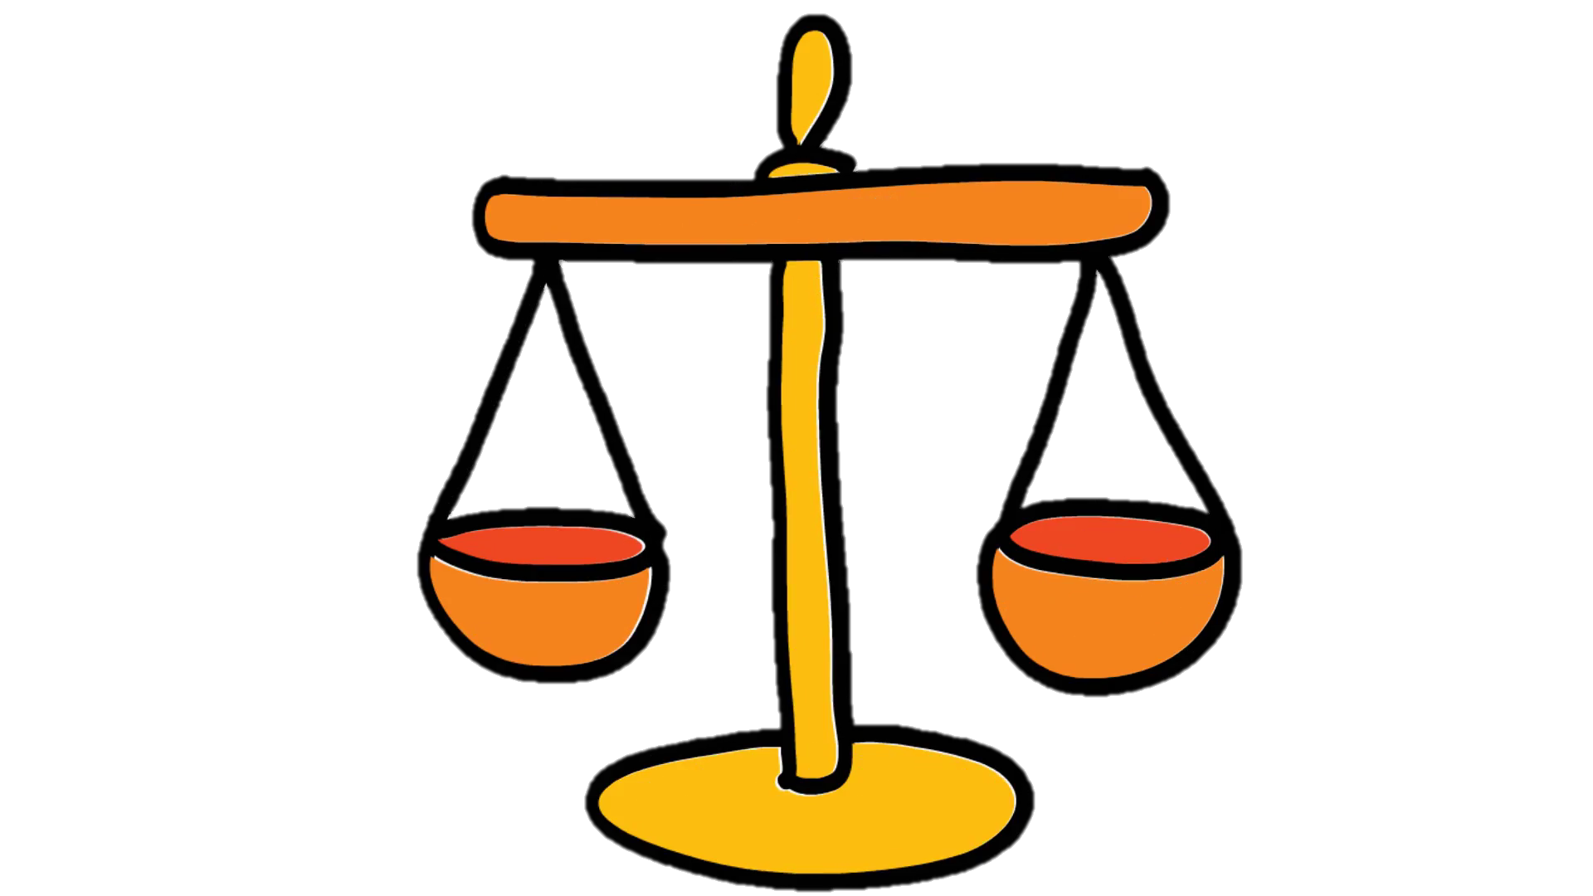
Monday Let’s have fun this week!
Watch the video below to learn
about heavier and lighter:
https://www.youtube.com/watch?v=ybEU-6U7s8k

Slide 20
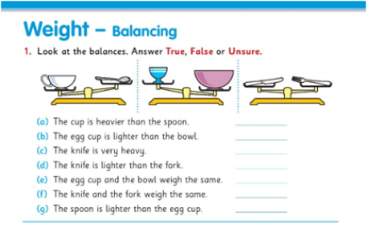
Which is heavier….?
(1) Look at the balances and decide
whether each sentence is… true or false.
(2) In your copy, draw two objects on a
scale, one heavier than the other, and write
a sentence about them.

Slide 21
http://data.cjfallon.ie/resources/19626/activity-104/index.html
How good are you at weighing ?..test yourself,
copy and paste the link below into your browser!

Slide 22
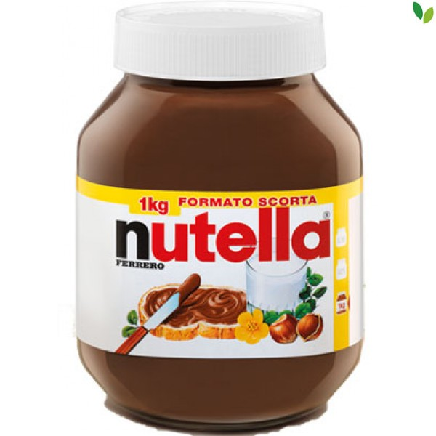
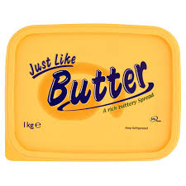
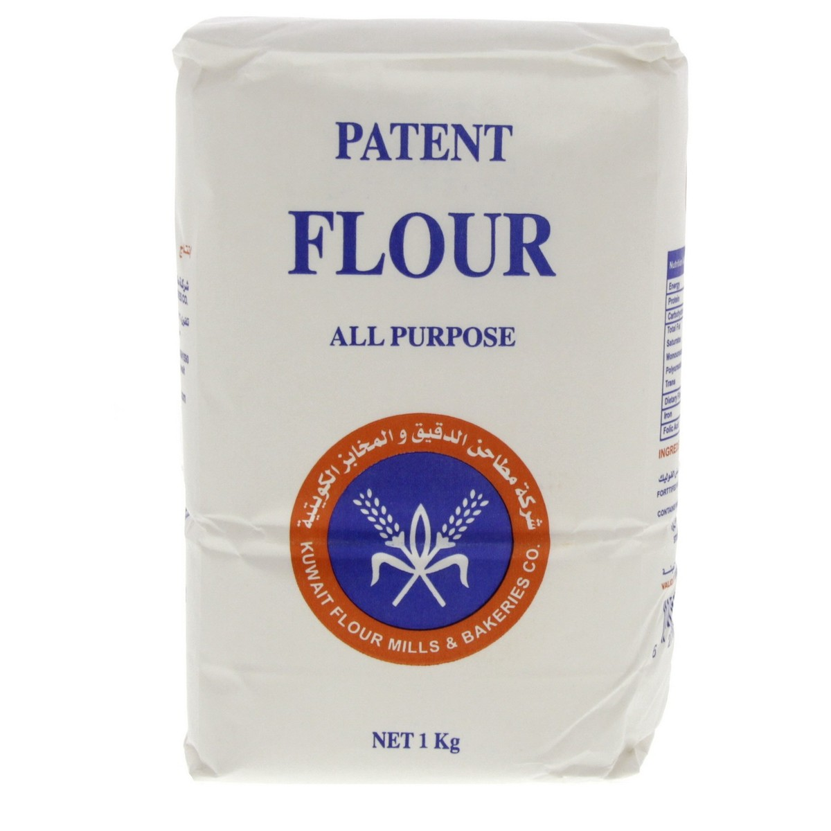
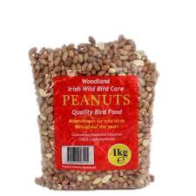
Tuesday
Weight is measured in kilograms (kgs). Today, find food in your kitchen that weigh 1kg and draw them in your copy, you can also upload photos to Aladdin Connect with the help of a grown-up. Some examples are:

Slide 23
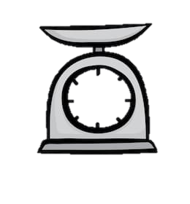
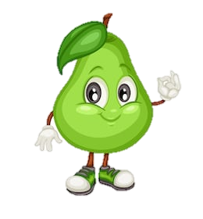
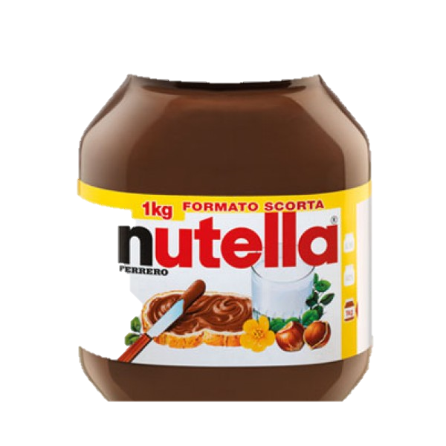
Tuesday
Ava weighs 48g of flour. She takes 11g of flour off the scales. How many grams of flour are left?
2. Sophie buys 2 bags of pears. One weighs 6kg, the other 2kg. What is the
difference in the weights of the bags?
Challenge question……
Claire buys 10 jars of Nutella weighing 3kg each, she gives 2 jars
to Summer, how many kg of Nutella does she have left?

Slide 24
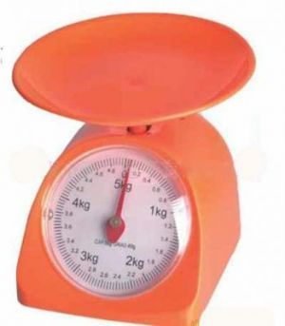
Wednesday
You will need a kitchen scales for this, ask a grown up to show you
where 1kg is on your scales. Most kitchen scales go up to 5kg.
1kg

Slide 25
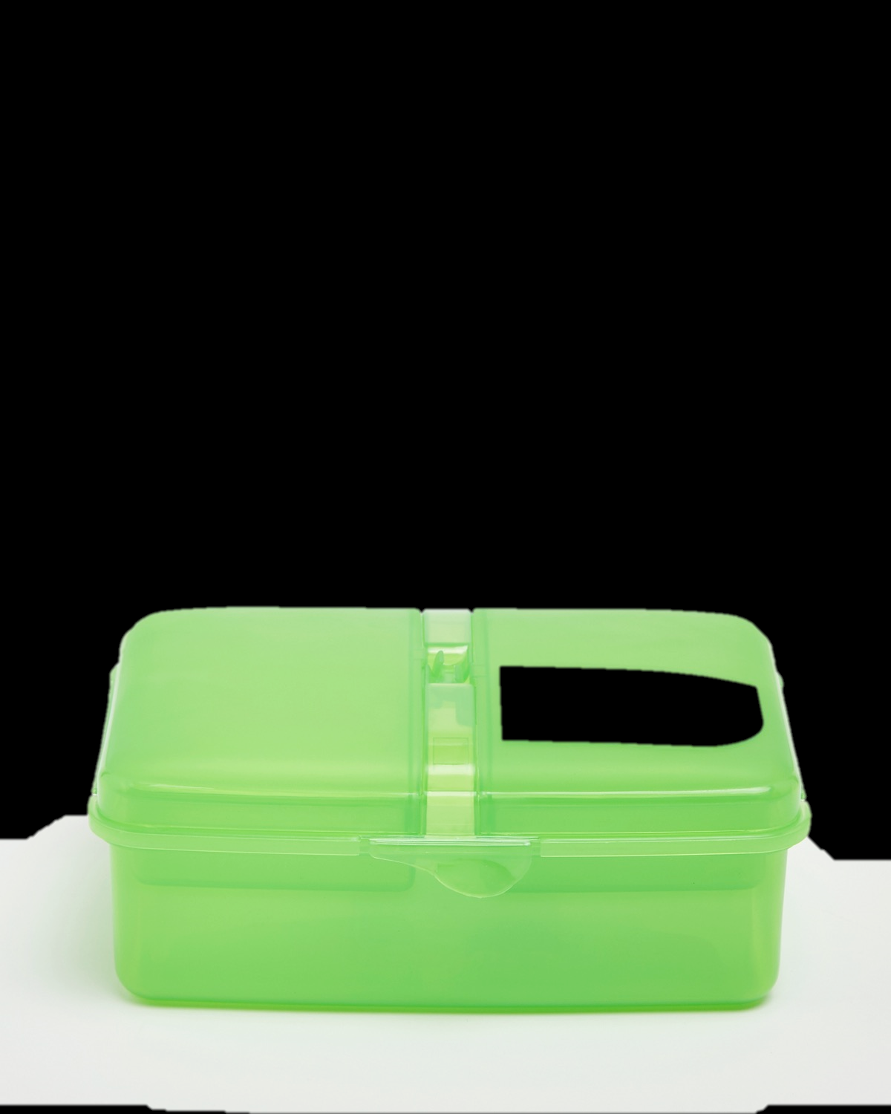
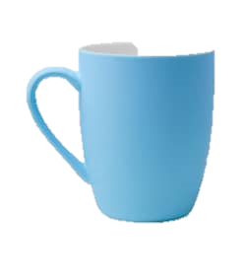
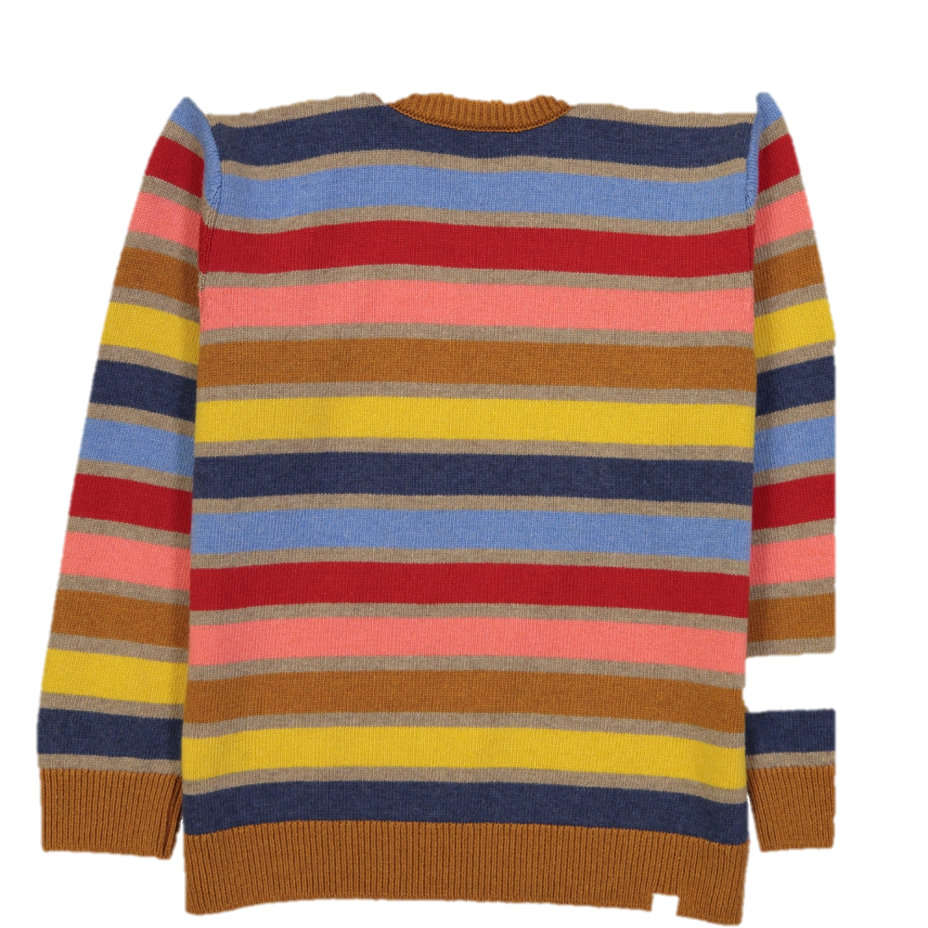
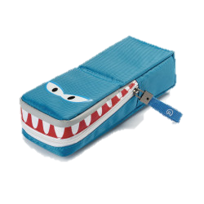
Estimate and Measure in Kilograms (Kgs)
 | > Kg (More than a kg) | =Kg the same as kg | <Kg (less than a kg)
Pencil
Lunch box
Cup
Jumper
A book
Pencil case
Draw this table in your copy, feel the weight of each item in your hand and decide whether it’s more than 1kg, less than 1kg
or the same as 1kg. Test your estimate by weighing each item on a kitchen scale and fill out the table…. Have fun!

Slide 26
http://data.cjfallon.ie/resources/19626/activity-106/index.html
How good are you now at estimating weight? test yourself…..
copy and paste the link below into your browser!

Slide 27
Thursday – ½ Kg
1kg = ½ kg + ½ kg, 1kg = 1000g, ½ kg = 500g
Ask a grown up to show you 500g on a weighing scales and
answer these questions in your copy….
1.) What is ½ kg + ½kg
2.) How many ½ kg are in 1kg ?
3.) How many grams are in 1kg?

Slide 28
Thursday - ¼ kg
1kg = ¼ kg + ¼ kg + ¼ kg + ¼ kg , ¼kg = 250g
½ kg = ¼ kg + ¼ kg
Ask a grown up to show you 250g on a weighing scales and
answer these questions in your copy….
1.) What is ¼kg + ¼ kg
2.) How many ¼ kg are in 1kg ?
3.) How many grams are in ¼ kg

Slide 29
http://data.cjfallon.ie/resources/19626/activity-107/index.html
What do you know about ½ kg and ¼ kg? Test yourself,
copy and paste the link below into your browser!

Slide 30
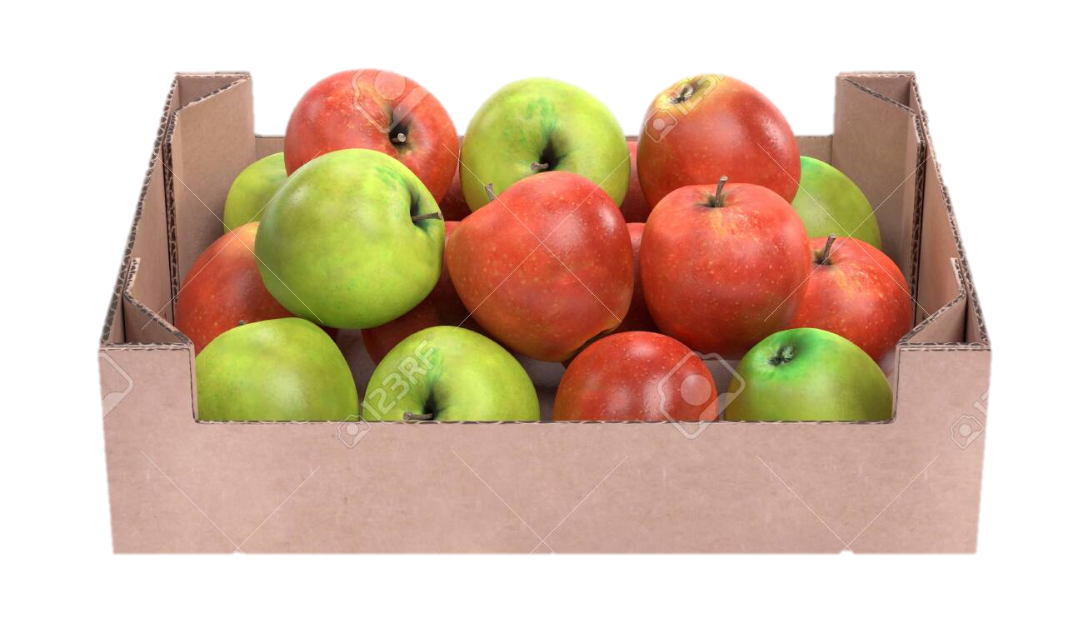
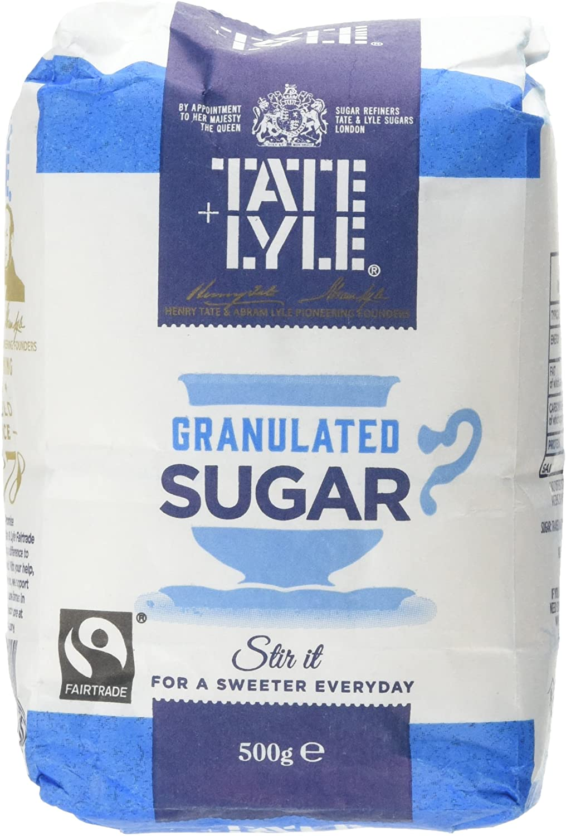
Friday
A box of apples weighs 22kg. Then 9kg of apples are sold. What
is the weight of the apples left in the box?
2. A large bag of sugar weighs 8kg. How many 2k bags can be filled from
the large bag?
Challenge question……
Caoimhe buys 4 bars of chocolate each weighing 500g,
what is the total weight of Caoimhe’s chocolate?

Slide 31
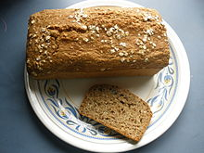
Irish Brown Bread
Try this recipe or one of your own (make sure an adult supervises your work), post a photo on Aladdin Connect and we can share it on the school website. Remember to share your recipes with the rest of the school!
Ingredients
200g plain white bread
250g wholemeal flour
1 teaspoon bread soda, sieved
1 teaspoon salt
1 egg
350ml buttermilk
1 teaspoon of honey
Method:
Preheat the oven to 200 degrees Celsius.
Mix the flour, salt and bread soda together in a bowl.
Combine the egg with the buttermilk and honey and mix in with the flour.
Pour the dough into a lightly-oiled loaf tin.
Sprinkle with seeds of your choice.
Bake for 40 – 45 minutes!

Slide 32
Well done, you are finished this fortnight’s work
Make sure to post some of your work to Aladdin Connect!

