Slide 1
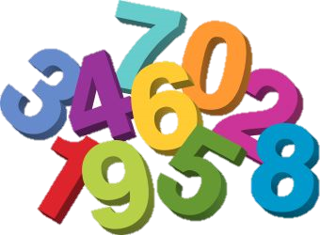
Numeracy – Second Class Module 2: Week 3 – 20_24th April Week 4 – 27th April_1st May

Slide 2
Module 2 work at a glance
Your child will need a copy and a pencil each day
Each day there will be a warm-up activity such as a word problem.
Parents….Fridays are fun with teacher-selected games on Matific, please help your child set up the Matific account the first time they use it, instructions are available on the Friday slide.
Week 3’s topic is time – months, season and calendars.
Week 4’s topic is 3-d shape

Slide 3
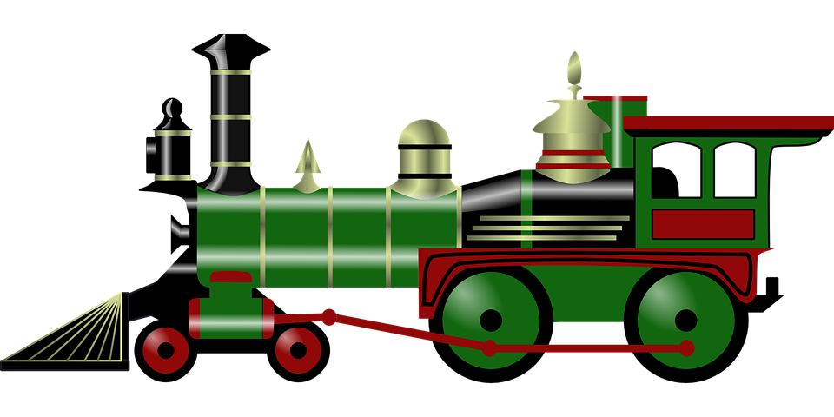
Monday
Skip count in 2’s this morning up to 40.
A train arrived at Cork station at 1 o’clock in the afternoon. It had left Dublin 3 hours earlier. At what time did the train leave Dublin?
Move the brown cylinder to find the answer
10 o’clock

Slide 4
https://www.youtube.com/watch?v=yQMBSJhUCAs
My Day
1. Open this link to the story ‘It’s About Time’ by Stuart Murphy
2. Write the sentences in your copy, fill in the gaps with the time and one of the words below.
evening morning noon afternoon midnight night
I get up every ______________ at ____________o’clock.
When I am in school, I go to the big yard at ____________.
I have my lunch at ___ o’clock in the _______________.
I eat my dinner at ___ o’clock in the __________________.
I brush my teeth and go to bed at__ o’clock each __________.
At____o’clock, it is ______________ and I am fast asleep.

Slide 5
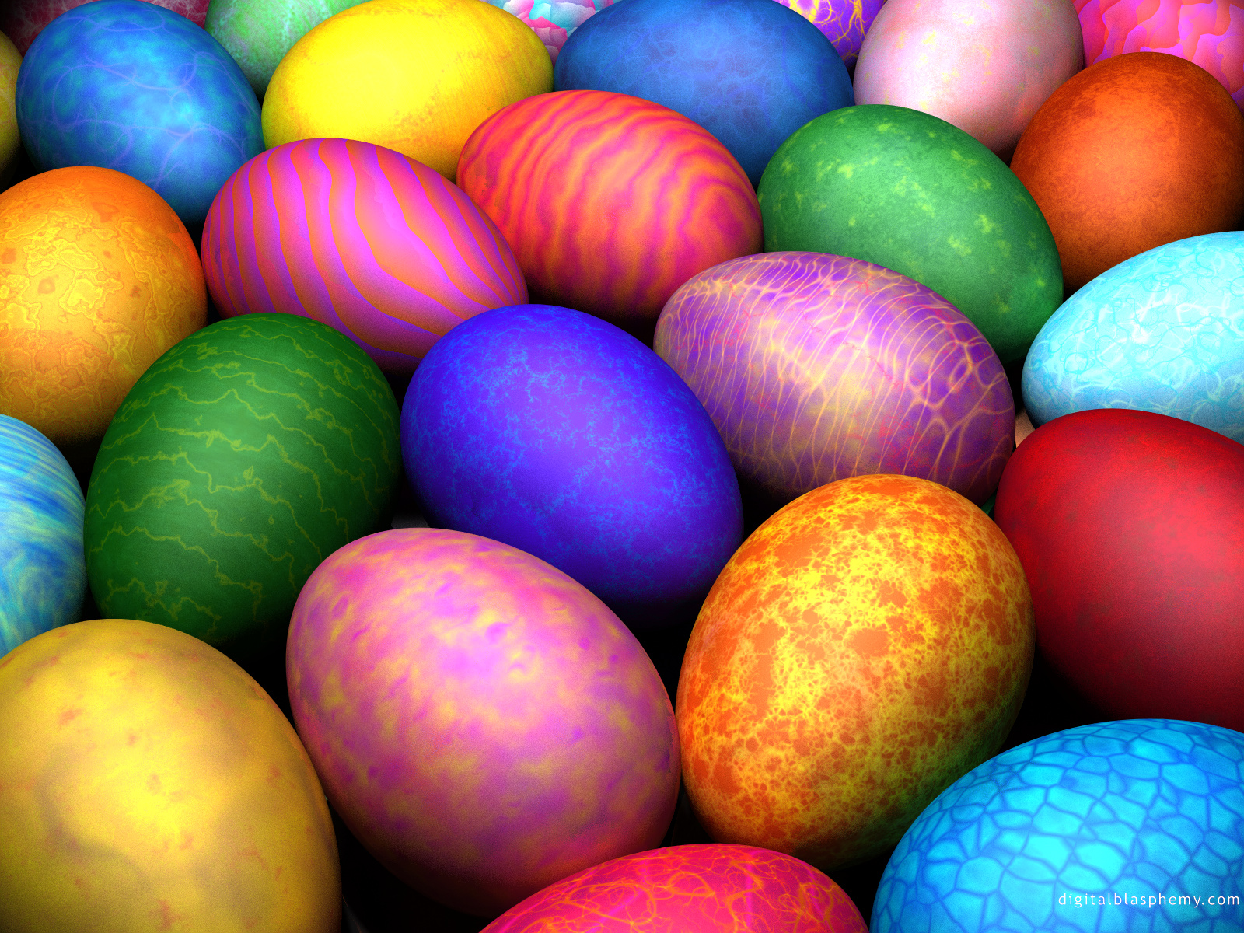
Tuesday
Skip count in 5’s this morning up to 80.
Susan liked Easter eggs, she got 15 from Auntie Claire, and 24 from Uncle Mike. On Monday she ate 4 eggs, on Tuesday she ate 2 eggs and on Thursday she ate 1 egg. On Friday she felt very sick and decided to give all her eggs to her to her teacher. How many eggs did she give to her teacher?
Move the red oval to find the answer
32

Slide 6
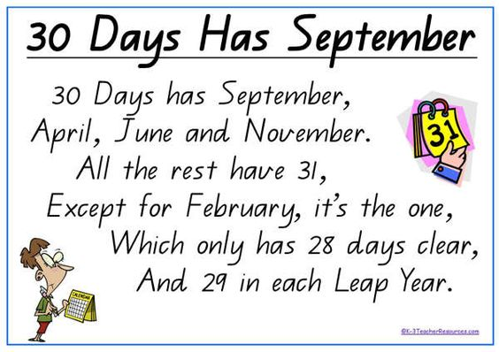
Learn this poem by the end of this week…..

Slide 7
(1) How many days in May?
Answer the questions below in your copy
(2) How many days does February have in a leap year ?
(3) How many days altogether in March and April?
(4) How many days in the 12th month of the year?
(5) How many days in the 8th and 11th months of the year
altogether?

Slide 8
Wednesday
Assumption Junior School visit a farm. They use 2 buses.
Each bus has 8 adults and 40 children.
(1) How many adults are on the 2 buses.
(2) How many children are on the 2 buses.
Move the red rectangles to find the answers
1.
16
2.
80

Slide 9
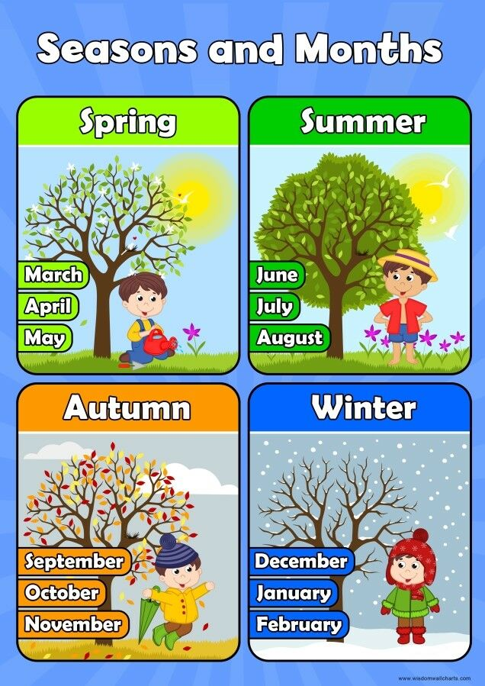
Answer these questions in your copy…..
What are the months of Spring?
In which season does your birthday fall?
What year were you born?
In which season do we start school each year?
In which season do we celebrate Halloween?

Slide 10
Thursday
Cara bakes some cakes. On each cake she puts 10 jelly sweets.
Altogether she uses 50 jelly sweets. How many cakes does she bake?

Slide 11
Claire’s April Calendar
Monday | Tuesday | Wednesday | Thursday | Friday | Saturday | Sunday
 |  | 1 | 2 | 3 dancing | 4 | 5 Granny’s
6 Karate class | 7 | 8 | 9 | 10 dancing | 11 cinema | 12
13 | 14 | 15 Ann’s party | 16 | 17 dancing | 18 | 19 Granny’s
20 Karate class | 21 | 22 | 23 | 24 dancing | 25 | 26
27 | 25 | 29 | 30
How many days a week did Claire go dancing in April?
How many Thursdays are there in April ?
What date is the first Sunday in April ?
What day is the last day of April ?
What date did Claire go to Ann’s party ?
How many times did Claire go to karate during April ?
What day was the last day of March ?
What day is the first day of May ?
On which dates did Claire go to visit Granny ?

Slide 12
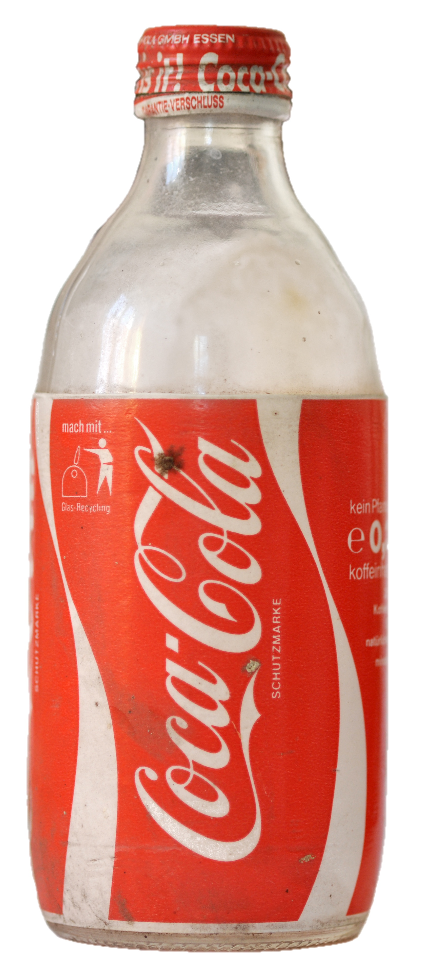
Friday
Recite all your doubles up to 20…
A bottle of Coke holds 2 litres. How much do 10 bottles of coke hold?
Move the yellow triangle to find the answer
20 Litres

Slide 13
Friday Fun!
** Parents/Guardians, we have set up some 2nd class games on the website Matific, please set up your child’s account, do not use their own name and surname, please follow the instructions below.
Follow the link below or type the address in your browser:
www.matific.com/class
(2) Enter the Class Code: 912IJX
(3) First name = Second Class Surname = any 4 digit number.
(4) Skip intro if you want
(5) Select ‘schoolwork’ on the left hand side
(6) Have fun

Slide 14
Monday
Put your finger on the right number on the 100 square:
I am 5 more than 20
I am 5 less than 14
I am 20 more than 34
I am 30 less than 66
I am 40 more than 21
I am between 75 and 77
I am 20 less than 100
I am 10 more than 52 + 2
I am 20 less than 73-3
I am 10 more than 14 + 5
1 | 2 | 3 | 4 | 5 | 6 | 7 | 8 | 9 | 10
11 | 12 | 13 | 14 | 15 | 16 | 17 | 18 | 19 | 20
21 | 22 | 23 | 24 | 25 | 26 | 27 | 28 | 29 | 30
31 | 32 | 33 | 34 | 35 | 36 | 37 | 38 | 39 | 40
41 | 42 | 43 | 44 | 45 | 46 | 47 | 48 | 49 | 50
51 | 52 | 53 | 54 | 55 | 56 | 57 | 58 | 59 | 60
61 | 62 | 63 | 64 | 65 | 66 | 67 | 68 | 69 | 70
71 | 72 | 73 | 74 | 75 | 76 | 77 | 78 | 79 | 80
81 | 82 | 83 | 84 | 85 | 86 | 87 | 88 | 89 | 90
91 | 92 | 93 | 94 | 95 | 96 | 97 | 98 | 99 | 100

Slide 15
3-D Shapes
Have a look at this video and learn all about 3d shapes
https://www.youtube.com/watch?v=61lZpLRnXUM

Slide 16
Cuboid
Cube
Find a cuboid in your house – remember, it has rectangular faces!
It could be a big cuboid like a cereal box.
Now, find a cube in your house, this could be a dice or a stock cube.

Slide 17
Cuboid
Draw the pictures of each shape and write the answers
to these questions in your copy:
How many faces does a cuboid have?
How many corners does a cuboid have?
How many edges does a cuboid have?
Cube
How many faces does a cube have?
How many corners does a cube have?
How many edges does a cube have?

Slide 18
Tuesday
Count in 10s up to 100
Recite your 1+ tables
I have 3 faces, 2 flat and one curved, I can roll, I can be
stacked and I can slide……what am I?
Did you get it right….?
cylinder

Slide 19
Cylinder
Sphere
Find a cylinder in your house – this could be a pringle box or even a cup.
Now, find a sphere in your house, this could be any type of ball.

Slide 20
cylinder
Draw the pictures of each shape and write the answers
to these questions in your copy:
How many faces does a cylinder have?
How many corners does a cylinder have?
How many edges does a cylinder have?
sphere
How many faces does a sphere have?
How many corners does a sphere have?
How many edges does a sphere have?

Slide 21
Wednesday
Count backwards from 20
Recite the 2+ tables
- I have one continuous face, no sides, no corners, I can roll,
I can’t slide and I can’t be stacked, what shape an I?
Move the red oval to reveal the answer
cylinder

Slide 22
Draw a picture of a cone and write the answers
to these questions in your copy:
How many faces does a cone have?
How many corners does a cone have?
How many edges does a cone have?

Slide 23
Thursday
Recite the 3+ tables
Count from 73 to 100
I have 2 faces, 1 flat and one curved, I can slide, I can’t roll and I can’t be stacked, what am I ?
Move the purple cylinder to find the answer
a cone

Slide 24
Stack, slide or roll ?
Today test whether your 3-d shapes can roll, slide or stack on
top of each other.
Listen to the stack, slide or roll song below when you are finished.
https://www.youtube.com/watch?v=AcsUQIxJKjY

Slide 25
Switch on your math’s eyes and look for shapes in your house and when out and about
The architect, Antoni Gaudí (1852-1926), created beautiful buildings using lots of different shapes. On the next page, look at the picture of one of his famous buildings ‘Casa Batlló’ in Spain, see which shapes you can spot

Slide 26
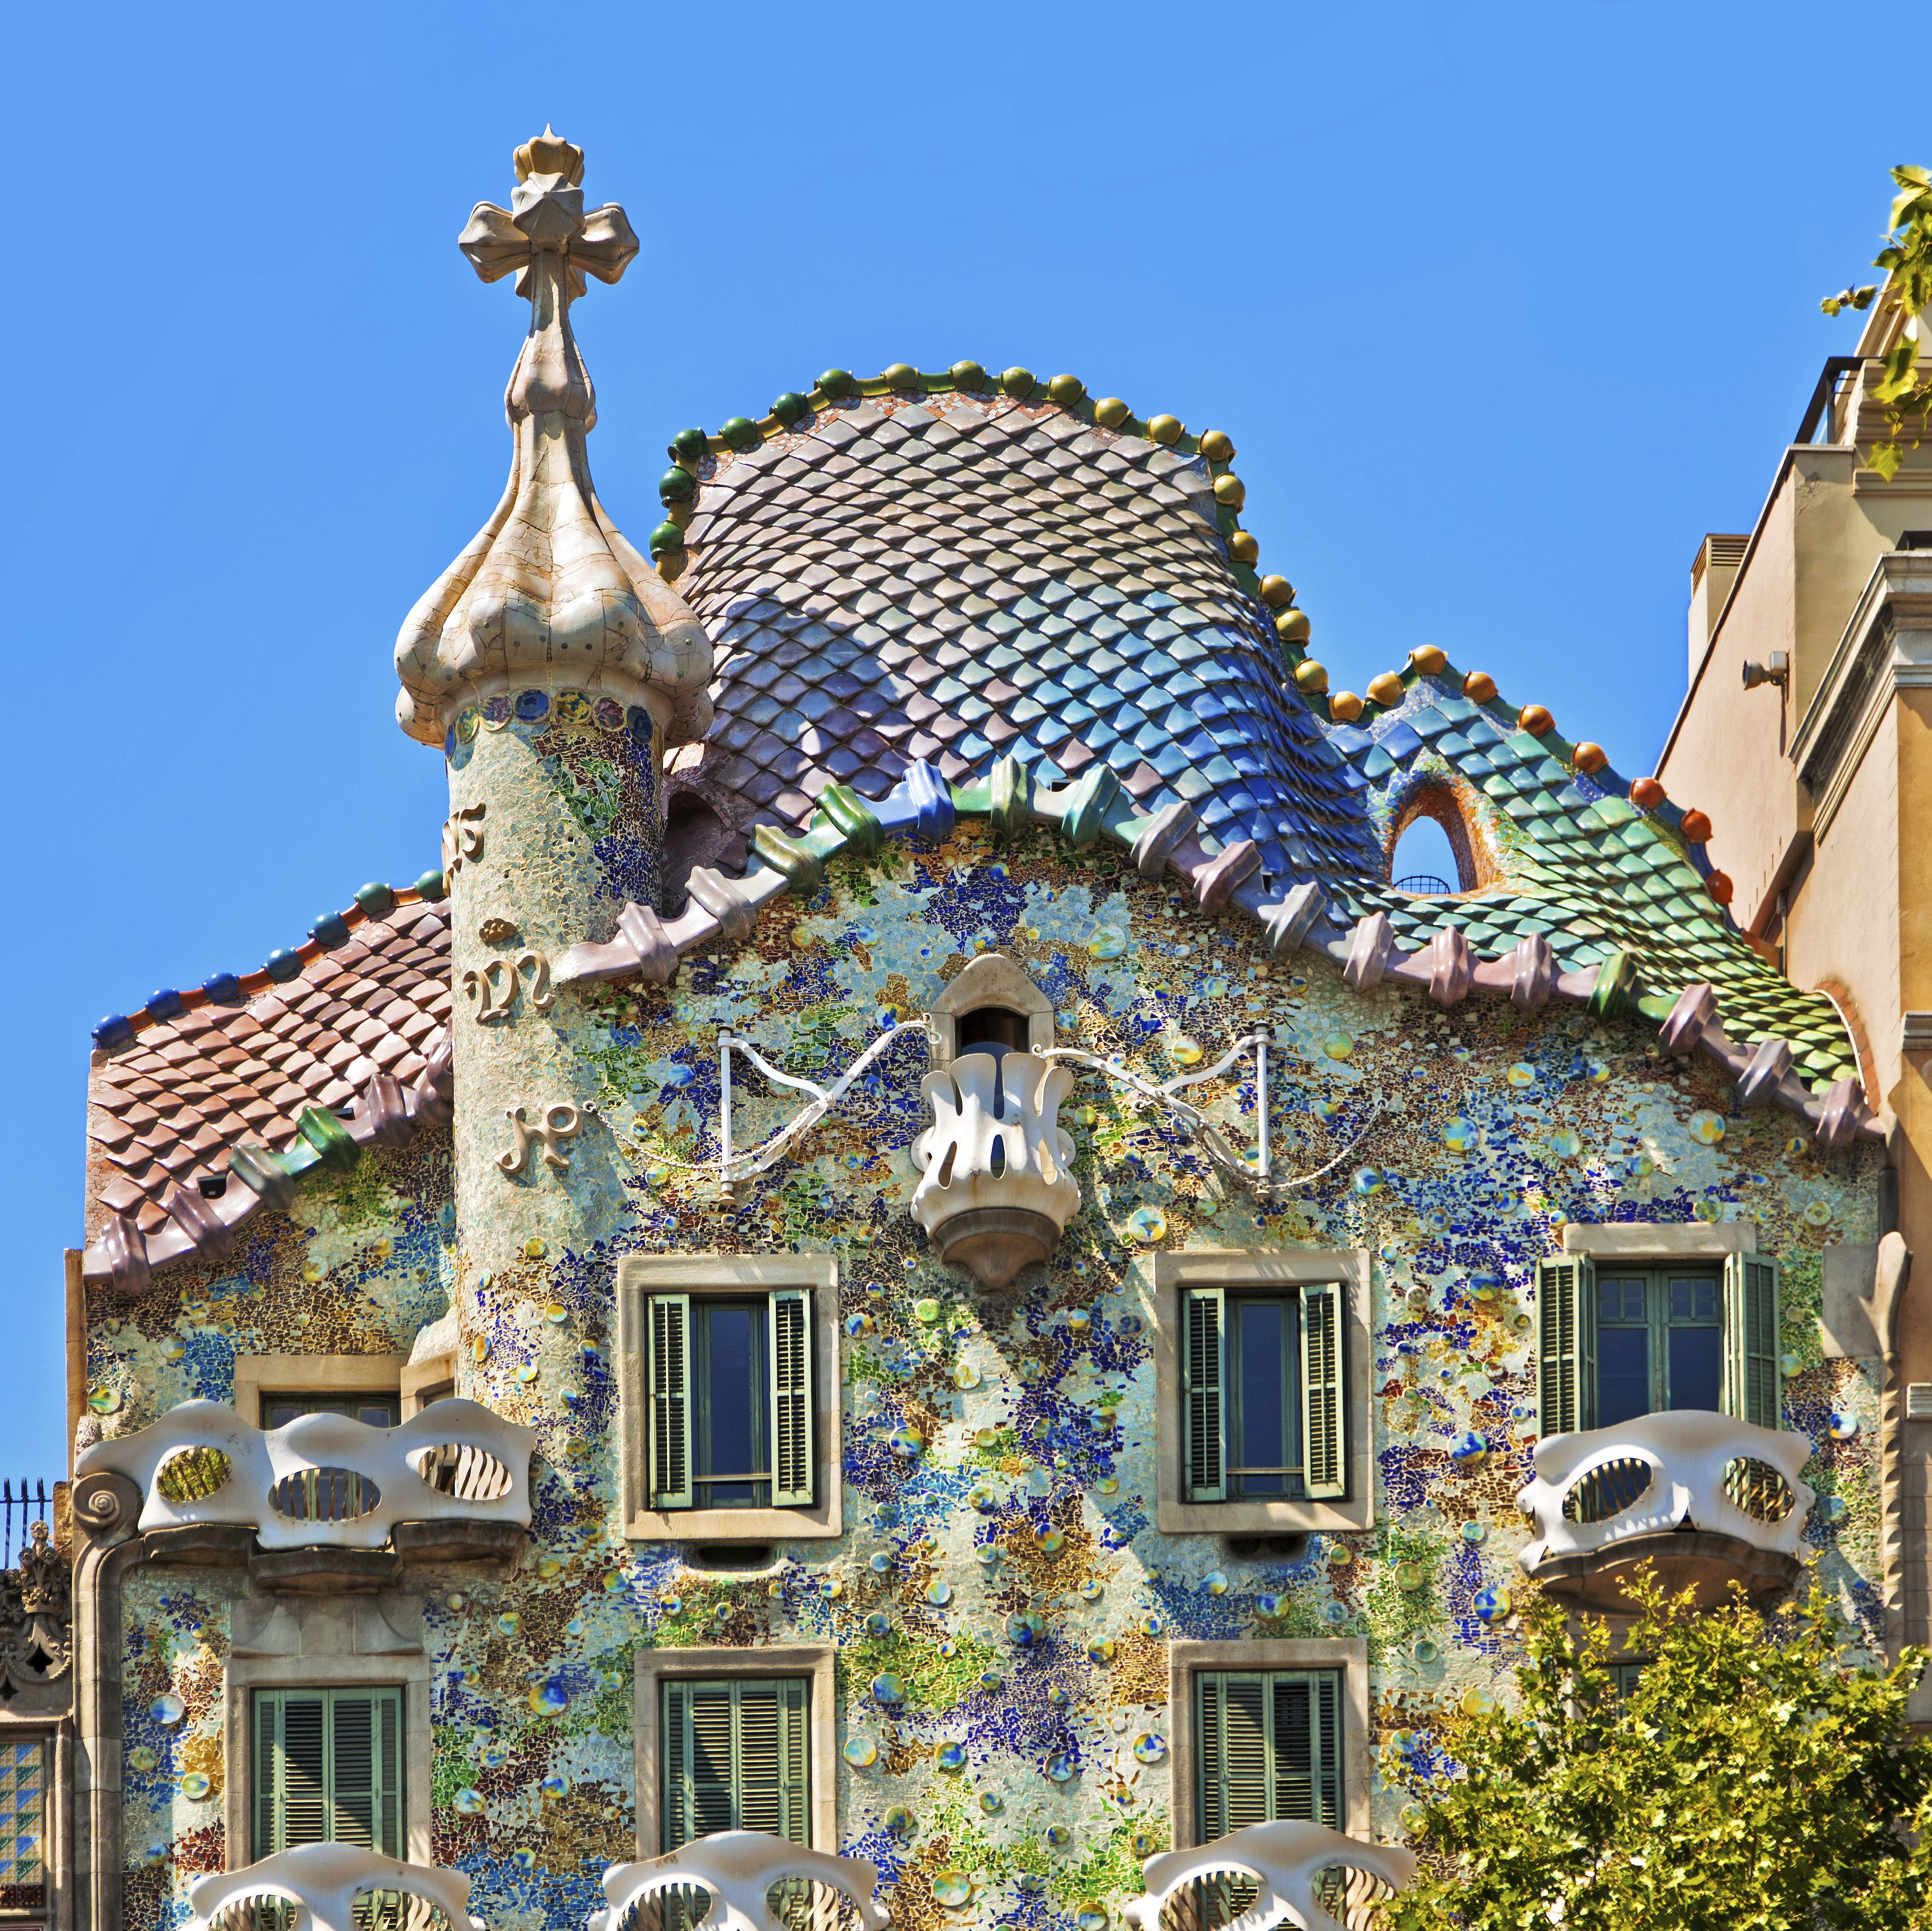

Slide 27
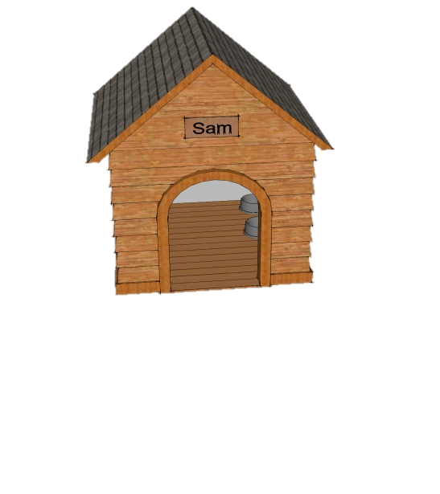
Friday
There are 16 dogs each in its own kennel. Twenty kennels are
empty. How many kennels are there altogether?
Move the orange cylinder to find the answer
36

Slide 28
Friday Fun!
**Parents – we have set up some new games this week, please enter the website using the details below, please do not use your child’s name.
Follow the link below or type the address in your browser:
www.matific.com/class
(2) Enter the Class Code: 912IJX
(3) First name = Second Class Surname = any 4 digit number
(4) Skip the intro if you want
(5) Select ‘schoolwork’ on the left hand side
(6) Have fun

Slide 29
Well done, your fortnight’s work is now complete!

