Slide 1
Second Class Literacy work at home 4
Try your best and do what you can!

Slide 2
Note to parents
Dear parents, we hope you and your loved ones are all well.
In this PowerPoint, as before, you will find some suggestions for helping your child’s English literacy. You can follow the suggested timetable or use this as a menu of ideas for what your child would like to do.
The 2nd class team have set as much work as we can that your children can do independently. However, they might need some help reading and figuring out some of the tasks/ instructions.
Please note work is planned for over two weeks.

Slide 3
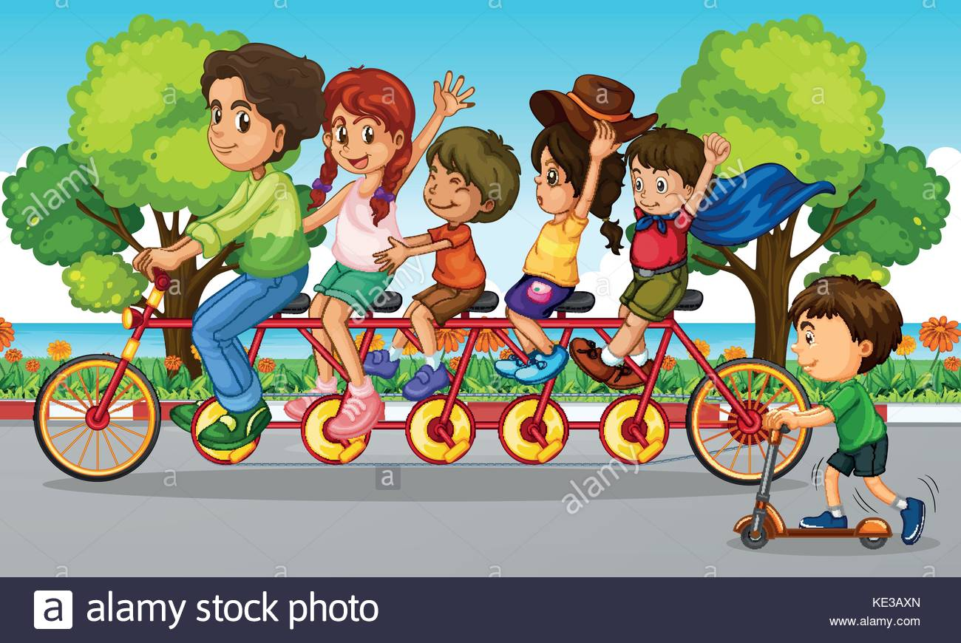
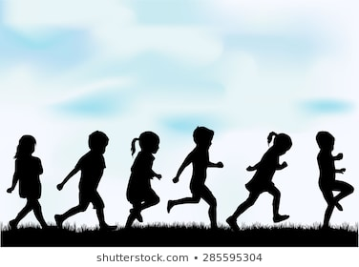
Note to children
Hello everyone, how are you?
What have you been up to for the past fortnight? Hasn’t the weather been lovely? We have been out and about walking and cycling. What have you been up to? We have loved hearing from some of you on Aladdin Connect! And we look forward to hearing from everyone else.
Here is some work for you to do over the next two weeks. See how you get on. Our themes for this fortnight are Sound and Flight.

Slide 4
You will need:
A copy book to record all your work
Pencils, colours, rubber
An adult to help sometimes!
A computer/ tablet/ phone for some activities

Slide 5
Contents
Week 7
Week 8
Read every day
Diary
Time capsule
Spellings 7
News
Story
Narrative writing: plot
Grammar 7
Comprehension
Read every day
Diary
Time capsule
Spellings 8
Writing: plot
Poem
Grammar 8
Comprehension
Oral language
And there are some more fun activities at the end if you’d like to check them out too!

Slide 6
Reading
If you have books at home that you can read, try to read for at least 15 minutes every day.
If you have read all your books at home, maybe mam or dad could set you up with an audiobook to listen to from Audible here (no charges for these at present):
https://stories.audible.com/discovery
(our favourites include Winnie the Pooh, Anne of Green Gables and Alice’s Adventures in Wonderland)
If you are a member of the local library, mam or dad can help you set up BorrowBox for ebooks and audio books (and if you aren’t you can set up an online account very easily). Use the instructions here: https://www.librariesireland.ie/news/online-services-during-coronavirus

Slide 7
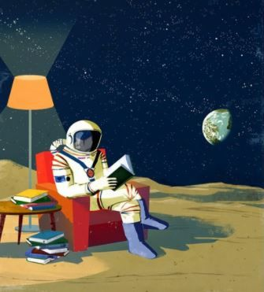
Diary / Time capsule
How is your diary writing going? How many entries have you now?
Did you make a time capsule? It would be so exciting to read it some time in the future, wouldn’t it?

Slide 8
Spellings Week 7: si as /zh/ Write a sentence for each word in your copy. Play games on Spelling City (parents, you might need to enable Flash in your browser): https://www.spellingcity.com/users/2ndClassRoom15and16
 | Look | Copy | Cover & Write | Check
Mon | vision
 | television
 | division
Tue | revision
 | invasion
 | occasion
Wed | explosion
 | extension
 | permission
Thur | pension
 | fraction
 | estimate

Slide 9
Week 7: Monday News

Slide 10
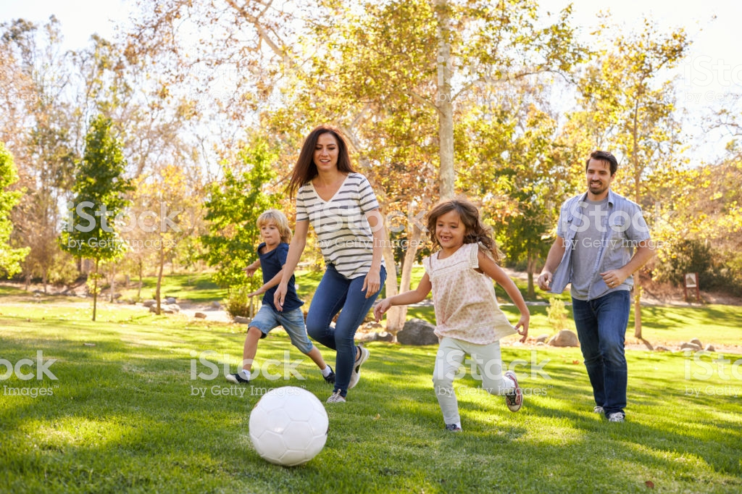
News
Write your news from last week in your copy. What did you do? Did you play in your garden or go to the park? Describe what you did. Remember the rules for recount writing.

Slide 11
Week 7: Tuesday Now for a story!

Slide 12
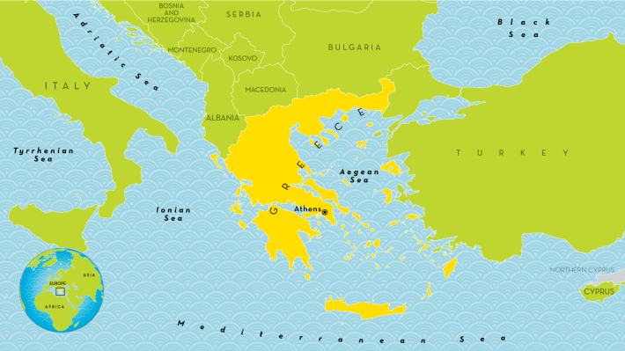
Story: Icarus, the boy who flew too high
Listen to this story on YouTube. It is a version of the famous myth from ancient Greece about Icarus and his father Daedalus.
https://www.youtube.com/watch?v=2DQ-98Bqazg

Slide 13
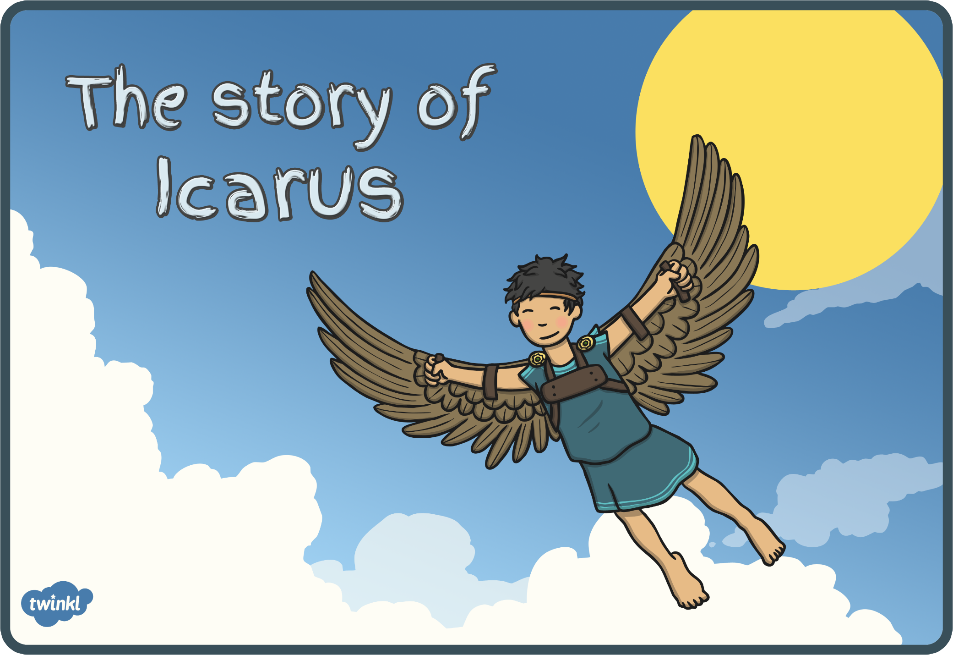
Story: Talk about
Tell your mam or dad or whoever is at home with you about the story. You can then answer the following questions in your copy (or if you’d prefer, tell your mam or dad the answers):
Did you like this story? Why?
What happened at the beginning, in the middle and at the end?
Would you say this story is an example of recount, procedural or narrative writing?
Retell the story using the pictures on the next three slides. Is anything missing?

Slide 14
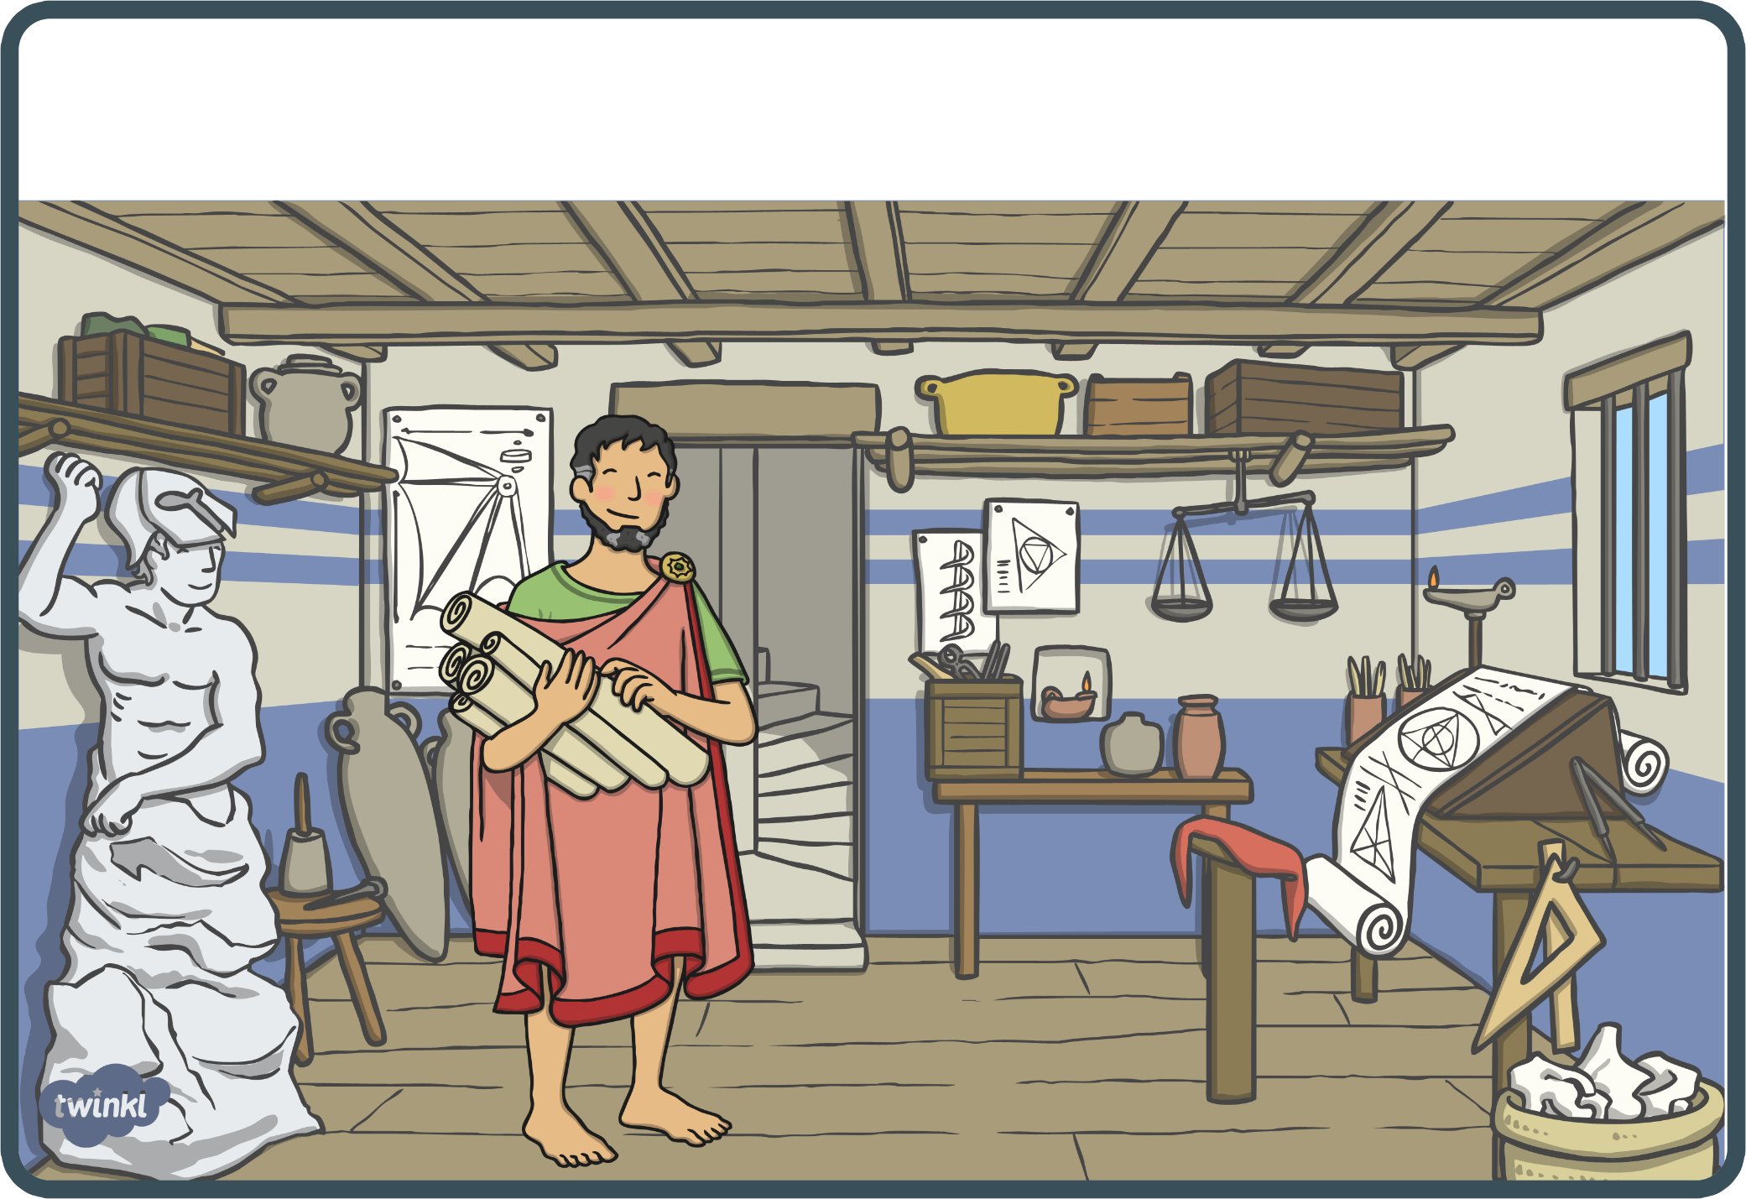
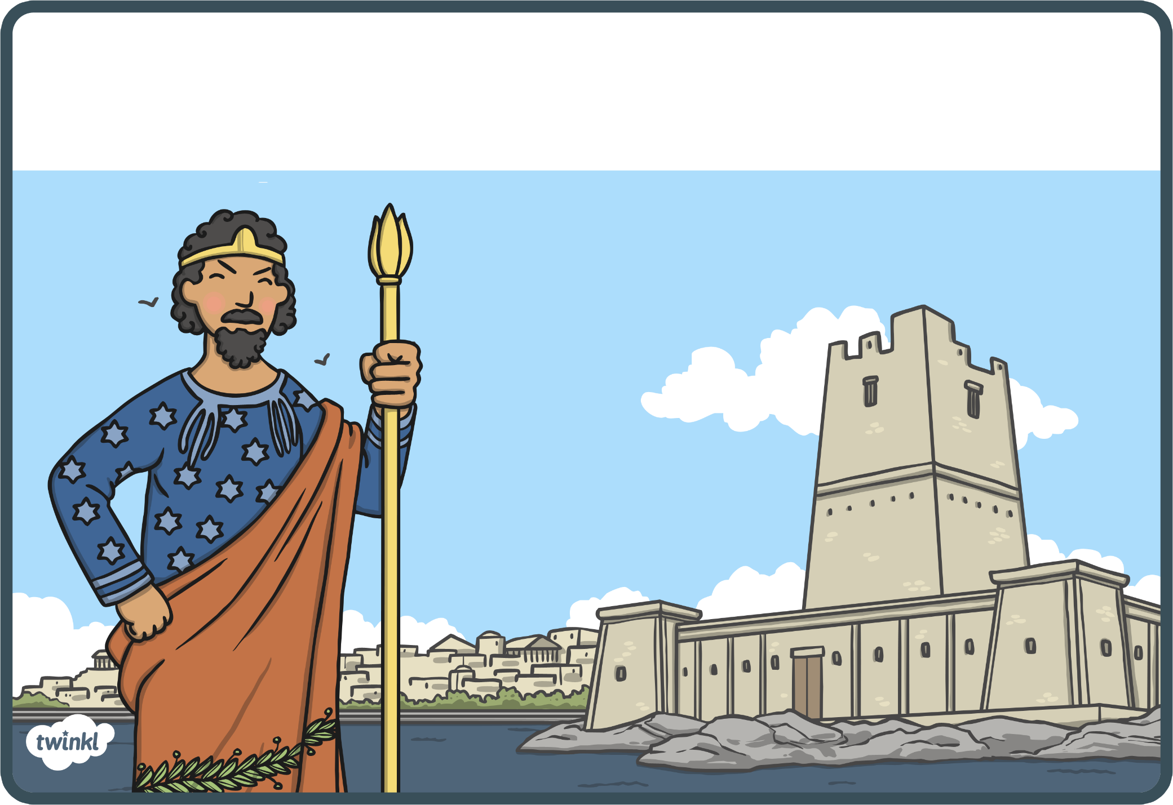
1
2
3
4

Slide 15
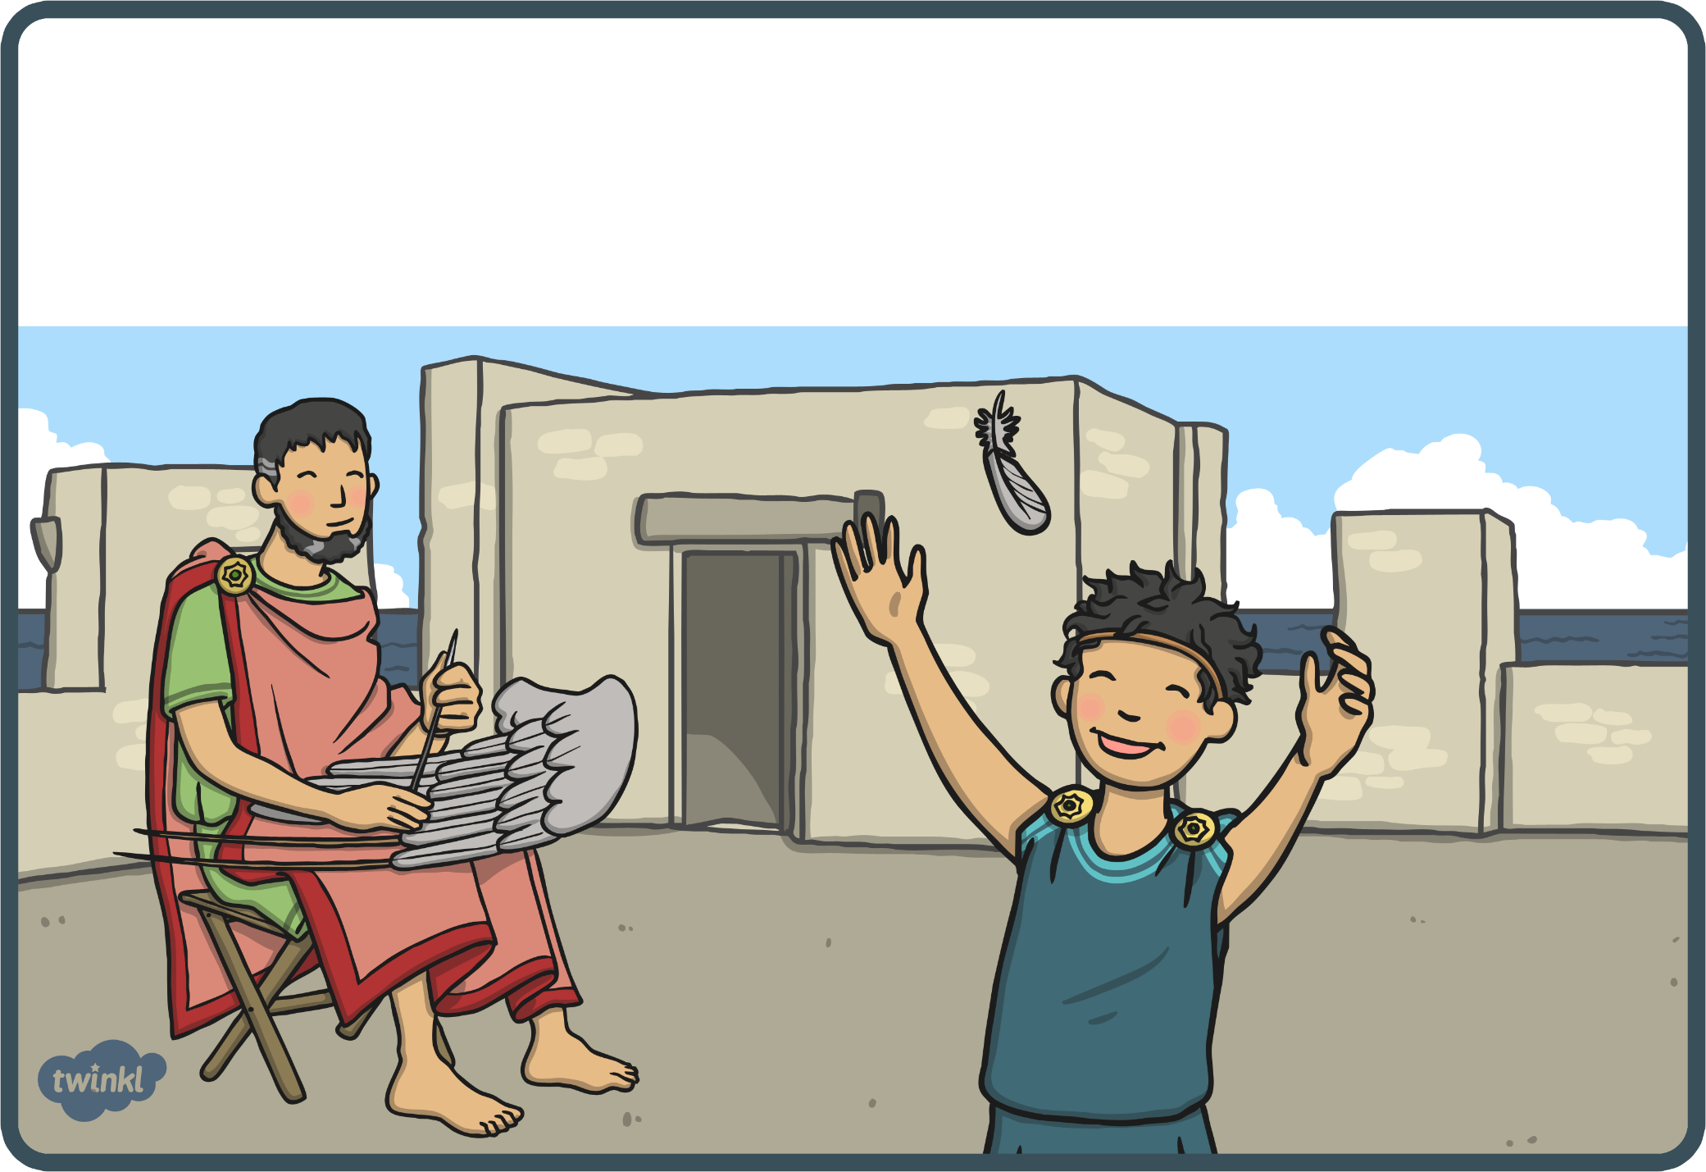
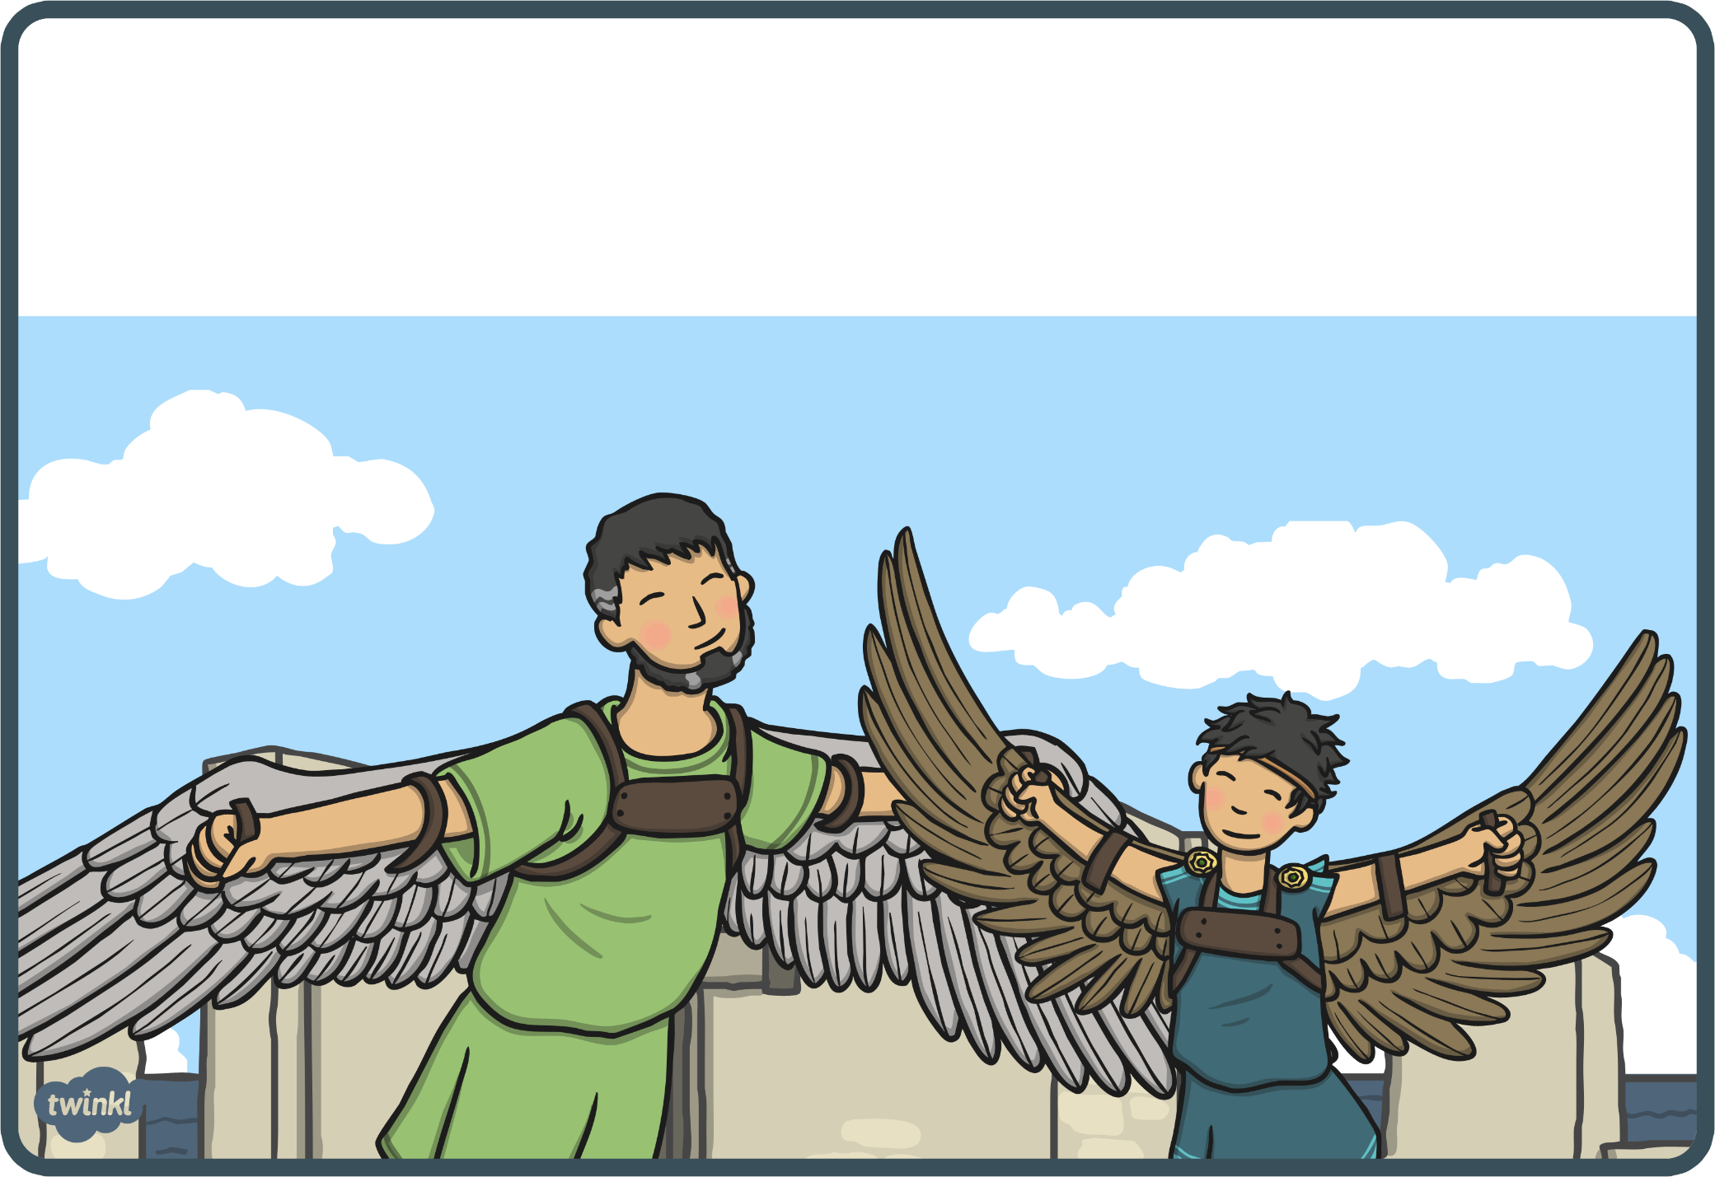
5
6
7
8

Slide 16
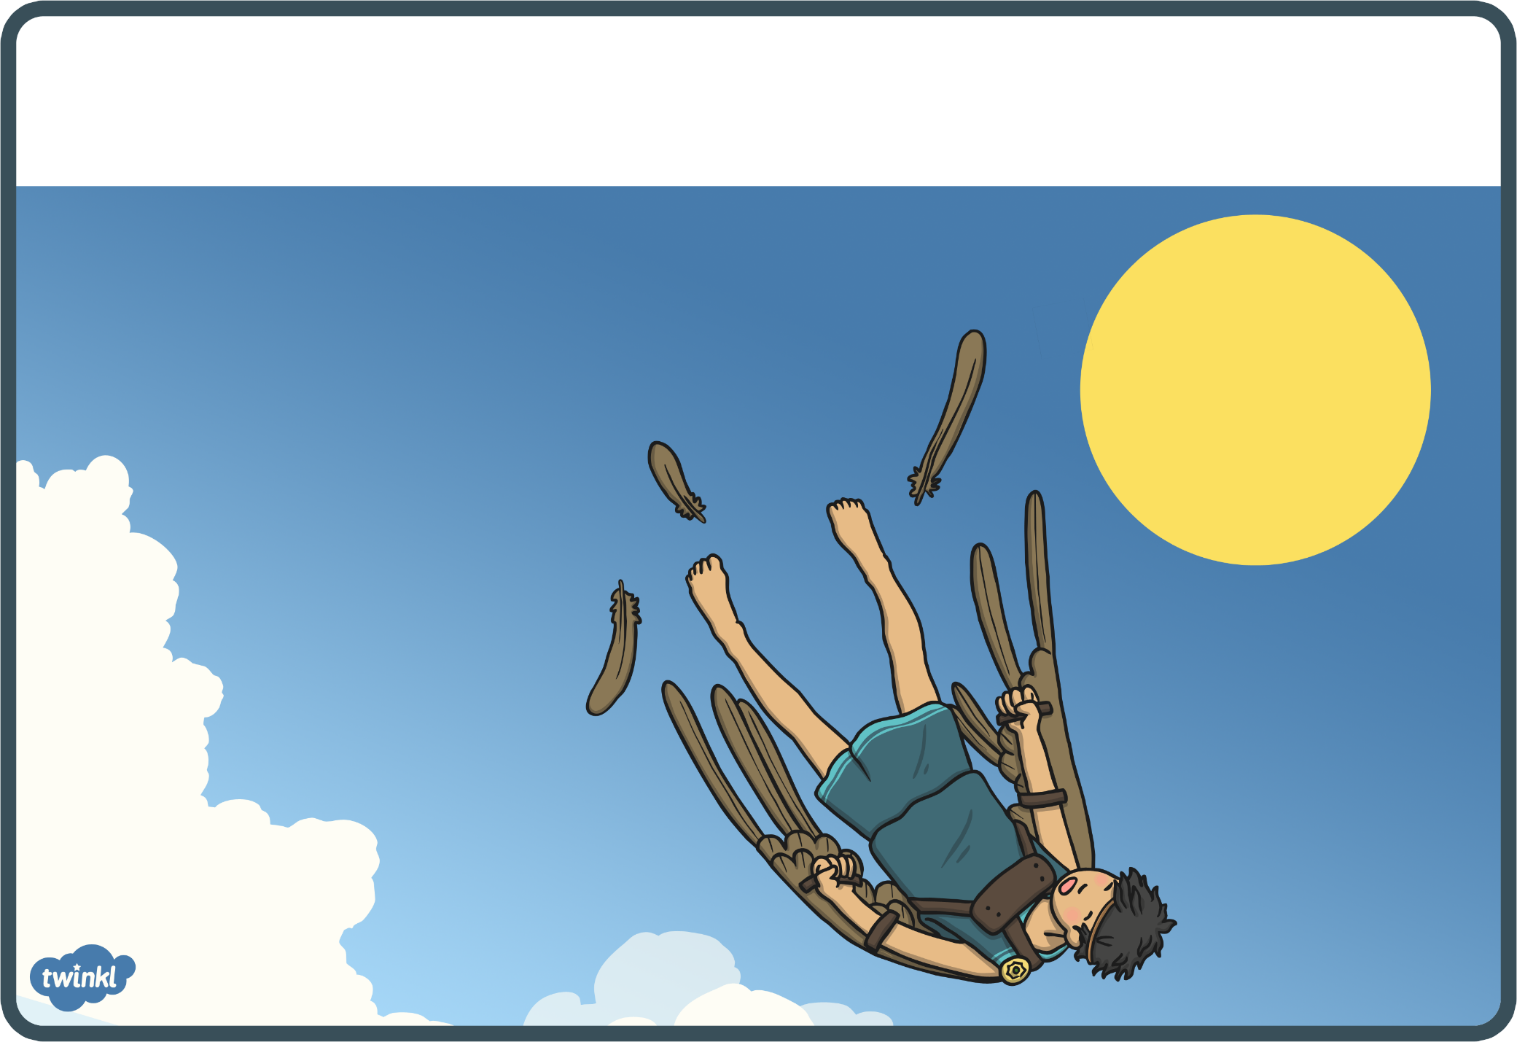
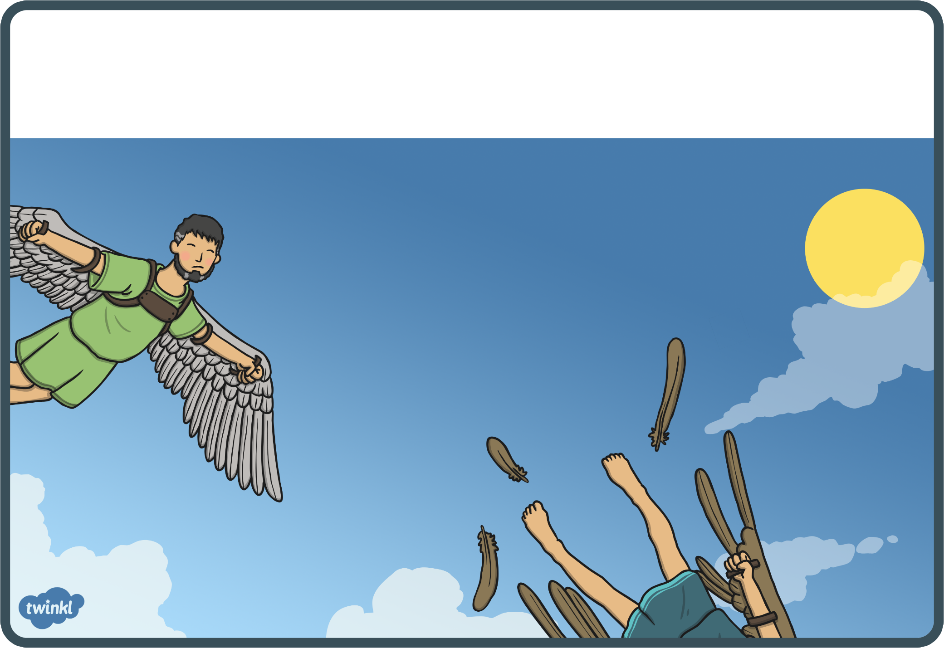
9
10
11
12

Slide 17
Story: Respond to the story
Thinking about the story:
Name the three characters in the story. Which character did you like best? Why?
Describe the setting of the story. (Remember: setting is the time and place of a story.) Write a few sentences about it in your copy.
Would you say the setting of this story is important? Why? How does it influence what happens in the story?
Having listened to the story, what do you think a “myth” is? Can you think of other examples of myths you know?
What lesson does this myth try to teach us? Do you agree with the lesson? Why?

Slide 18
Week 7: Wednesday Narrative Writing Genre

Slide 19
Narrative writing: Plot
So we have been learning about the narrative writing genre, which is all about story-telling in an imaginative way. These stories always have a beginning, middle and end.
Now let’s revise the elements you see in narrative writing: character, setting and plot. We first looked at the element of character. Then we looked at setting. This week, we are going to look at plot.
Plot describes the sequence of events in a story.

Slide 20
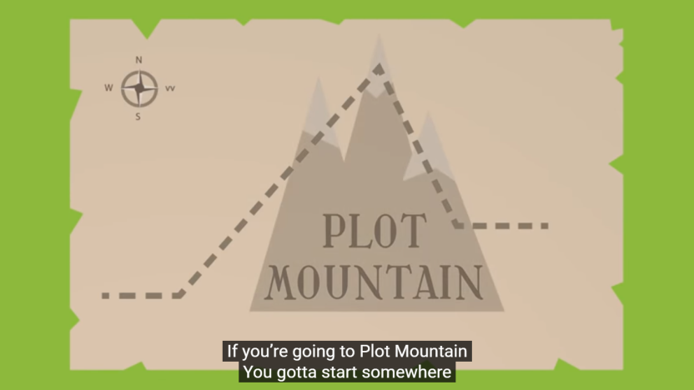
Narrative writing: Plot
Up until now, we have talked about story plots in terms of beginning, middle and end. But now we are going to look at them in more detail. There are actually 5 things that need to be in a plot:
Introduction (where you introduce the characters and describe the setting)
Rising action (where the story starts to get going, maybe something happens or a problem arises)
Climax (this is the turning point of the story, where things change for better or worse)
Falling action (where the story starts to wind down)
Resolution (where the story ends)
Have a look at this video (and song!) to find out more:
https://www.youtube.com/watch?v=NpWHZJZQDSE

Slide 21
Narrative writing: Plot
Now, think about the story of Icarus, and about the sequence of events in the story. Remember: Plot Mountain!
What happens in the introduction? (Who do we meet? Where are they?)
What happens in the rising action? (What is the problem that arises? )
What is the climax of the story? (What happens that makes the story take a turn for the worst?)
What happens in the falling action? (Clue: somebody falls!)
What is the resolution of the story? (You looked at two versions of the story, so this will be different in each one.)

Slide 22
Week 7: Thursday Grammar

Slide 23
Grammar 7: Prepositions
A preposition is a word that relates one noun or pronoun to another in the sentence, often describing where it is or where it is moving towards.
We have met them in Maths and in Gaeilge, so now here they are in Literacy!
Have a look at the examples of prepositions in red below:
The witch flew over the wood.
The rabbit disappeared into its burrow.
I dropped my pencil and it rolled under my chair.

Slide 24
Grammar 7: Prepositions
Check out all these prepositions!
across
along
among
around
behind
beside
between
down
from
in
into
near
over
past
round
through
to
towards
under
up

Slide 25
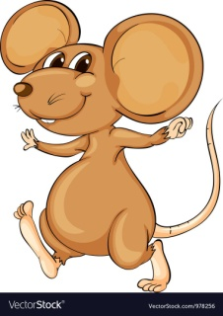
Grammar 7: Prepositions
Can you use the prepositions to complete the story? Write the whole text into your copy:
Suzy left her mouse-hole and went ____ the path,
____ the flowers,
____ the fence,
____ the garden,
____ the field,
____ the forest,
____ the trees,
____ the bridge and
____ the farm.
across
along
among
around
behind
beside
between
round
through
to
down
from
in
into
near
over
past
towards
under
up
When you’re ready, have a look at what we thought, on the next slide!

Slide 26
Grammar 7: Prepositions
How did you get on? Here’s what we wrote:
Suzy left her mouse-hole and went
along the path,
among the flowers,
past the fence,
down the garden,
across the field,
through the forest,
between the trees,
under the bridge and
towards the farm.
You might have written something different but as long as it makes sense, that’s fine. Well done!! Send us a photo on Aladdin Connect!
You might like to draw a map of Suzy’s journey now!

Slide 27
Week 7: Friday Comprehension

Slide 28
Comprehension Read this.

Slide 29
Comprehension Now write full sentences to answer these questions in your copy.

Slide 30
End of Week 7
Give yourself a spelling test. How did you get on? Send us a picture on Aladdin Connect if you like!
Well done on finishing Week 7!

Slide 31
Week 8

Slide 32
Spellings Week 8: ei and eigh Write a sentence for each word in your copy. Play games on Spelling City (parents, you might need to enable Flash in your browser): https://www.spellingcity.com/users/2ndClassRoom15and16
 | Look | Copy | Cover & Write | Check
Mon | eight
 | eighteen
 | eighty
Tue | weight
 | neigh
 | neighbour
Wed | reindeer
 | reins
 | sleigh
Thur | veil
 | child
 | children

Slide 33
Week 8: Monday Plot in narrative writing

Slide 34
Plot: recap
Thinking back to last week’s lesson on the element of plot in the narrative genre, can you remember what plot is? That’s right: Plot describes the sequence of events in a story.
Do you remember the video about
Plot Mountain? It’s a handy way to
remember how to build a plot.
You are now going to watch a short movie (about 3 minutes long) from Pixar called “For the Birds”. Enjoy! (And think about the plot!) Click here to get started:
https://www.youtube.com/watch?v=pWIVoW9jAOs&list=PLrM5TEiTLkp9_yYlfg5cPziQUe_Wi-jdi

Slide 35
Plot of the story: some questions
Describe the introduction to the story in your copy. (Who are the characters? Where is the story set?) Use full sentences!
What happens in the rising action? (Are the little birds being nice? Tell us what is happening.)
What is the climax of the story? (This is the turning point. It turns for the better for one character and not so well for the others!)
What is the falling action? (Clue: we see something falling!)
Describe the story’s resolution. (How does it end? Are all the characters happy? )

Slide 36
Plot: write your own
Now think about the plot of the story of Cinderella.
In your copy, write a few lines for each part of the plot. You can use these headings to help you. Send us your work on Aladdin Connect – we’d love to see it!
Introduction
Rising action
Climax
Falling action
Resolution

Slide 37
Week 7: Tuesday Poem

Slide 38
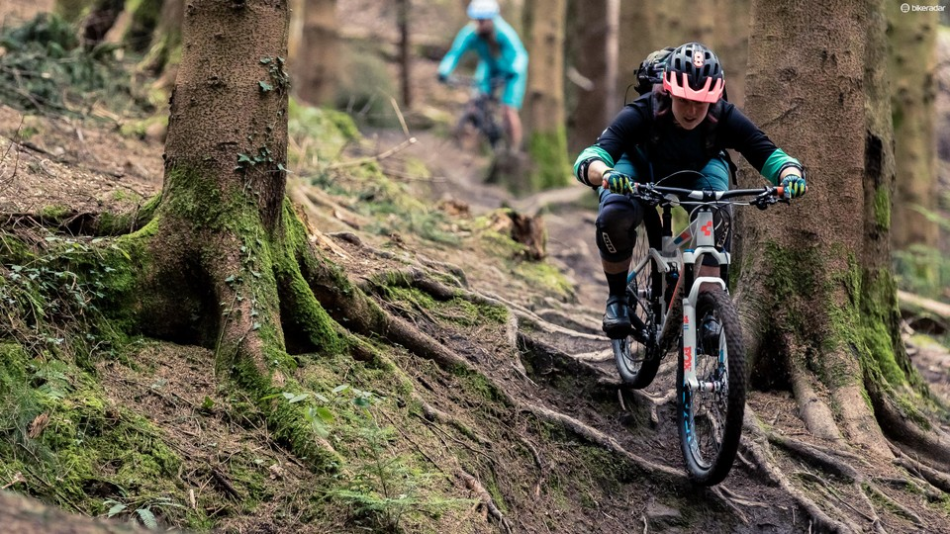
Poem: “Biking” by Judith Nicholls Read through this and answer the questions on the next two slides.
Fingers grip,
toes curl;
head down,
wheels whirl.
Air streams,
fields race;
ears sting,
winds chase.
Breathe deep,
troubles gone;
Just feel
windsong.

Slide 39
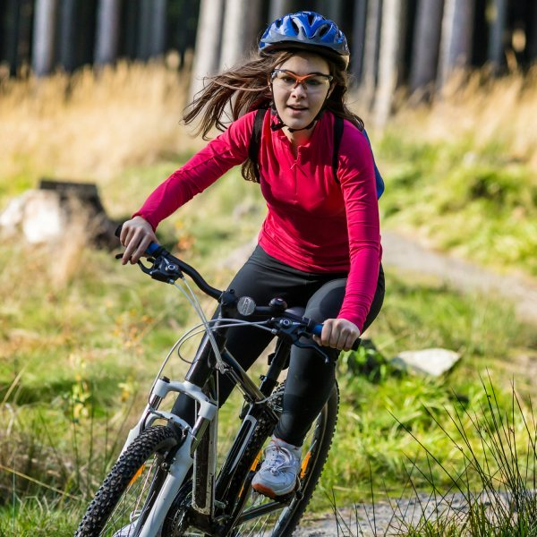
Poem: Some questions Answer these questions about the poem in your copy. Don’t forget to write full sentences using capital letters, full stops and the spellings you know.
What is the poem about?
What is “biking”? What word do we use instead?
How does the poet feel? Can you describe her mood in three words?
Have you ever felt like this when you were cycling? Tell us about it.
Do you think the poet likes cycling? Why?
Is she travelling fast or slowly? How do you know?

Slide 40
Poem: Some more questions Answer these questions about the poem in your copy. Don’t forget to write full sentences using capital letters, full stops and the spellings you know.
What is happening in the first verse? And the second?
What is she talking about in the last verse? Have her feelings changed?
Write down the rhyming words you spot. Is there a pattern? Are the words that rhyme spelt the same?
Write out the poem into your copy using your best handwriting. If you want, you can draw a picture to go with it.
If you like, you could learn off the poem and /or record yourself reading it using your tablet.

Slide 41
Week 8: Wednesday Grammar

Slide 42
Grammar 8: Word webs
We use some words a lot, which can make our writing sound a bit boring. For example:
“It’s my birthday and I’m so excited!” said Heidi.
Maybe we could make this sentence more interesting by replacing said with one of these:
cried, exclaimed, whispered, announced, screamed
So you could write:
“It’s my birthday and I’m so excited!” screamed Heidi.

Slide 43
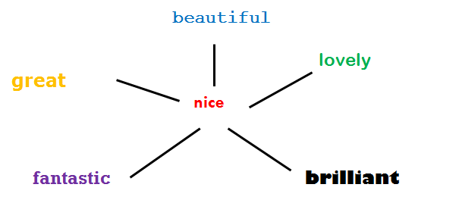
Grammar 8: Word webs
How about this one?
The view from the top of the hill was nice.
You could use any one of the words from the word web below instead of nice. Which one would you pick? Write your new sentence into your copy.

Slide 44
Grammar 8: Word webs
Now in your copy write down all the words you can think of in a word web like this for the word hot.
hot
What’s your favourite one? Write it an interesting sentence! Send us a picture on Aladdin Connect!

Slide 45
Week 8: Thursday Comprehension

Slide 46
Comprehension Read this.

Slide 47
Comprehension Now write full sentences to answer these questions in your copy.

Slide 48
Week 8: Friday Oral Language

Slide 49
Oral Language: Birdsong
Because our worlds have become so much quieter recently, we are all getting the chance to listen to some of the amazing birdsong around us. Have you noticed it too?
Today, if you are sitting in your garden or on your balcony, or when you go for a walk, listen carefully to the birds singing. Can you hear different songs? Describe them to whoever is with you. Which birds do you think are singing the songs?
If you’d like to learn more, have a look at the birds and their descriptions here. Can you find “the teacher bird”? Maybe you’ve heard it!
If you’d like to listen to some more beautiful birdsong, here is the Dawn Chorus recorded in Co. Laois: https://www.youtube.com/watch?v=bfVR7_nsQ7w

Slide 50
Fun literacy activities
See how many words starting with ‘c’ you can write down in 3 minutes. Now, go look for things starting with c in your bedroom, the kitchen, the garden...
Try making a word web for a word you use a lot.
Now make word webs for these words:
little
big
ran
angry
quick
pretty

Slide 51
End of Week 8
Give yourself a spelling test. How did you get on? Send us a picture on Aladdin Connect if you like!
Well done on finishing Week 8!

