Slide 1
Second Class Literacy work at home 5
Try your best and do what you can!

Slide 2
Note to parents
Dear parents, we hope you and your loved ones are all well.
In this PowerPoint, as before, you will find some suggestions for helping your child’s English literacy. You can follow the suggested timetable or use this as a menu of ideas for what your child would like to do. We have loved hearing from some of the children on Aladdin Connect in the past few weeks. We have also posted photos on the school website of what some children in the class and in the school have been up to: https://www.assumptionjns.com/online-learning-resources1.html
The 2nd class team have set as much work as we can that your children can do independently. However, they might need some help reading and figuring out some of the tasks/ instructions.
Please note work is planned for over two weeks.

Slide 3
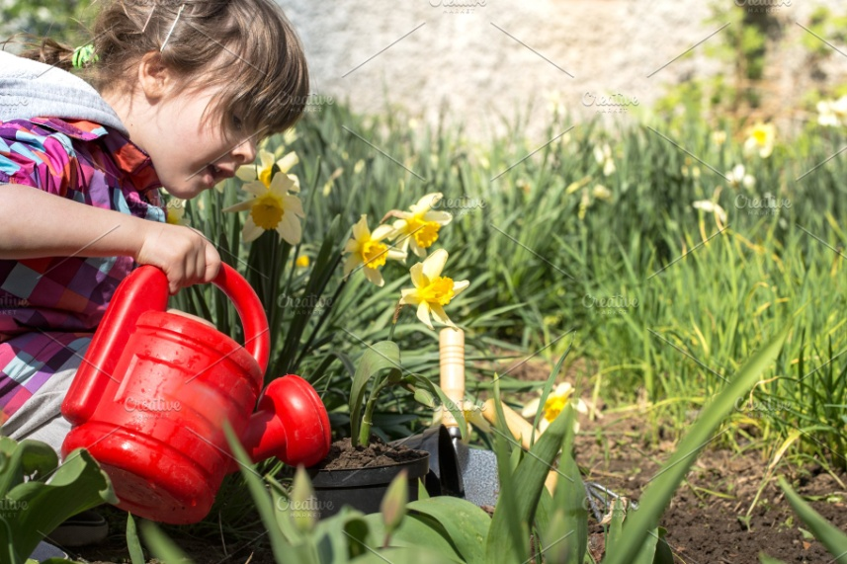
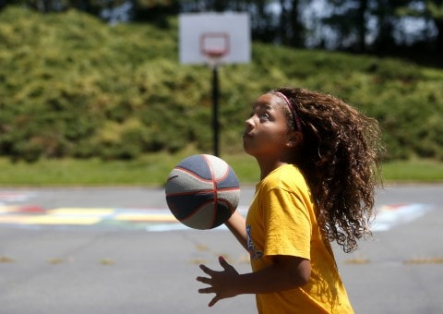
Note to children
Hello everyone, how are you?
What have you been doing for the past fortnight? We hope you have had the chance to go outside and enjoy the weather.
We have loved hearing from some of you on Aladdin Connect! And we look forward to hearing from everyone else. Check out this page on the school website to see what other children in your class and in the school have been up to: https://www.assumptionjns.com/online-learning-resources1.html
Here is some work for you to do over the next two weeks. See how you get on. Our themes for this fortnight are Summer and Bees.

Slide 4
You will need:
A copy book to record all your work
Pencils, colours, rubber
An adult to help sometimes!
A computer/ tablet/ phone for some activities

Slide 5
Contents
Week 9
Week 10
Read every day
Diary and/ or time capsule
Spellings 9
News
Story
Narrative writing
Grammar 9
Comprehension
Read every day
Diary and/ or time capsule
Spellings 10
Narrative writing
Poem
Grammar 10
Comprehension
Oral language
And there are some more fun activities at the end if you’d like to check them out too!

Slide 6
Reading
If you have books at home that you can read, try to read for at least 15 minutes every day.
If you have read all your books at home, maybe mam or dad could set you up with an audiobook to listen to from Audible here (no charges for these at present):
https://stories.audible.com/discovery
(our favourites include Winnie the Pooh, Anne of Green Gables and Alice’s Adventures in Wonderland)
If you are a member of the local library, mam or dad can help you set up BorrowBox for ebooks and audio books (and if you aren’t you can set up an online account very easily). Use the instructions here: https://www.librariesireland.ie/news/online-services-during-coronavirus

Slide 7
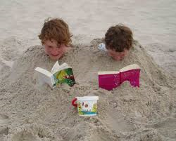
Diary / Time capsule
How is your diary writing going? How many entries have you now?
Did you make a time capsule? It would be so exciting to read and look at it some time in the future, wouldn’t it? What kinds of things did you put in it? Let us know on Aladdin Connect!

Slide 8
Spellings Week 9: o as /u/ Write a sentence for each word in your copy. Play games on Spelling City (parents, you might need to enable Flash in your browser): https://www.spellingcity.com/users/2ndClassRoom15and16
 | Look | Copy | Cover & Write | Check
Mon | glove
 | son
 | wonderful
Tue | brother
 | monkey
 | month
Wed | somebody
 | front
 | Monday
Thur | money
 | woman
 | women

Slide 9
Week 9: Monday News

Slide 10
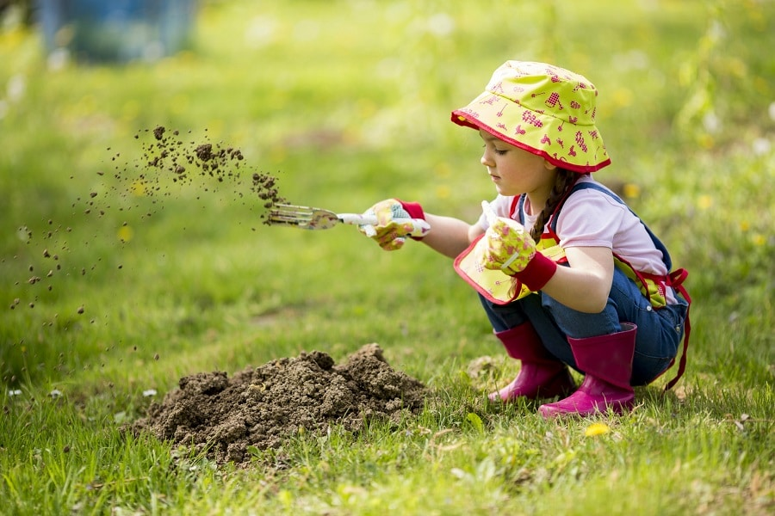
News
Write your news from last week in your copy. What did you do? Did you play in your garden or go to the park? Maybe you did some gardening? Describe what you did. Remember the rules for recount writing.

Slide 11
Week 9: Tuesday Now for a story!

Slide 12
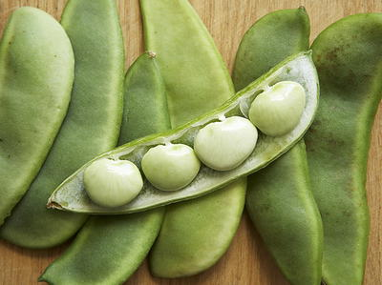
Story: A Bad Case of Stripes by David Shannon
Listen to this story on YouTube. It is about a girl who had a very strange illness. Copy and paste this link into your Internet browser:
https://www.storylineonline.net/books/a-bad-case-of-stripes/

Slide 13
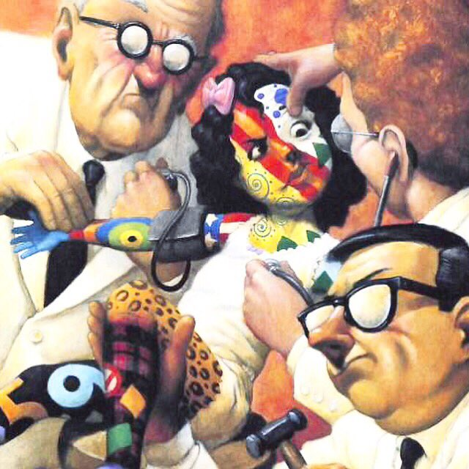
Story: Talk about
Answer the following questions in your copy (or if you’d prefer, tell your mam or dad the answers):
Did you like this story? Why?
What happened at the beginning, in the middle and at the end? Retell the story.
What kind of writing is it an example of (recount, procedural or narrative writing)?

Slide 14
Story: Respond to the story
Thinking about the story:
Name the characters in the story. Which character did you like best? Why?
Describe the setting of the story. Write a few sentences about it in your copy.
Write a summary of the plot of the story using the plot mountain. Remember: the plot describes the sequence of events in a story.
Introduction (where you introduce the characters and describe the setting)
Rising action (where the story starts to get going, maybe something happens or a problem arises)
Climax (this is the turning point of the story, where things change for better or worse)
Falling action (where the story starts to wind down)
Resolution (where the story ends)

Slide 15
Week 9: Wednesday Narrative Writing

Slide 16
Narrative writing: your story
We have been learning about the narrative writing genre, which is all about story-telling in an imaginative way. These stories always have a beginning, middle and end.
Now let’s revise the elements you see in narrative writing: character, setting and plot. We have looked at these three elements over the past few weeks. Remember:
Characters are usually people, animals or creatures in a story that can think, feel or act.
Setting is the time and place of a story.
Plot describes the sequence of events in a story.

Slide 17
Narrative writing: your story
Now we would like you to think about writing your own story.
You will plan it out this week and then write it next week. Take out a sheet of paper and split it into four parts like this:
Characters
Setting
Plot
Title

Slide 18
Narrative writing: your story
Think about who your characters are and briefly describe them. What do they look like? Where do they live? What kinds of personalities have they? What kinds of clothes do they wear? Is there anything else you can tell us about them? Draw a picture of them when you are finished to help.
Characters
Setting
Plot
Title

Slide 19
Narrative writing: your story
2. Think about the setting of your story and give a description of it. Where is the story set (space, a forest, a city)? When is it set (in the time of the dinosaurs, during a war, recently)?
Characters
Setting
Plot
Title

Slide 20
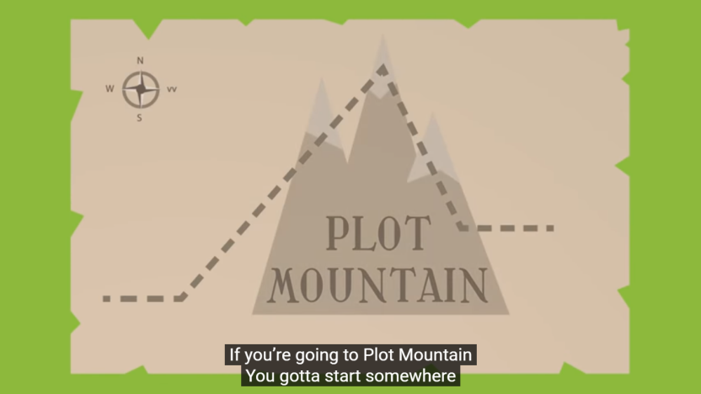
Narrative writing: your story
3. Now think about the plot: what is going to happen and how. Use the plot mountain to help: introduction > rising action > climax > falling action > resolution.
Characters
Setting
Plot
Title

Slide 21
Narrative writing: your story
4. Last of all, think of a good title for your story. Now you are ready! Put your plan in a safe place until you are ready to use it next week.
Characters
Setting
Plot
Title

Slide 22
Week 9: Thursday Grammar

Slide 23
Grammar 9: -ing suffix
Remember when we learned about what a prefix does a few weeks ago (un-, dis-, mis- and im-). You add one at the beginning of a word to change its meaning (e.g. mistake, unkind, impatient).
This week, we are going to learn about what a suffix does. It is added to the end of a word to change its meaning. For example:
-less > hopeless
-ful > wonderful
-ing > walking

Slide 24
Grammar 9: -ing suffix
This week, we will look at the –ing suffix. It can be added to verbs in three different ways:
For a verb ending on a consonant, add just –ing:
jump > jumping
For a verb ending in the letter ‘e’, remove the ‘e’ and add –ing:
save > saving
For a verb ending on a consonant immediately after a vowel, double the consonant and add –ing:
pat > patting

Slide 25
Grammar 9: -ing suffix
boil
amuse
hug
fight
tease
plan
talk
ride
run
clap
fly
hope
swim
sneeze
Now try these:
knock > knocking
save > sa___
wag
wish
complete
get
try
hide
spin
look
joke
drop
Have a look at the next slide to see the answers.

Slide 26
Grammar 9: -ing suffix
boil > boiling
amuse >amusing
hug > hugging
fight > fighting
tease > teasing
plan > planning
talk > talking
ride > riding
run > running
clap > clapping
fly > flying
hope > hoping
swim > swimming
sneeze > sneezing
How did you get on?
knock > knocking
save > saving
wag > wagging
wish > wishing
complete > completing
get > getting
try > trying
hide > hiding
spin > spinning
look > looking
joke > joking
drop > dropping

Slide 27
Week 9: Friday Comprehension

Slide 28
Comprehension Read this.

Slide 29
Comprehension Now write full sentences to answer these questions in your copy.

Slide 30
End of Week 9
Give yourself a spelling test. How did you get on? Send us a picture on Aladdin Connect if you like!
Well done on finishing Week 9!

Slide 31
Week 10

Slide 32
Spellings Week 10: -ture Write a sentence for each word in your copy. Play games on Spelling City (parents, you might need to enable Flash in your browser): https://www.spellingcity.com/users/2ndClassRoom15and16
 | Look | Copy | Cover & Write | Check
Mon | picture
 | future
 | nature
Tue | creature
 | fracture
 | adventure
Wed | mixture
 | capture
 | furniture
Thur | puncture
 | mouse
 | mice

Slide 33
Week 10: Monday Narrative writing

Slide 34
Narrative writing genre: recap
The narrative writing genre is all about telling a story in an imaginative way. There is always a beginning, middle and end.
The elements of narrative writing are: character, setting and plot. Remember:
Characters are usually people, animals or creatures in a story that can think, feel or act.
Setting is the time and place of a story.
Plot describes the sequence of events in a story.

Slide 35
Narrative writing: write your story
Take out your narrative writing plan from last week:
Think of a good opening line. Pay special attention to your plot mountain.
Now off you go and write your story! We can’t wait to read it. Please upload it to Aladdin Connect.
Characters
Setting
Plot
Title

Slide 36
Week 10: Tuesday Poem

Slide 37
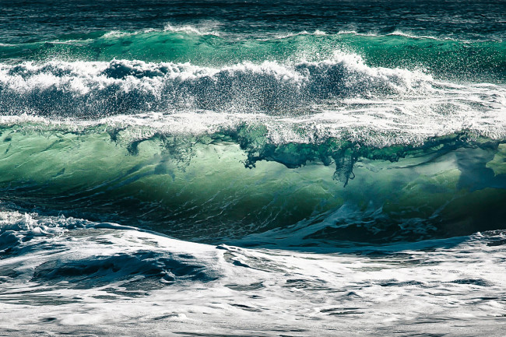
Poem: “There Are Big Waves” by Eleanor Farjeon Read through this and answer the questions on the next two slides.
There are big waves and little waves,
Green waves and blue,
Waves you can jump over,
Waves you dive thro',
Waves that rise up
Like a great water wall,
Waves that swell softly
And don't break at all,
Waves that can whisper,
Waves that can roar,
And tiny waves that run at you
Running on the shore.

Slide 38
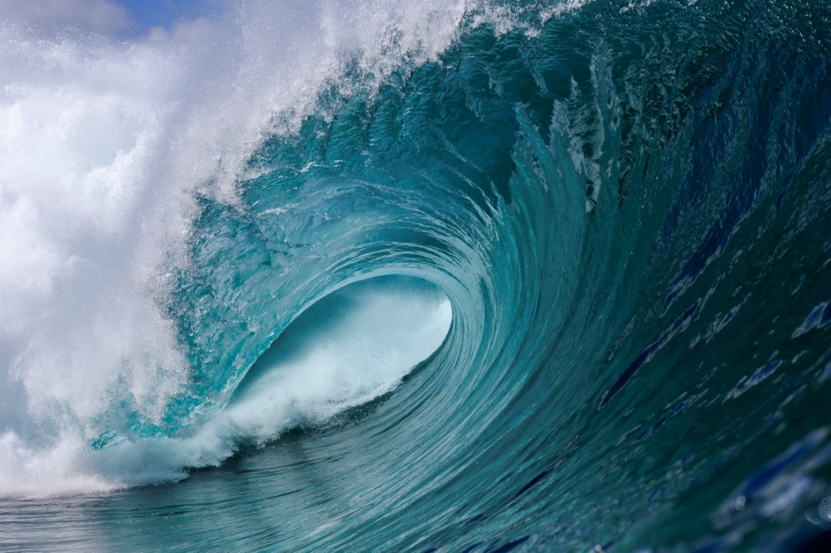
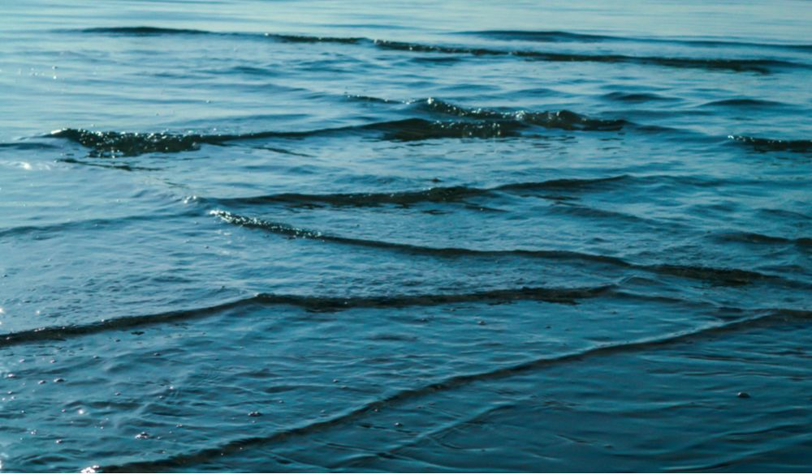
Poem: Some questions Answer these questions about the poem in your copy. Don’t forget to write full sentences using capital letters, full stops and the spellings you know.
What is the poem about?
Do you think the poet likes waves? Why?
Have you seen all the different types of waves the poet describes? Tell us about it.
Do you think the poet describes waves well? Explain your answer.

Slide 39
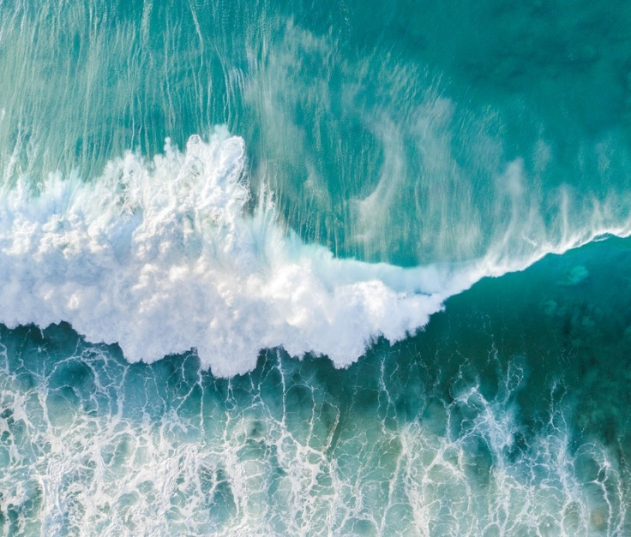
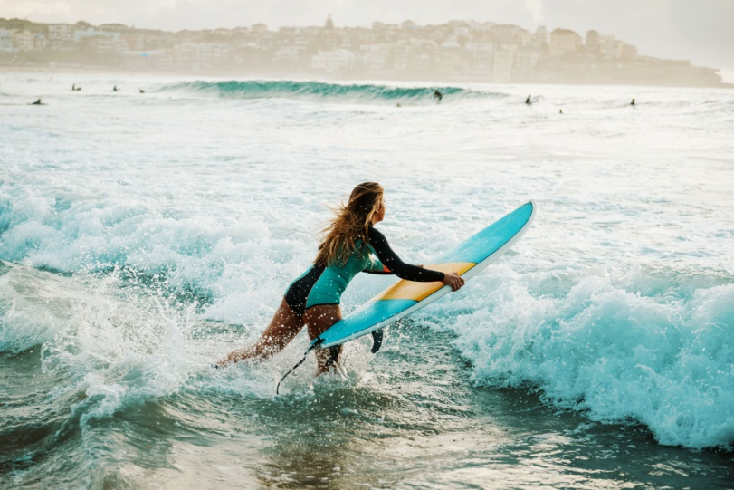
Poem: Some more questions Answer these questions about the poem in your copy. Don’t forget to write full sentences using capital letters, full stops and the spellings you know.
Write down the rhyming words you spot. Is there a pattern? Are the words that rhyme spelt the same?
What does the poet mean by “thro’”? Did she spell it in the usual way? Why not?
Write out the poem into your copy using your best handwriting. If you want, you can draw a picture to go with it.
If you like, you could learn off the poem and /or record yourself reading it using your tablet.

Slide 40
Week 10: Wednesday Grammar

Slide 41
Grammar 10: –er and –est suffixes
Last week, we learned about what a suffix does. It is added to the end of a word to change its meaning.
We looked at some examples:
-less > hopeless
-ful > wonderful
We did lots of work on the suffix –ing:
jump > jumping
save > saving
pat > patting

Slide 42
Grammar 10: –er and –est suffixes
This week, we are going to look at the suffixes –er and –est.
–er is added to an adjective (remember: this is a word which describes a noun) to make its comparative. A comparative is used for comparing a noun with one more item. It means ‘more’, so small becomes smaller.
–est is added to an adjective to make its superlative. A superlative is used for comparing two items or more. It means ‘most’, so small becomes smallest.

Slide 43
Grammar 10: –er and –est suffixes
There are two important rules to remember before you try the exercise:
If the letter before a ‘y’ is a vowel, you don’t have to do anything, so:
grey > greyer
If the letter before a ‘y’ is a consonant, you must replace the ‘y’ with an ‘i’, so:
happy > happier

Slide 44
Grammar 10: –er and –est suffixes
One more thing:
Short adjectives usually use their comparatives and superlatives with the -er and -est suffixes, so:
small > smaller > smallest
pretty > prettier > prettiest
But longer ones use more and most instead, so:
beautiful > more beautiful > most beautiful
boring > more boring > most boring

Slide 45
Grammar 10: –er and –est suffixes Do these in your copy.
Adjective
Make the comparative
Make the superlative
short
safe
sad
happy
tall
blue
red
heavy
high
nice
big
silly
sweet
close
hot
floppy
dark
rude
flat
dusty
soft
large
thin
lazy
shorter
shortest
Check your answers on the next slide!

Slide 46
Grammar 10: –er and –est suffixes How did you do?
Adjective
Comparative
Superlative
short
safe
sad
happy
tall
blue
red
heavy
high
nice
big
silly
sweet
close
hot
floppy
dark
rude
flat
dusty
soft
large
thin
lazy
shorter
safer
sadder
happier
taller
bluer
redder
heavier
higher
nicer
bigger
sillier
sweeter
closer
hotter
floppier
darker
ruder
flatter
dustier
softer
larger
thinner
lazier
shortest
safest
saddest
happiest
tallest
bluest
reddest
heaviest
highest
nicest
biggest
silliest
sweetest
closest
hottest
floppiest
darkest
rudest
flattest
dustiest
softest
largest
thinnest
laziest

Slide 47
Week 10: Thursday Comprehension

Slide 48
Comprehension Read this.

Slide 49
Comprehension Now write full sentences to answer these questions in your copy.

Slide 50
Week 10: Friday Oral Language

Slide 51
Oral Language: Bees
Like we talked about a few weeks ago, our worlds have become much quieter recently, so we are all getting the chance to look at and listen to some of the amazing things around us in nature.
Today, if you are sitting in your garden or on your balcony, or when you go for a walk, look out for bees. They will probably be buzzing near or around flowers. Don’t worry, they don’t want to sting you! Describe them to whoever is with you. What words would you use?
Now watch this video of Maddie helping her mother collect honey: https://www.youtube.com/watch?v=xnhmxNoo4EY
Explain to whoever is with you what you think these words mean and how they relate to bees:
hive, nectar, pollen, hexagon, smoker, bellows, beekeeper.
If you don’t know the meaning of any word, you could use a dictionary online (like https://www.collinsdictionary.com).

Slide 52
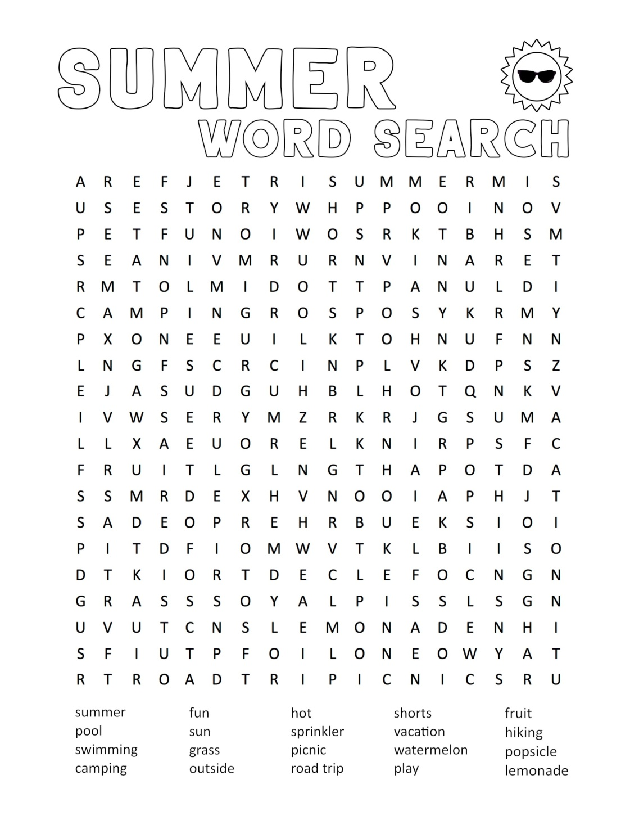
Fun literacy activities
See how many words starting with ‘d’ you can write down in 3 minutes. Now, go look for things starting with ‘d’ in your bedroom, the kitchen, the garden...
Try this summer wordsearch!

Slide 53
End of Week 10
Give yourself a spelling test. How did you get on? Send us a picture on Aladdin Connect if you like!
Well done on finishing Week 10!

