Slide 1
Second Class Literacy work at home 2
Try your best and do what you can!

Slide 2
Note to parents
Dear parents, we hope you and your loved ones are all well.
In this PowerPoint, as before, you will find some suggestions for helping your child’s Literacy. You can follow the suggested timetable or use this as a menu of ideas for what your child would like to do.
The 2nd class team have set as much work as we can that your children can do independently. However, they might need some help reading and figuring out some of the tasks/ instructions.
Please note work is planned for over two weeks.

Slide 3
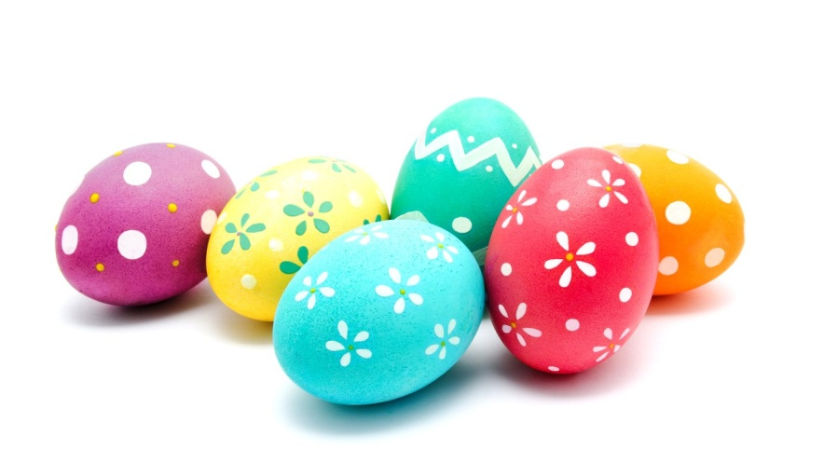
Note to children
Hello everyone, we hope you are all well.
Have you been enjoying the sunshine and maybe some chocolate?
Here is some work for you to do over the next two weeks. See how you get on.

Slide 4
You will need:
A copy book to record all your work
Pencils, colours, rubber
An adult to help sometimes!
A computer/ tablet/ phone for some activities

Slide 5
Contents
Week 3
Week 4
Read every day
Diary
Time capsule
Spellings 3
News
Story
Narrative writing: character
Grammar 3
Comprehension
Read every day
Diary
Time capsule
Spellings 4
Writing: character profile
Poem
Grammar 4
Comprehension
Oral language: Spring
And there are some more fun activities at the end if you’d like to check them out too!

Slide 6
Reading
If you have books at home that you can read, try to read for at least 15 minutes every day.
If you have read all your books at home, maybe mam or dad could set you up with an audiobook to listen to from Audible here (no charges for these at present):
https://stories.audible.com/discovery
(our favourites include Winnie the Pooh, Anne of Green Gables and Alice’s Adventures in Wonderland)
If you are a member of the local library, mam or dad can help you set up BorrowBox for ebooks and audio books (and if you aren’t you can set up an online account very easily). Use the instructions here: https://www.librariesireland.ie/news/online-services-during-coronavirus

Slide 7
Diary / Time capsule
Did you start a diary? Any copy or notebook will do. Just put the day and date on top of each entry. It will be very interesting to read back over your diary when you are 100!
We found a lovely idea online - to make a time capsule of this time. If you have a printer you could print it out and then put it somewhere safe for you to discover in 10 years’ time! Check it out on the 2nd class padlet here: https://www.assumptionjns.com/2nd-class.html

Slide 8
Spellings Week 3: silent c Write a sentence for each word in your copy. Play games on Spelling City (parents, you might need to enable Flash in your browser): https://www.spellingcity.com/users/2ndClassRoom15and16
 | Look | Copy | Cover & Write | Check
Mon | scent
 | crescent
 | scissors
Tue | scene
 | scenic
 | scenery
Wed | muscle
 | science
 | scientist
Thur | fascinate
 | gram
 | kilogram

Slide 9
Week 3: Monday News

Slide 10
News
Write your news from Easter in your copy. What did you do? Did you get any eggs? Describe them. Remember the rules for recount writing.

Slide 11
Week 3: Tuesday Now for a story!

Slide 12
Story: The Lighthouse Keeper’s Lunch
Have a look at this story on YouTube.
It is written by Ronda and David Armitage and is called The Lighthouse Keeper’s Lunch. Hope it doesn’t make you hungry!
https://www.youtube.com/watch?v=46wCRq50Wwg

Slide 13
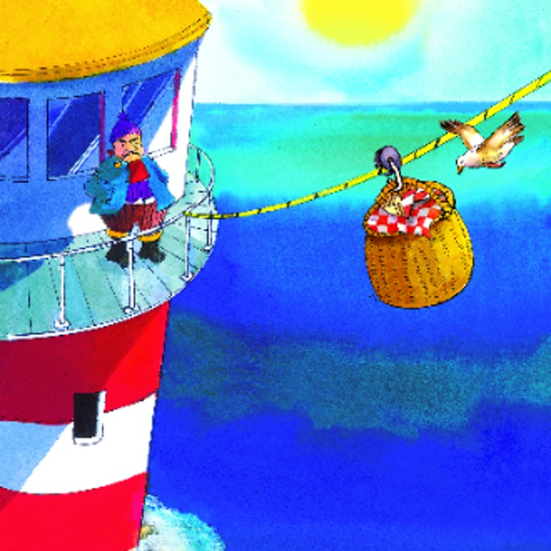
Story: Talk about
Tell your mam or dad or whoever is at home with you about the story. You can then answer the following questions in your copy (or if you’d prefer, tell your mam or dad the answers):
Did the story have a good title? Why?
What happened at the beginning, in the middle and at the end?
Would you like to live in or near a lighthouse? Why?
Would you say this is an example of recount, procedural or narrative writing?

Slide 14
Story: Respond to the story
Thinking about the story:
Describe your favourite scene from the story in your copy. Now draw or paint it.
OR
Have you ever been to a lighthouse? Write a description of a lighthouse in your copy. Then draw or paint one. You can use this template to help if you like.

Slide 15
Week 3: Wednesday Narrative writing genre

Slide 16
Narrative writing: Character
Before the school closed, we learnt that the narrative writing genre is all about story-telling in an imaginative way. These stories always have a beginning, middle and end.
Now have a think about what other things or elements you see in narrative writing ... Remember: character, setting and plot. This week, we are going to look at the element of character.
Characters are usually people, animals or creatures in a story that can think, feel or act (as in, “do something”). Have a look at this video to find out more: https://www.youtube.com/watch?v=LhOBuYQJPEY

Slide 17
Narrative writing: Character
So thinking back to our story from yesterday, The Lighthouse Keeper’s Lunch, make a list of the story’s characters in your copy. How many did you get? There are six, aren’t there?
Describe two of them (you can write this in your copy):
What do they look like? Where do they live? What kind of personality have they? What kind of clothes do they wear (or do they wear any?!)? Is there anything else you can tell us about them?
Now draw a picture of the two of them sharing lunch.

Slide 18
Week 3: Thursday Grammar

Slide 19
Grammar 3: Proofreading
As you know, after writing something, it is a good idea to read it through, to make sure there are no mistakes.
You might spot that you have forgotten a full stop or capital letter, or maybe speech marks or a comma. You might even notice a word you have misspelt.
Can you correct this sentence?
Do u no wot the time is asked Bonnie
That’s right, it should read:
“Do you know what the time is?” asked Bonnie.

Slide 20
Grammar 3: Proofreading
Now try these in your copy:
My presents were a kite a buk a paintbox and a box of chocolates said Mia.
Oh no I told you not to do dat yelled the furious man
jimmy bought soap cornflakes egs and flour in the supermarket
Check the next slide for the answers.

Slide 21
Grammar 3: Proofreading
How did you get on? Here are the correct answers:
“My presents were a kite, a book, a paintbox and a box of chocolates” said Mia.
“Oh no! I told you not to do that!” yelled the furious man.
Jimmy bought soap, cornflakes, eggs and flour in the supermarket.

Slide 22
Grammar 3: Proofreading
On the next slide, you will read the beginning of a story. Write it out in your copy, correcting the spelling mistakes, and adding in capital letters where they are needed.
Don’t forget to add punctuation (full stops, commas, speech marks, exclamation marks and question marks) where it is needed too.
There are 13 missing capital letters, 9 missing full stops, 4 missing commas, 6 missing speech marks, 2 missing exclamation marks and 13 spelling mistakes.

Slide 23
Grammar 3: Proofreading
farmer brown has lots of animals on his farm he has rabits pigz cows horses a donkee and a goat the goat has a very bad temper and butts his horns against the tree trunc wen he is angry it wos munday morning and farner brown was feding his animals good morning he called to the horses here is your hai he gave the goat a big bag of oats just then a little rodin flew down and started pecing at them those are mine showted the gote
When you have proofread the text, have a look at the next slide to see how you did.

Slide 24
Grammar 3: Proofreading
How did you do? Was it hard? Bet you were great!
Farmer Brown has lots of animals on his farm. He has rabbits, pig, cows, horses, a donkey and a goat. The goat has a very bad temper and butts his horns against the tree trunk when he is angry. It was Monday morning and Farmer Brown was feeding his animals. “Good morning!” he called to the horses. “Here is your hay.” He gave the goat a big bag of oats. Just then a little robin flew down and started pecking at them. “Those are mine!” shouted the goat.

Slide 25
Grammar 3: Proofreading
What do you think might happen next in the story?
If you would like, continue the story in your copy, remembering to proofread your work when you have finished. Did you forget anything?

Slide 26
Week 3: Friday Comprehension

Slide 27
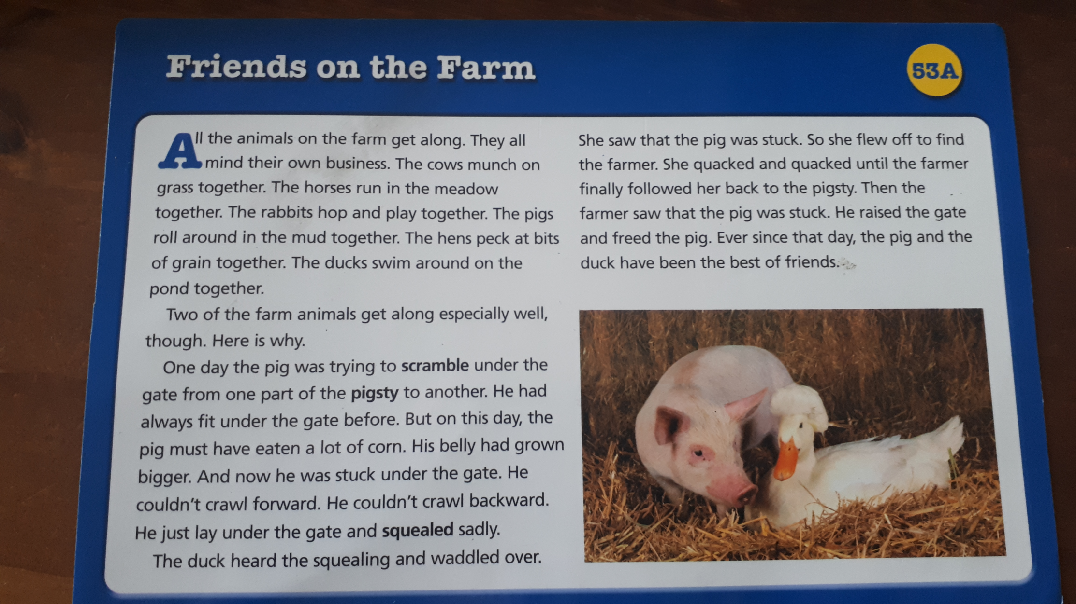
Comprehension Read this.

Slide 28
Comprehension Now write full sentences to answer these questions in your copy.

Slide 29
End of Week 3
Give yourself a spelling test. How did you get on?
Well done on finishing Week 3!

Slide 30
Week 4

Slide 31
Spellings Week 4: are as/air/ Write a sentence for each word in your copy. Play games on Spelling City (parents, you might need to enable Flash in your browser): https://www.spellingcity.com/users/2ndClassRoom15and16
 | Look | Copy | Cover & Write | Check
Mon | care
 | spare
 | share
Tue | scare
 | square
 | nightmare
Wed | flare
 | bare
 | blare
Thur | dare
 | litre
 | millilitre

Slide 32
Week 4: Monday Character profile

Slide 33
Character: recap
Thinking back to last week’s lesson on the element of character in the narrative genre, can you remember what a character is? That’s right:
Characters are usually people, animals or creatures in a story that can think, feel or act.
On the next slide, you will read a scene from a very famous book. What do you learn about the characters in the story from it?

Slide 34
Character profile: Matilda
By the time she was three, Matilda had taught herself to read by studying newspapers and magazines that lay around the house. At the age of four, she could read fast and well and she naturally began hankering after books. The only book in the whole of this enlightened household was something called Easy Cooking belonging to her mother, and when she had read this from cover to cover and had learnt all the recipes by heart, she decided she wanted something more interesting.
‘Daddy,’ she said, ‘do you think you could buy me a book?’
‘A book?’ he said. ‘What d’you want a flaming book for?’
‘To read, Daddy.’
‘What’s wrong with the telly, for heaven’s sake? We’ve got a lovely telly with a twelve-inch screen and now you come asking for a book! You’re getting spoiled, my girl!’
Nearly every weekday afternoon Matilda was left alone in the house. Her brother (five years older than her) went to school. Her father went to work and her mother went out playing bingo in a town eight miles away. Mrs Wormwood was hooked on bingo and played it five afternoons a week. On the afternoon of the day when her father had refused to buy her a book, Matilda set out all by herself to walk to the public library in the village. When she arrived, she introduced herself to the librarian, Mrs Phelps. She asked if she might sit awhile and read a book. Mrs Phelps, slightly taken aback at the arrival of such a tiny girl unaccompanied by a parent, nevertheless told her she was very welcome.
‘Where are the children’s books please?’ Matilda asked.
‘They’re over there on those lower shelves,’ Mrs Phelps told her. ‘Would you like me to help you find a nice one with lots of pictures in it?’
‘No, thank you,’ Matilda said. ‘I’m sure I can manage.’

Slide 35
Character profile: Matilda
Did you recognise the story? That’s right, this was taken from Roald Dahl’s Matilda, which we know lots of you love!
How would you describe Matilda’s character based on what you read about her there? What about her father? Her mother? Her brother? The librarian?
Now, think about your dad or mam: how would you describe their character? What do they look like? What is their personality? What kind of clothes do they like to wear? Have they any hobbies? What are they good at? Is there anything they’re not so good at?

Slide 36
Character profile: write your own
Now look at this photo and think about how you would describe this character. Use your imagination!
Who is she?
Describe her (face, clothes, age, look – is she stooped or straight, etc?)
What is her personality?
Where does she live?
Describe her house.
Where has she been and where is she going?
Write your description in your copy.

Slide 37
Week 4: Tuesday Poem

Slide 38
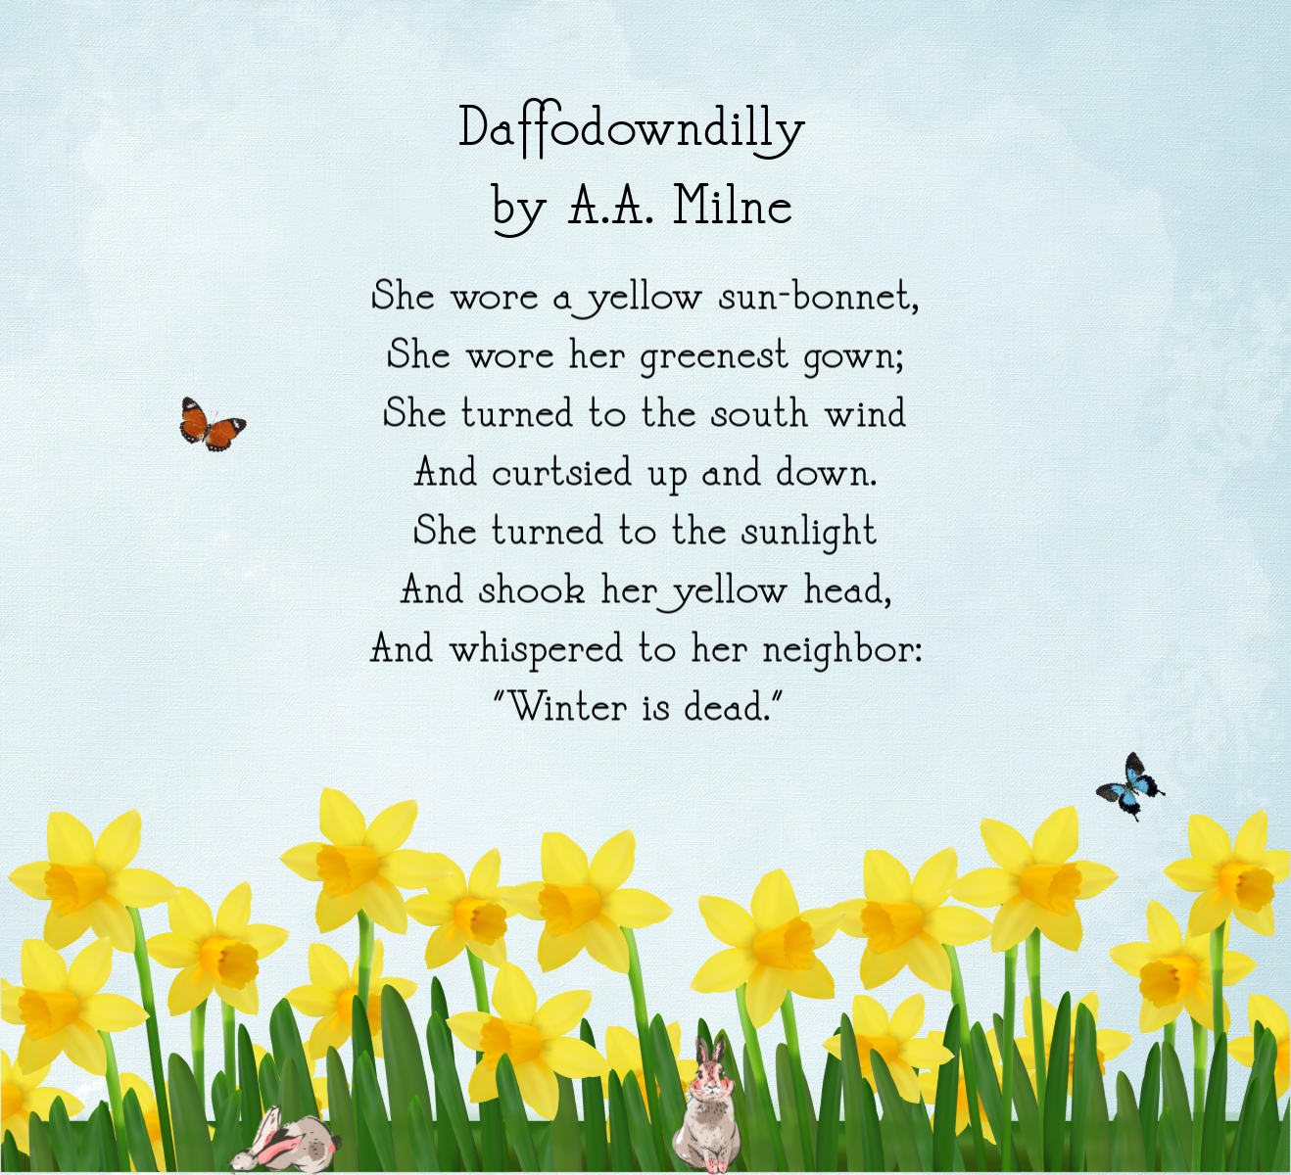
Poem: “Daffodowndilly” by A.A. Milne
Read through this and answer the questions on the next two slides.

Slide 39
Poem: Some questions Answer these questions about the poem in your copy. Don’t forget to write full sentences using capital letters, full stops and the spellings you know.
What is the poem about? (There’s a big clue in the picture!)
What do you think of the poem’s title? Does it give you a clue about how the poet feels about daffodils? Do you think he is happy to see them bloom again? Why?
Write down the rhyming words you spot. Is there a pattern?
What is a bonnet? What is a gown? Are these words we still use? What words have replaced them? Do you think the poet wrote this recently? Or would you guess that this poem is nearly one hundred years old?!

Slide 40
Poem: Some more questions Answer these questions about the poem in your copy. Don’t forget to write full sentences using capital letters, full stops and the spellings you know.
5. Write the poem out into your copy using your best handwriting. Now illustrate it using the description in the poem.
6. If you like, you could learn off the poem and /or record yourself reading it out using your tablet.
7. A.A. Milne, who wrote this poem, is more famous for writing about a certain bear. Look him up online and find out who it is! Maybe you could listen to some of the stories here https://stories.audible.com/discovery or watch the movie at the weekend if your mam or dad can find it.

Slide 41
Week 4: Wednesday Grammar

Slide 42
Grammar 4: Prefixes
A prefix is something added at the beginning of a word to change its meaning.
There are many prefixes, but these four are the most useful ones:
un dis mis im
So, happy and unhappy have different meanings because of the prefix un.
The same goes for kind and unkind. Can you think of any others?

Slide 43
Grammar 4: Prefixes
Choose a prefix to go in front of each of the base words below. Write out the new sentences in your copy. See how the meaning of the words and sentences has changed.
un dis mis im
It was ___possible to walk along the path.
I really __like writing stories in school.
Mum __packed the holiday suitcases.
Jason __understood what he had to do.

Slide 44
Grammar 4: Prefixes
Now choose a prefix for each of these base words and write them out into your copy.
un dis mis im
__ happy __ patient __ lucky
__ appear __ behave __ lock
__ do __ take __ agree
__ dress __ possible __comfortable
Check the next slide to see the answers...

Slide 45
Grammar 4: Prefixes
How did you do?
unhappy impatient unlucky
disappear misbehave unlock
undo mistake disagree
undress impossible uncomfortable
Now write a sentence for each new word into your copy.

Slide 46
Week 4: Thursday Comprehension

Slide 47
Comprehension Read this.

Slide 48
Comprehension Now answer these questions in your copy.

Slide 49
Week 4: Friday Oral Language

Slide 50
Oral Language: Spring
Some time today, if you can, go out for a walk. Tell your mam or dad or whoever is with you what signs of Spring you can see.
For example – do you see blossoms on any of the trees? Can you see daffodils, tulips or crocuses? How many different types of flowers can you see? Are they all growing in gardens? Why/ why not?
Which is your favourite flower? Why? When you get home, maybe you could call out a description of it and get someone else at home to draw the flower you are thinking of. Don’t forget to use descriptive words (adjectives and adverbs are great!). When they finish their drawing, check to see how they did and if it looks like the real thing. Why/ why not?
Did you spot or hear any baby animals or birds? What were they doing? What were their parent(s) doing? Why?

Slide 51
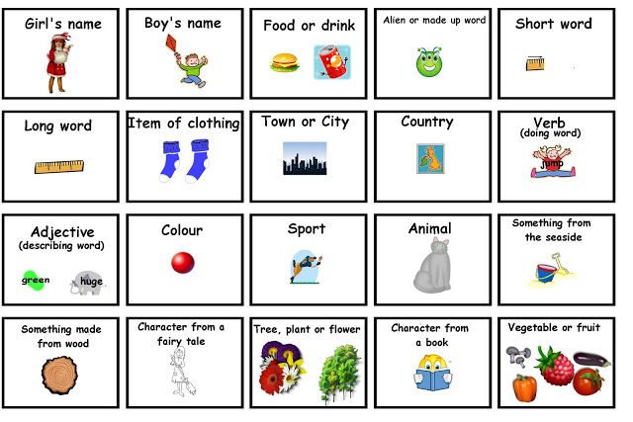
Silly writing activities
Write a ridiculous recipe for your mam or dad to follow.
Write a picnic lunch menu for the Lighthouse Keeper.
Write an apology letter from Matilda’s parents to her.
See how many words starting with ‘a’ you can write down in 3 minutes.
Play “Stop the Bus” with someone you live with. (If you don’t know how to play it, check out this video: https://www.youtube.com/watch?v=9nslEXxCwNA
You can use any of these categories ➔

Slide 52
End of Week 4
Give yourself a spelling test. How did you get on?
Well done on finishing Week 4!

