Slide 1
Gaeilge - Rang a dó
Is fearr Gaeilge briste, ná Béarla clíste
Broken Irish is better than clever English – speak what you can
Module 5
Week 1 – June 2th_5th
Week 2 – June 8th_12th

Slide 2
Cúla 4 ar Scoil
Cliceáil ar an bpictiúr
https://www.cula4.com/en/shows/cula4-ar-scoil/
Please watch this programme at least once a week. You won’t understand everything but watching Gaeilge ar an teilifís is a great way to train your ears to hear the words you do know!

Slide 3
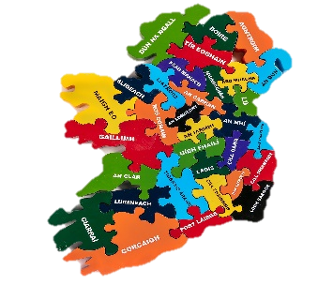
Week 1: Select lesson 10: - An Seomra Folctha
Go to this link:
https://content.folensonline.ie/programmes/AbairLiom/2nd_class/resources/Poster/AL_2C_ACT_Postaer_L10_001/index.html
or select postaer.
Suggested Activities
Learn the song (amhrán) ‘Mo Mhadra a Ni’
Learn the poem (dán) ‘Stop é Sin a Thafaí’.
Éist leis an scéal (Listen to the story)
Cuardach (Click on the pictures to hear the phrases)
Foclóir 1 agus 2 (Listen to words and click on the right picture)
Freagair na Ceisteanna (Answer the questions)
Léigh an scéal – turn sound off and read the story.

Slide 5
Ceisteanna agus Freagraí Ask somebody at home- you can make up your own questions too – here are some samples.
Cá bhfuil Mamaí, Séan, Siofra agus Oisin? Tá said sa seomra folctha.
Cad atá ina lámh ag Seán? Tá scuab fiacla ina lámh ag Séan.
Cá bhfuil Taifí? Tá Taifí san fholcadán.
Cad atá i ngach áit? Tá uisce i ngach áit.

Slide 6
Léigh – Read
Tá Mamaí, Seán, Síofra agus Oisín sa seomra folctha.
Tá an seomra folctha bun os cionn!
Tá Tafaí san fholcadán!
Tá uisce i ngach áit.

Slide 7
Cluiche : Pléasc uisce- Seomra Folctha
Cliceáil ar an nasc seo:
https://content.folensonline.ie/programmes/AbairLiom/2nd_class/resources/Vocabulary_games/AL_2C_GAME_Waterblast_L11_003/index.html

Slide 8
Week 2: Select lesson 10 – Cluiche Nua
Go to this link:
https://content.folensonline.ie/programmes/AbairLiom/2nd_class/resources/Poster/AL_2C_ACT_Postaer_L11_001/index.html
or select postaer.
Suggested Activities
Learn the song (amhrán) ‘Mo X-Bhosca’.
Learn the poem (dán) ‘’An Clar Céanna’.
Éist leis an scéal (Listen to the story)
Cuardach (Click on the pictures to hear the phrases)
Foclóir 1 agus 2 (Listen to words and click on the right picture)
Freagair na Ceisteanna (Answer the questions)
Léigh an scéal – turn sound off and read the story.

Slide 9
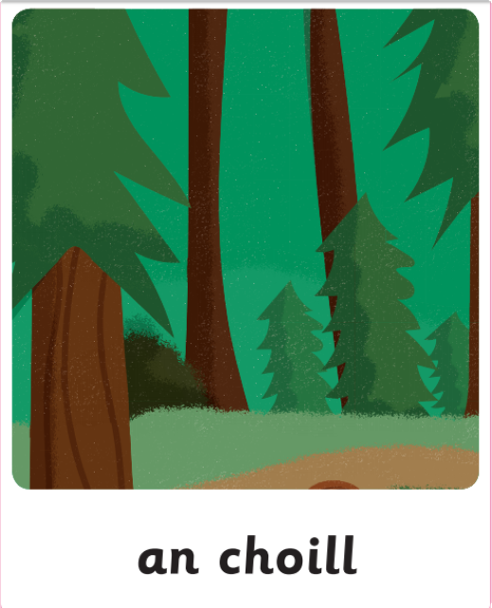
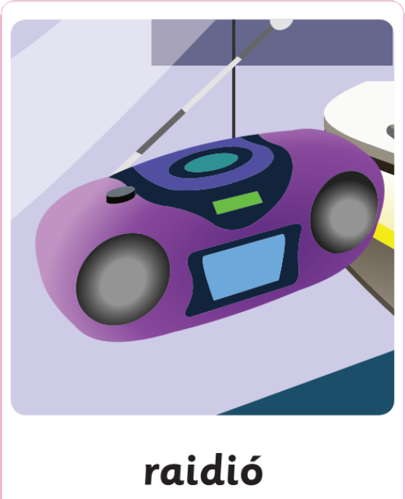
Cluiche Nua: Scríobh an foclóir nua i do chóipleabhar agus tarraing pictiúr in aice le gach focal. (Write the new words in your copy and draw a picture with each word.)

Slide 10
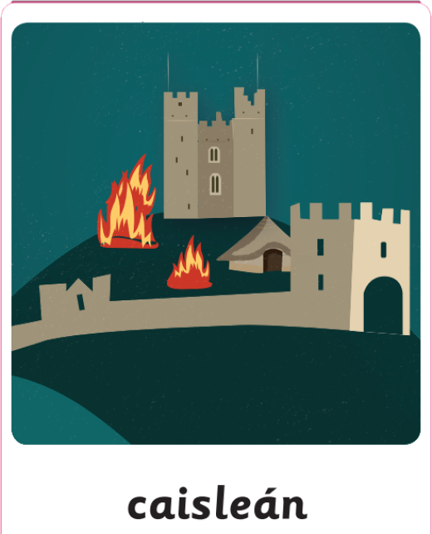
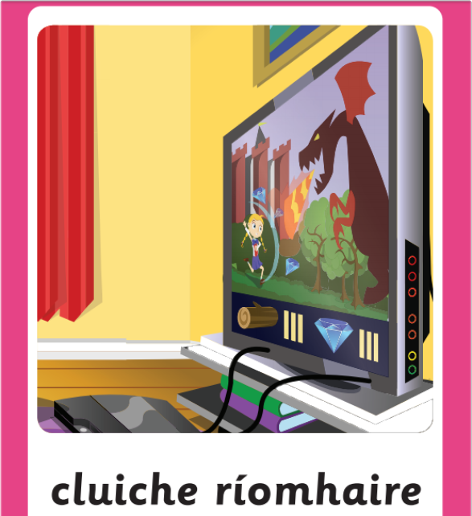
…Cluiche Nua: Scríobh an foclóir nua i do chóipleabhar agus tarraing pictiúr in aice le gach focal. (Write the new words in your copy and draw a picture with each word.)

Slide 11
Cluiche : Pléasc uisce- Cluiche Nua
Cliceáil ar an nasc seo:
https://content.folensonline.ie/programmes/AbairLiom/2nd_class/resources/Vocabulary_games/AL_2C_GAME_Waterblast_L11_003/index.html

Slide 12
Check out YouTube and the TG4 player
for the Irish programmes listed below.
Cúla4.com
Is Eolaí Mé
Ár Scéal
An Siopa Ealaíne (cúla4.com)
Cúla4 ar Scoil at 10.00 a.m on TG4
IIs breá liom Gaeilge ar an teilifís!
Youtube.com
Corpoidechas Le Ciarán ( PE)
Dino Lingo

Slide 13
Maith thú!

