Slide 1

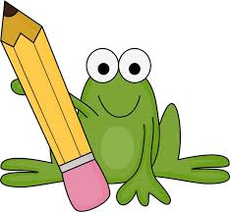
First Class
Literacy remote learning
***Children need a copy, pencil, eraser and colours to complete the tasks***
Assumption Junior School
Module 2- to be completed over two weeks

Slide 2
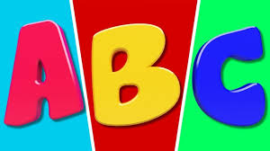
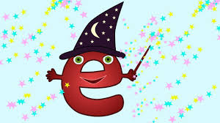
Spellings/ Phonics
Sound(s) of the fortnight
Remember Magic ‘e’ makes the other vowel say it’s name
Magic ‘e’ with the vowel ‘a’
Week 1: cake gate lake plate game hate pale made same face rake late
Magic ‘e’ with the vowel ‘o’
Week 2: bone code cone hole hope zone rope pole rose woke joke home

Slide 3

Spellings/ Phonics
Activities
List as many words as you can with magic ‘e’ changing the vowel a
This activity can be done with the magic ‘e’ changing the vowel o next week
Draw an illustration to go with your words
e.g. cake ---

Slide 4
Spellings / Phonics
Choose 6 magic ‘e’ words from the week 1 list and put them into sentences.
Next week choose 6 magic ‘e’ words from the week 2 list and put them into sentences.
Make your sentences long and interesting – (who, what where, when…)
Remember to
Write clearly – use a capital letter at the beginning of the sentence and a full stop at the end.
Write beside the margin. If your copy does not have one ask a parent to draw one.

Slide 5
Spellings/ Phonics
In your copy add magic ‘e’ to these words to make a new word draw a picture for your new words
cap + e = _________
flam + e = _________
lak + e = ________
tam + e =________
bak + e =_________
grap + e = _________
gat + e = __________
dat + e =__________

Slide 6
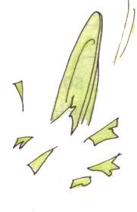


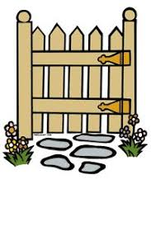
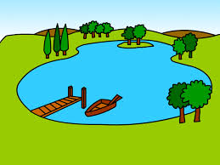

Spellings/ Phonics
Copy these sentences into your copy and fill in the missing words.
The ________ fell off the table and smashed.
I bring a suit_______ on holidays.
Superman wears a red ______.
I will have eight candles on my birthday _______.
Close the _____ or the dog will escape.
I went swimming in the _______.
In Autumn I help my Dad to ________ the leaves.

Slide 7

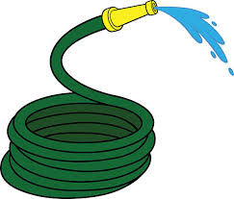
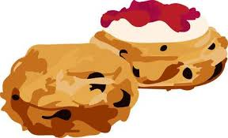
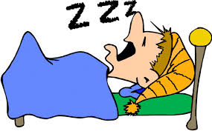
Spellings/ Phonics
Copy these sentences into your copy and fill in the missing words.
The most beautiful flower is a ________.
The dog could not find his _______.
The water came out of the ________.
I put jam on my _________.
I’m tired. I want to go _________.
I can see Ireland on the _______.
The man fell asleep and began to _________.

Slide 8
Reading
We are asking parents to sign up to the website https://home.oxfordowl.co.uk/books/free-ebooks/
Create an account and each day choose a book for your child to read from the appropriate age category. THEY NEED TO READ EACH DAY
(PLEASE do this!!!) The books are quite long so one book may do 2 days of reading.
We encourage you to read to your child as much as possible. This is a nice way to bond but it also shows them how reading should sound. It shows them that you see it as a meaningful activity.
Roald Dahl books, Harry Potter, Princess Mirrorbelle, Fairy tales, David Walliams books are a few examples or a book you enjoyed as a child.

Slide 9
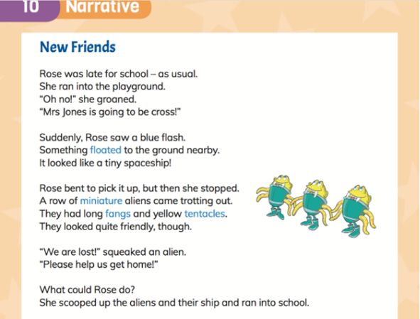
Reading
Comprehension
Read the story ‘New Friends’

Slide 10
Reading Comprehension
After reading the story ‘New Friends’ answer the following questions in your copy. Remember full answers!
Where does the story take place?
Why did Rose think Mrs. Jones would be cross?
What did Rose see after the blue flash?
What did the aliens look like?
What problem did the aliens have?
How do you think Rosie felt?
What do you think the aliens planet might look like? Draw a picture of it in your copy

Slide 11
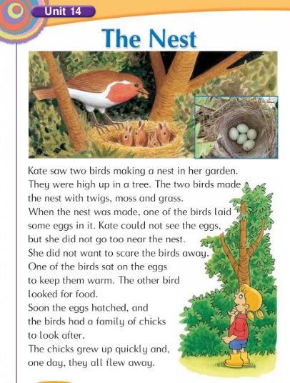
Reading
Comprehension
Read the story

Slide 12
Reading Comprehension
After reading the story ‘New Friends’ answer the following questions in your copy. Remember full answers!
Who saw the two birds in the garden?
What were the birds doing?
What season was it? How do you know?
What materials did the birds use to make the nest?
Why did Kate stay away from the nest?
What did the chicks do when they grew up?

Slide 13
Grammar
A verb is an action word. It is when someone or something is involved in an action e.g. Sneezing, smiling, talking, walking, bouncing, listening, whispering. Can you think of any others?
    Look at the story New Friends again. Make a list of the verbs in your copy.

Slide 14

Writing
Narrative Writing
Read the story ‘New Friends’ again
Write 10 lines (approx) in your copy describing what you think will happen next.
Will Mrs Jones see the aliens?
What will she do?

Slide 15
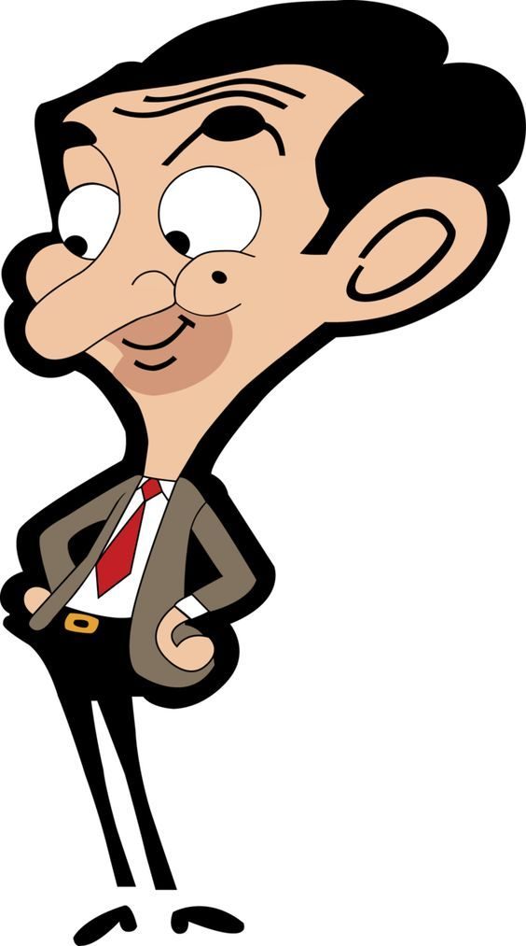
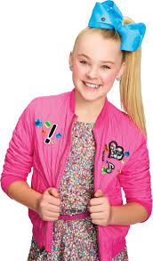
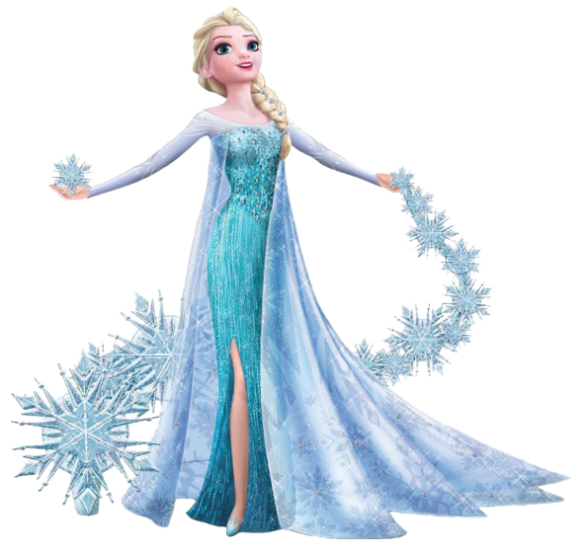
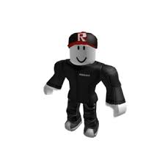
Character Profile
We love to read stories (also called narratives) because they are interesting and fun. Your next task is to become an author.
Look at the images of these characters. Describe them using the grid on the next page to help. (you can copy the grid into your copy)

Slide 16
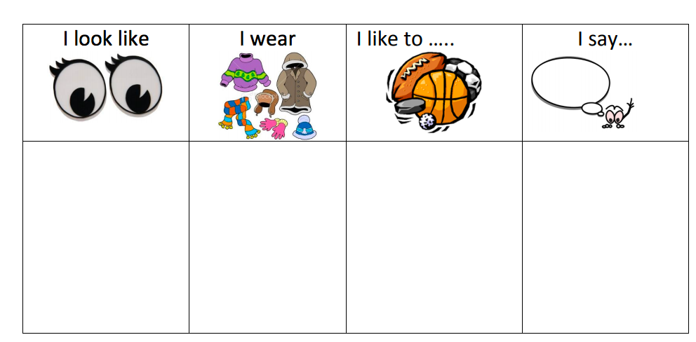

Slide 17
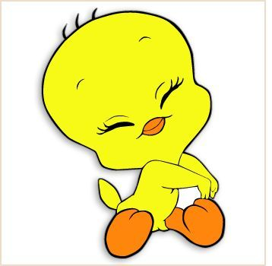
Character Profiles
When we read stories, we learn a lot about the characters in the stories. Let’s build more character profiles with more descriptions.
Choose one of the following characters (or if you’d like you can choose your own character):
The Big Bad Wolf
Cinderella
Harry Potter
Little Red Riding Hood
The Wicked Witch
Then fill out the page with sentences to describe your character (copy page into your copy)

Slide 18
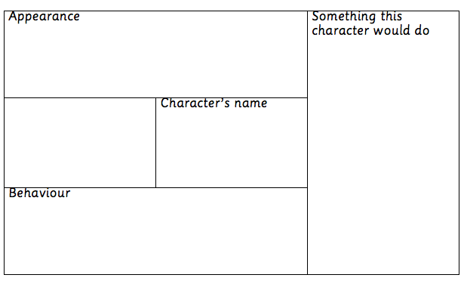
Example on padlet page

Slide 19
Writing
All forms of free writing are encouraged, you could ask your child to help you write a shopping list or a list of chores that have to be done around the house. Here are other examples;
Write about your favourite T.V. show
A genie grants you 3 wishes
If animals could talk – what would they say?
My favourite sports team or favourite sport
If I won the lotto…
If I has a super power…

Slide 20

You have completed this fortnights tasks!
Well done!

